Slide 1
District heating in Finland
2025

Slide 2
Contents
The statistical presentation is divided into three parts. The first part presents statistical graphs. The next section provides statistical analysis. The third part presents future scenarios.
Contents
Statistics in graphs
Analysis
Future scenarios

Slide 3
Statistical year 2025
In 2025, the electrification of district heating continued.
  Non-combustion-based district heat production increased by 20 % from 2024.
Large-scale coal use in district heating production ended in spring 2025.
The year 2025 was on average 1,5 °C warmer than the normal year (1991–2020 average). However, the monthly temperatures differed from the average year.
  The winter was warmer than normal, while May, June and August were colder than normal.

Slide 4
Statistics in graphs

Slide 5
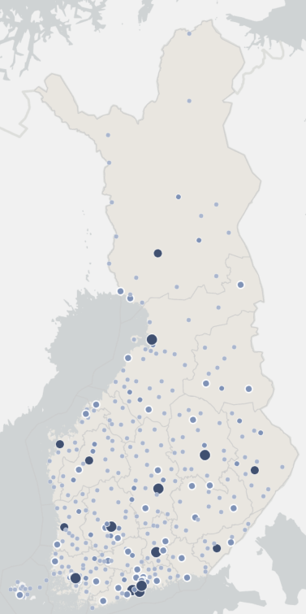
Statistics 2025
District heating networks in Finland
~34 TWh
energy sold annually
~3,0 million people
lives in houses with district heating
~16 600 km
district heating networks
~11,0 cent/kWh
The average price including taxes
46 %
market share*
~3 mrd. EUR
the value of heat sold including taxes
*market share of heating in residential and apartment buildings

Slide 6
Market share of space heating in 2024
Includes residential, commercial and public buildings
Heat pump: ambient energy extracted with heat pumps
Heat pump, electricity: Estimated electricity used by heat pumps that is converted into heat.
Electricity: includes the electricity consumption of heat distribution equipment and electric sauna stoves
Wood: includes the wood used by sauna stoves
Source: Statistics Finland: Energy 2025 –table service, Table 7.2. and ”Energy consumption in households: documentation of statistics”
Electricity consumption of heat pumps is estimated by Finnish Energy

Slide 7
District heat consumption and connected heat load of the customers

Slide 8
Temperature corrected heat consumption
District heat consumption 30,2 TWh (year 2025)
  Temperature corrected heat consumption 33,9 TWh
Temperature corrected heat consumption did not change compared with the previous year.
Temperature correction takes into account annual temperature differences.

Slide 9
Number of customers and the length of networks
The deviation in the number of customers in 2021 is mainly due to changes in how respondents reported their data.

Slide 10
Specific heat consumption in district heated buildings
Specific heat consumption indicates how much energy has been used to heat premises and domestic water per building volume or surface area.
Specific heat consumption has been standardised to correspond to the comparison period 1991-2020

Slide 11
District heat supply and the share of cogeneration

Slide 12
District heat supply and the fuels used for DH and cogeneration
Total district heat supply | 33,5 TWh
District heat production by fuels | 24,2 TWh
Net production of electricity in CHP production | 3,6 TWh
Fuel energy consumed | 34,1 TWh
Heat recovery and heat produced by heat pumps | 9,3 TWh

Slide 13
Energy sources for district heat supply in 2025 by fuel category
Carbon neutral*: 83 %
  Renewables (incl. bio waste) + Heat recovery + electricity usage of electric boilers
Share of imported fossil fuels in district heat supply 7 %
*Carbon neutral energy sources include those energy sources whose carbon dioxide impact is not reported in heat production. The climate impact of bioenergy is included in the land use sector and emissions from electricity used in district heat production in electricity production.
Waste category includes municipal waste, recovered fuels, demolition wood, impregnated wood, plastic waste and hazardous waste.
  Bio share of waste is 49 % and fossil share 51 %.
Other biofuels: other biofuels and mixed fuels
Others: steam, hydrogen

Slide 14
Energy sources for district heat supply in 2025 by fuels

Slide 15
Energy sources for district heat supply in 2025 and 2024
Heat recovery: energy that would otherwise go to waste, e.g. heat recovery from wastewater, flue gases, return water from district cooling.
Waste category includes municipal waste, recovered fuels, demolition wood, impregnated wood, plastic waste and hazardous waste.
Others: steam, hydrogen

Slide 16
Energy sources for district heat supply in 2025 and 2019
Heat recovery: energy that would otherwise go to waste, e.g. heat recovery from wastewater, flue gases, return water from district cooling.
Waste category includes municipal waste, recovered fuels, demolition wood, impregnated wood, plastic waste and hazardous waste.
Others: steam, hydrogen

Slide 17
Energy sources for district heat supply 1990-2024
Fossil fuels have increasingly been replaced by biomass, recovered heat and electric boilers.
The use of biomass has increased 1.3-fold since 2019.
The amount of recovered heat has increased increased 2.5-fold since 2019. Fuel consumption is avoided by making use of surplus heat.
* includes heat pumps, heat recovery and electric boilers

Slide 18
Energy sources for district heat supply 1976-2024
*includes heat pumps, heat recovery and electric boilers

Slide 19
Energy sources for district heat by region in 2025
The share of district heat energy sources in combined heat and power plants has been estimated using general coefficients that have not been adjusted to the county-specific level.

Slide 20
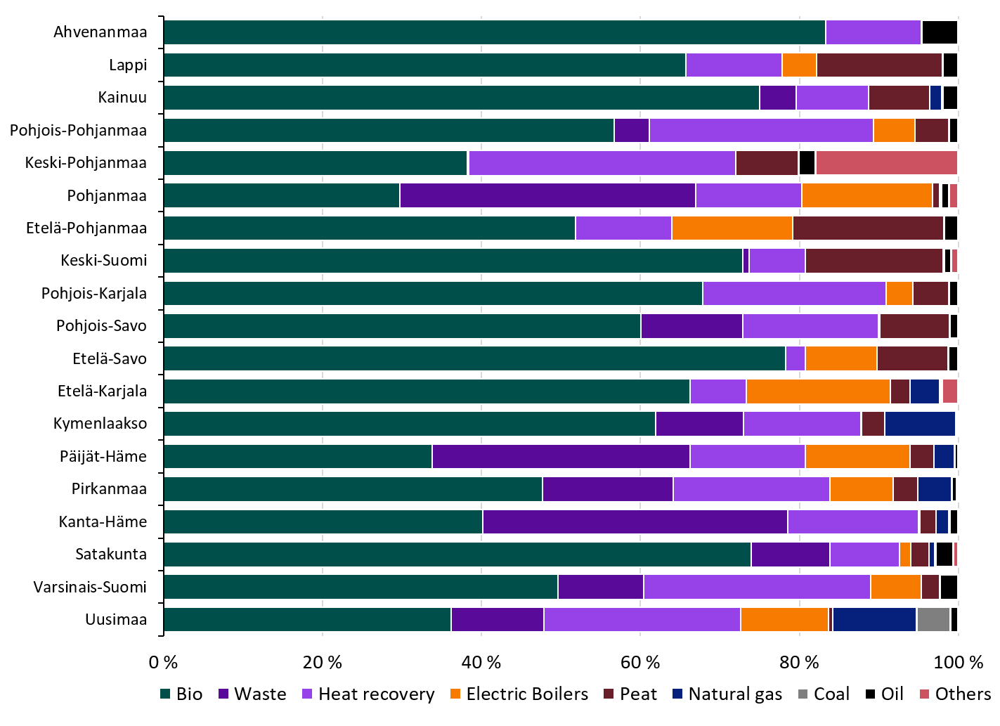
Energy sources for DH by region in 2005 and in 2025
Year 2005
Year 2025

Slide 21
Renewable fuels in the production of district heat and CHP electricity
Renewable fuels used for district heat and associated electricity production

Slide 22
Heat recovery and electric boilers
The electric boilers produced 2720 GWh of heat in 2025.
6620 GWh of district heat was produced by heat recovery
Heat recovery by heat exchangers 4000 GWh
  The most significant heat sources: flue gases and industrial processes.
Heat produced by the heat pumps 2620 GWh
  The most significant heat sources: sewage, district cooling return water and data centers

Slide 23
Heat generated by electric boilers
Electric boilers reduce the use of fuels when electricity price is low.
Alongside electric boilers, there is usually a heat storage.
Electric boilers can also participate in the balancing power market.

Slide 24
Total emissions from district heating
CO₂-emissions from district heat production in 2025 were 1,7 Million tons and decreased by 34 % from the previous year

Slide 25
CO₂ -emissions from the district heat supply
Specific emissions from district heat production in 2025 were 51 gCO₂/kWh, which
  Decreased by 35 % from the previous year
  Decreased by 75 % since 2010
Fuels used in combined heat and power production were allocated according to the benefit allocation method
Sources: Statistics Finland (2000…2024), Finnish Energy (1976…1999, 2025)

Slide 26
Inflation-adjusted price of district heat (incl. VAT)
Average, minimum and maximum values
The price includes all taxes, demand and energy charges as well as other possible annual charges. Connection fees are excluded.
Adjusted for inflation
Weighted average price: 109,54 €/MWh
Arithmetical average price: 110,23 €/MWh
Source: Finnish Energy, DH statistics; Statistics Finland, cost-of-living index

Slide 27
The share of district heating companies according to the average heat sales price in 2025 (incl. VAT)
The price includes all taxes, demand and energy charges as well as other possible annual charges. Connection fees are excluded.
The graph represents only enterprises that responded to the sales section of the statistics.

Slide 28
Price of district heat in new buildings (€/MWh)
Fixed price + energy fee, incl. taxes
The price includes all taxes, demand and energy charges as well as other possible annual charges. Connection fees are excluded.
Source: Finnish Energy, District heating prices 07/2025

Slide 29
District heat consumption in 2025

Slide 30
Production capacity and connected heat load of the customers

Slide 31
Analysis

Slide 32
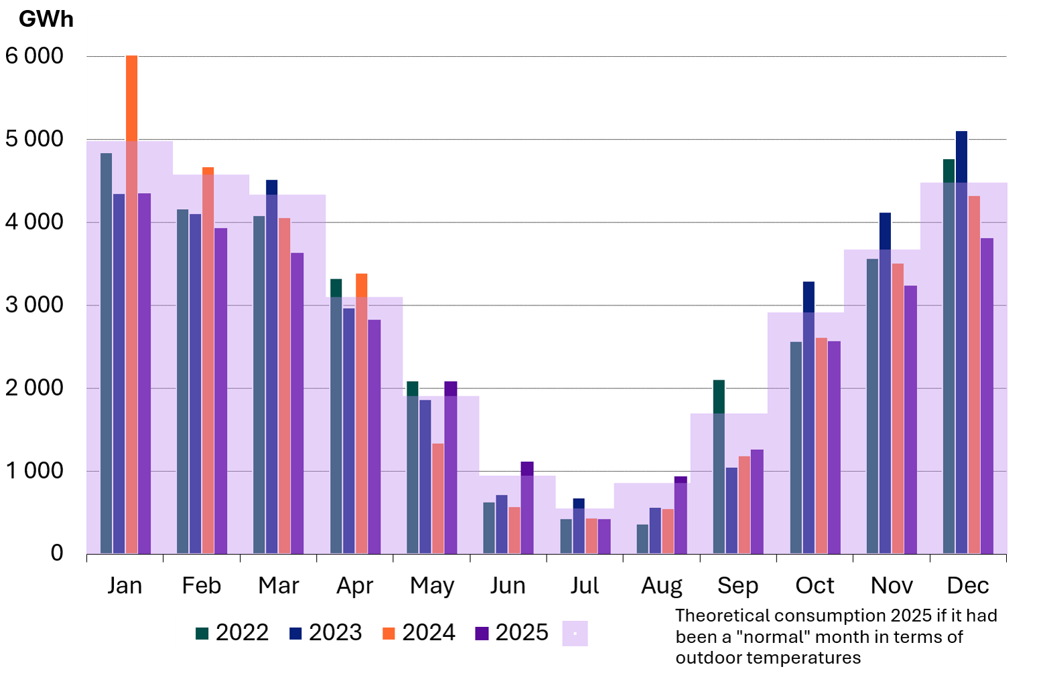
Estimated monthly district heat demand
Year 2025 was 1,5 °C warmer than the normal period of 1991-2020.
However, monthly temperatures differed from the average year.
Heating season was warmer than normal, and summer was colder than normal.
The cold winter months exemplify the need for a wide palette of fuels to ensure the security of supply of heating.

Slide 33
Comparison 2024 - Peak consumptions of district heat and electricity are close to each other
Hourly consumption of district heat and electricity in 2024
Despite a significant difference in overall demand for electricity and heat, peak consumptions are relatively close to each other
Source: Finnish Energy; estimation is based on
Helen preliminary open data 2024 and Entso-E

Slide 34
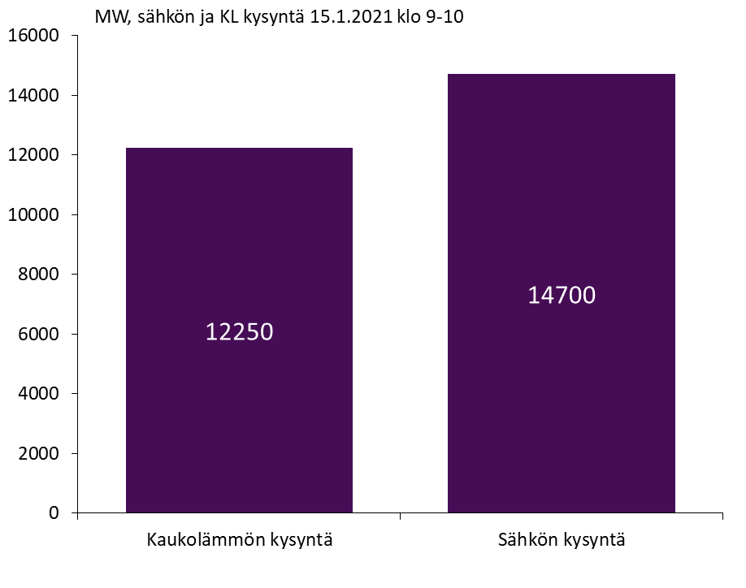
Electricity vs heat demand in winter in 2021
Demand of district heating (DH) at the time of the peak consumption is about the same magnitude as the demand for electricity. On annual basis the demand of electricity is higher than DH (ca. 85 TWh vs. 35 TWh)
Combined Heat and Power (CHP) plants produce a significant amount of electricity (2 500 MW) while producing heat.
District heating reduces electricity demand peaks, in addition to electricity production

Slide 35
Analysis
District heating as an electricity producer and consumer

Slide 36

We are quite good at producing a lot of energy cheaply
Very low electricity prices on average
Nuclear power, wind power and hydropower...

Slide 37
However, we have certain situations where very flexible consumption and production are required
Wind power production 1.1.2026-17.2.2026
Number of negative and 0-price hours in Finland 2020-2025
Low-wind and windless periods
Moments of energy surplus production
January | February

Slide 38
Low-wind and windless periods: fuels enable very high flexibility in heat and electricity production
Fact Box
In district heating, CHP plants produce both electricity and heat
Heating only plants produce heat without the need to use electricity
District heating has the ability to reduce electricity consumption and produce heat with fuels, and in CHP plants increase electricity production when there is a need for it in the market. This significantly reduces the pressure on the electricity system and helps to balance the demand for electricity
In early 2026, district heating CHPs produced 24% of domestic electricity at their best
In cold weather, district heating output peaks at over 12 GW, alongside more than 2.5 GW of electricity generation
14.7

Slide 39
Combined heat and power plants balance the fluctuations in wind power production and thus help to keep the Finnish energy system in balance
Electricity production of wind power and district heat combined heat and power plants 1.1.2026-18.2.2026
Source: Fingrid open data

Slide 40
Moments of overproduction: The ever-increasing flexibility of district heating enables the balancing of wind power production
Wind power production and electricity consumption of electric boilers 12/2025
Electric boiler production follows wind power production
Electric boilers balance the energy system at times when electricity is produced in abundance

Slide 41
Future scenarios

Slide 42
Use of fossil fuels and peat is declining rapidly
Source: Member survey in spring 2024

Slide 43
The share of biomass and waste in district heating will decrease slightly towards the end of the decade
Source: Member survey in spring 2024

Slide 44
Electrifying district heat production replaces fossil fuels and peat and reduces the need for energy use of biomass
Source: Member survey in spring 2024

Slide 45
Energy sources for district heat supply 1990-2030
Source for 2025-2030: Member survey in spring 2024
*includes heat pumps and heat recovery

