Slide 1
Energy Year 2024 District Heating
28.01.2025
Finnish Energy
District heating preliminary data 2024

Slide 2
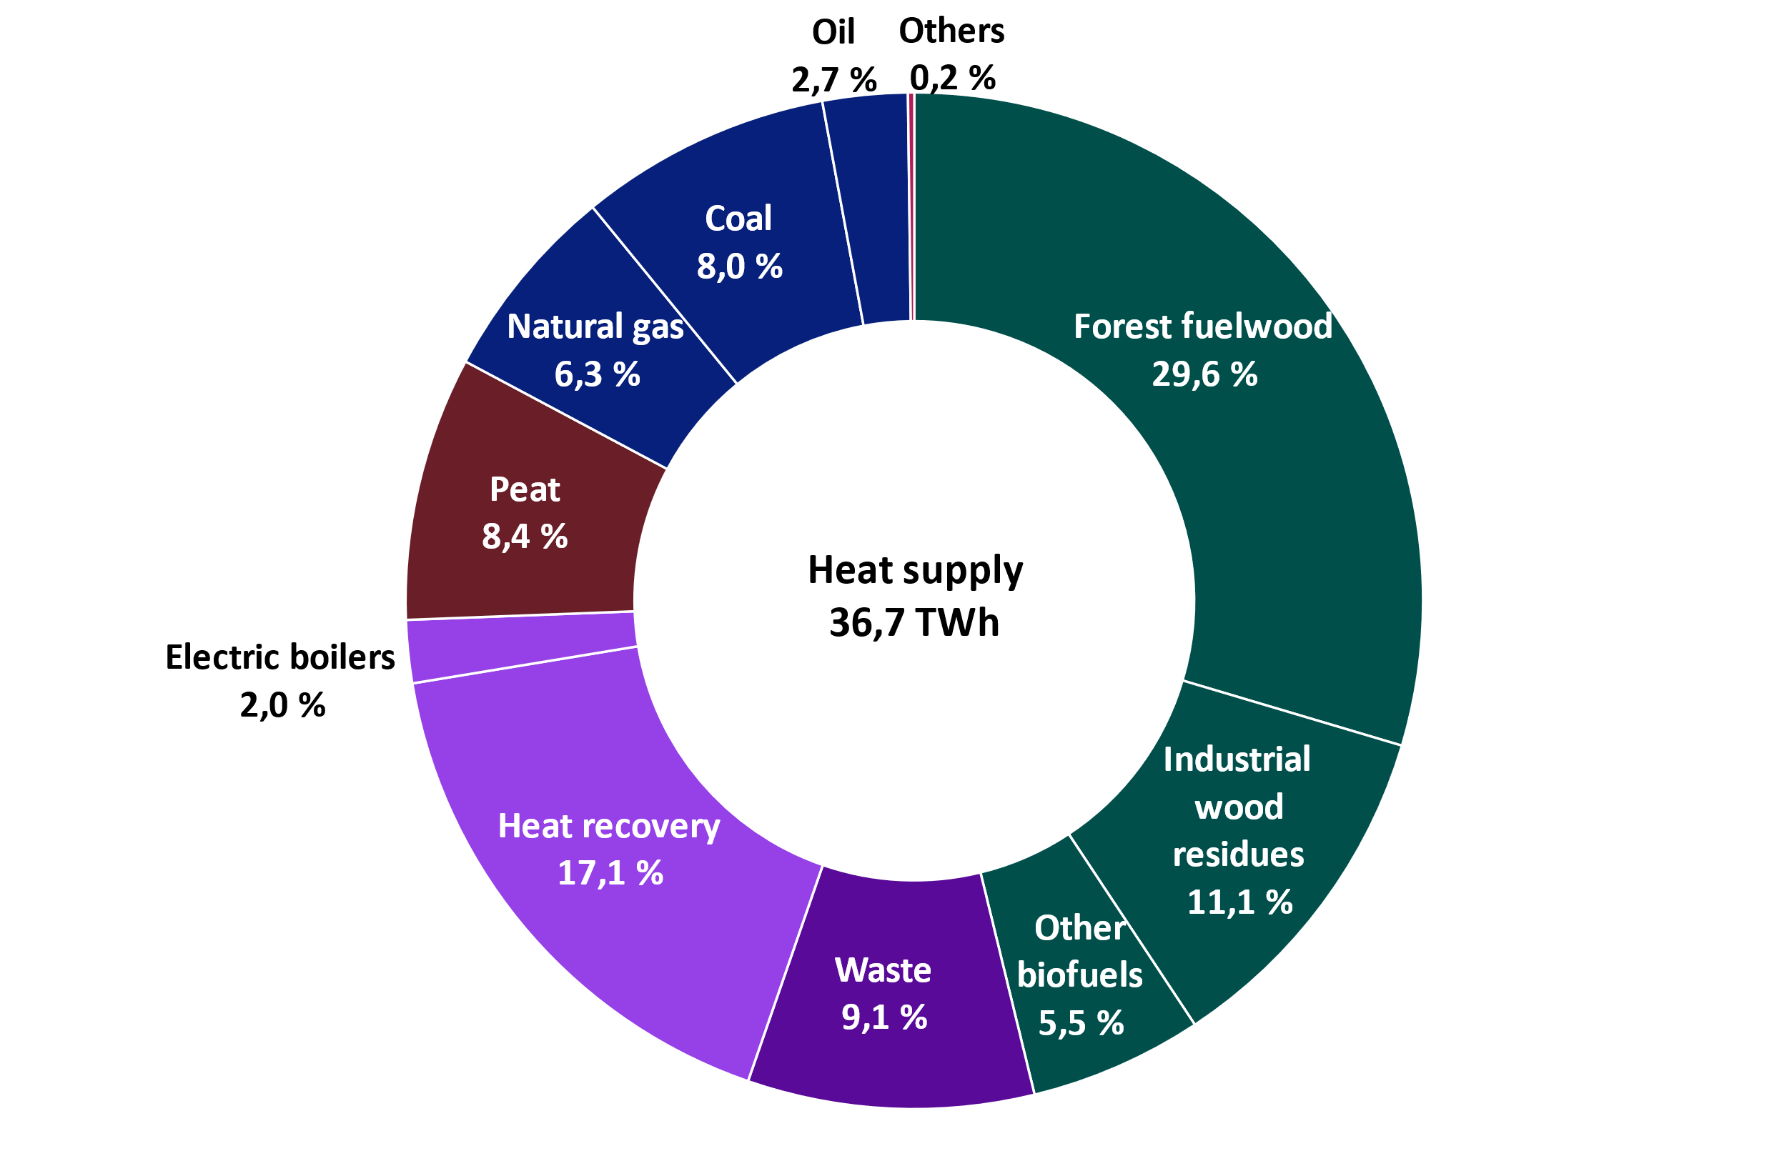
Share of climate neutral energy continued to grow Share of renewables, heat recovery and electric boilers increased from 70 percent to 73 percent
2024
2023
Heat recovery (also renewable heat produced with heat pumps): otherwise unutilised heat energy, e.g. heat recovery from wastewater, flue gases, return water from district cooling.
Waste: municipal waste, recovered fuels, demolition wood, impregnated wood, plastic waste and hazardous waste.
Other biofuels: wood pellets, recovered wood, black liquor tai other biomass
Others: steam, hydrogen.

Slide 3
District heating goes electric
Heat generated by electric boilers
Electric boilers produced 1540 GWh heat in 2024
Electric boilers reduce the use of fuels when electricity price is low

Slide 4
Temperature corrected heat consumption stayed in the same level with the previous year
District heat consumption 31,8 TWh
The heating season was 0,9 ºC warmer than the normal year
Temperature corrected district heat consumption 33,5 TWh
Temperature correction takes into account annual temperature differences.

Slide 5
Monthly district heat demand
Year 2024 was 1 ºC warmer than the normal period of 1991-2020
January and April were colder than normal, and the other months were warmer than normal.
The cold winter months exemplify the need for a wide palette of fuels to ensure the security of supply of heating.
Notes:
Graafi päivitetty – data pitää vielä tarkistaa, vuoden 2022 alussa. (MT)

Slide 6
District heating supports the Finnish electricity system

Slide 7
Peak consumptions of district heat and electricity are close to each other
1 | 2 | 3 | 4 | 5 | 6 | 7 | 8 | 9 | 10 | 11 | 12
Hourly consumption of district heat and electricity in 2024
Despite a significant difference in overall demand for electricity and heat, peak consumptions are relatively close to each
Source: estimation is based on Entso-E and Helen open data 2024*, hourly demand, district heat demand scaled based on Helen's hourly data,
* Preliminary data for 2024.

Slide 8
The energy transition in district heat production has advanced well

Slide 9
Share of renewables has more than doubled and share of heat recovery has multiplied compared to year 2010 Share of renewables has increased from 18 to 48 percent and heat recovery from 2 to 16 percent
2024
2010

Slide 10
Share of renewables and recovered heat is over 70 % in 2024
Fossil fuels have increasingly been replaced by biomass and recovered heat.
Use of biomass has more than doubled since 2010.
Amount of heat recovery has nearly fivefold compared to 2010. Fuel consumption is avoided by making use of surplus heat.
*Includes waste heat, heat pumps and electric boilers

Slide 11
The use of excess heat and electricity remained on the same level with the previous year In 2024, the heat demand was lower than normal because the year was warmer than normal
Fuel consumption can be avoided by making use of surplus heat. Heat can be recovered from data centers, industrial processes, flue gases, sewage water etc.
Electric boilers played a significant role in 2024 and they produced 1540 GWh heat

Slide 12
Use of biomass made a slight downturn
In municipalities where district heating is provided
85 per cent of networks heat comes from renewable fuels or recovered heat
Renewable fuels used in producing district heat are e.g. forest fuelwood, industrial wood residue, wood pellets, bio share of municipal waste.
Use of renewables in the production of district heat and cogeneration

Slide 13
Future scenarios for district heating
Electrifying district heat production replaces fossil fuels and peat and reduces the need for energy use of biomass

Slide 14
Electrifying district heat production replaces fossil fuels and peat and reduces the need for energy use of biomass
Source: Member survey in spring 2024

Slide 15
Use of fossil fuels and peat is falling rapidly
Source: Member survey in spring 2024

Slide 16
The share of biomass and waste in district heating will decrease slightly towards the end of the decade
Source: Member survey in spring 2024

Slide 17
Energy sources for district heat supply 1990-2030
*includes heat pumps and heat recovery
Source for 2024-2030: Member survey in spring 2024

Slide 18
Carbon dioxide emissions from district heating are decreasing

Slide 19
CO2-emissions from district heat production decreased by 19 %
CO2-emissions from district heat production in 2024 were 2,5 Million tons and decreased by 19 % from the previous year

Slide 20
Specific CO2-emissions from district heat production have decreased by 65 % since 2010
Specific emissions from district heat production in 2024 were 72 gCO2/kWh(*, which
Decreased by 16 % from the previous year
Decreased by 65 % since 2010
*) Fuels used in combined heat and power production were allocated according to the benefit allocation method
Source: Statistics Finland (2000...2022); Finnish Energy (1976...1999, 2023…2024)

Slide 21
The CO2-emissions from Finland’s energy production are decreasing
CO2-emissions of electricity and district heating production 4,6 million tons in year 2024
Emissions have declined 86 % compared to 2000s highest emission year 2003

Slide 22
District heat is the most common source of space heating in Finland

Slide 23
Market share of space heating 2022 Residential, commercial and public buildings
Heat pump: ambient energy extracted with heat pumps, and electricity consumption of heat pumps
Electricity: includes the electricity consumption of heat distribution equipment and electric sauna stoves
Wood: includes the wood used by sauna stoves
Lähde: Statistics Finland
The electricity consumed by heat pumps has been estimated by Finnish Energy.

Slide 24
The number of building permits applied for for residential construction has fallen strongly
Source: Statistics Finland

Slide 25
District heating is the most popular method of heating in new buildings
Source: Statistics Finland, Granted building permits (heated cubic volume)

Slide 26
Main heating methods in new buildings
Source: Statistics Finland, Granted building permits (heated cubic volume)

Slide 27
District cooling is cost-effective and environmentally friendly

Slide 28
The use of district cooling increased by 20 % in 2024 The warm year increased the need for cooling
District cooling sales increased by 20 % from the previous year
Connected load increased by 3 %
Energy companies which sold district cooling 2024:
Etelä-Savon Energia Oy
Fortum Power and Heat Oy
Helen Oy
Jyväskylän Energia Oy
Kuopion Energia Oy
Lahti Energia Oy
Lempäälän Lämpö Oy
Loimua Oy, Hämeenlinna
Oulun Energia Oy
Pori Energia Oy
Tampereen Sähkölaitos Oy
Turku Energia Oy
Vierumäen Infra Oy

Slide 29
District cooling is produced efficiently
Same heat pumps often produce both heat and cooling energy
the cooling water is cooled and the district heating water is warmed up in the same process.
District cooling also utilizes the ambient energy from sea, lakes and rivers as well as outdoor air whenever the temperature is low enough.

