Slide 1
Policy architecture for a sustainable energy system
Finnish Energy input to energy policy agenda of 2024-29

Slide 2
Vision of the Finnish Energy sector
Services of the new energy system empower the customers.
Energy sector has a net positive impact on biodiversity.
In 2035
customers, society and the environment will gain new wellbeing from carbon-neutral energy
Secure energy is making Finland attractive for investment.
Energy investments are funded by the market, utilise new technology and deliver prosperity in a cost-effective way.

Slide 3
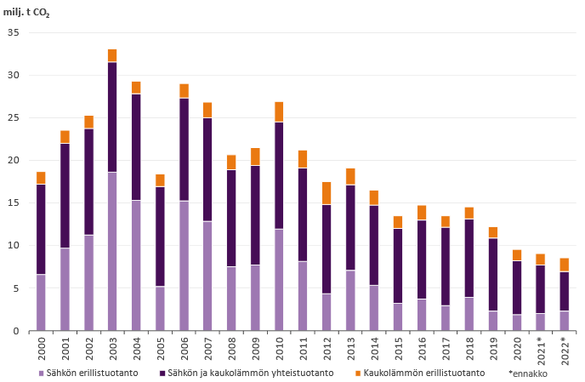
What is needed to continue this trend of CO₂ emissions
If it can be done in Finnish conditions, it can be done in Europe!
Finland is an energy intensive country
Emissions from energy production in Finland have declined 74% from the peak of 2003
Primary energy consumption
(per capita per year)
68 MWh
35 MWh
Electricity consumption
(per capita per year)
16 MWh
7
MWh

Slide 4
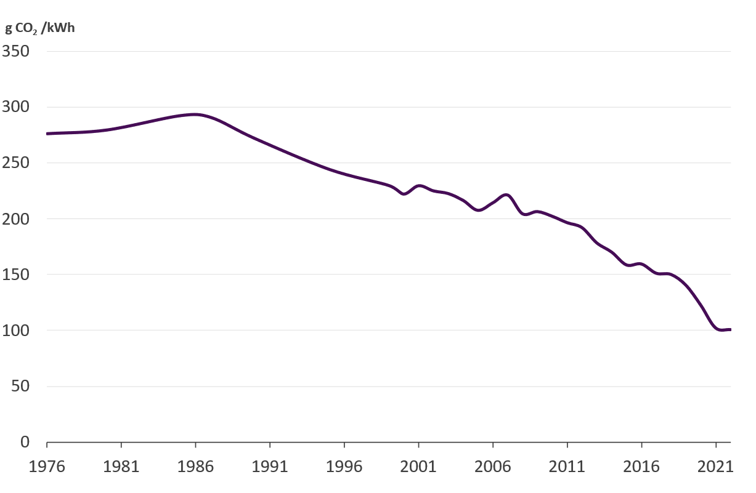
Emissions of district heating in Finland will likely be phased out by 2030
History of district heating emissions
Future of district heating emissions
Estimate based on the plans of the Finnish district heating companies

Slide 5
What do we want from energy policy
We certainly cannot pick just one…
Having to pick only two would be a failure of policy…
But getting these all three requires balanced energy policy
Secure
Secure
Secure
Cheap
Clean
Cheap
Clean
Cheap
Clean
Notes:
Climate change and biodiversity loss are among the greatest threats to humankind and must be tackled
Competition and functioning markets provide a good environment for investment, innovation and prosperity
Risk preparedness needs to be more controlled and prudent
Legislative coherence and high quality impact assessment reduce political risks whihc is poison to investments
Investments are the only way to sustainable future
Let's discuss whether the ideology is right, but let's not confuse regulation with different ideologies

Slide 6
Legacy of the term 2019-24
Green deal, FF55, RePowerEU
2024-29
How can we streamline policies, cater for strategic autonomy and ensure wellbeing and competetiveness of Europe
How the world has changed
Pandemic, strategic rivalry, war, biodiversity
What is the stage of energy transition
Cost of renewables, flexibility, hydrogen, industry, grids
Mobilising investment by streamlining regulation
What is politically feasible
Polarisation, the economy, prices

Slide 7
Ideas for the 2024-29 term The 2040 climate target, halting biodiversity loss and well-functioning markets require clarity on energy policy
Mobilising investment by streamlining regulation
Well-functioning electricity markets
Strong infrastructure
Environment and energy together
Strengthen the incentives to invest in power grids
Zero-emission economy
Fitness check of the rules governing energy communities and small-scale production
Energy efficiency regulation compatible with the internal market
Targeting emissions when regulating hydrogen and electrification
Streamlined environmental permitting
Reconciling green transition projects with environmental sustainability
Emissions from electricity and heat to be reduced by developing emissions trading
A route out of emergency politics
Developing financial regulation of the energy sector
Ensure the availability of an alternative heating infrastructure
Common sustainability indicators, taking value chains into account

Slide 8
Well-functioning electricity markets
A route out of the crisis-era
Removal of price regulation
Promoting free competition and a functioning market by removing excessive detail in regulation
Eliminate or at least open up to competition state aid that restricts and discourages market-driven investment
Launch a study on the development of a common European electricity market model to ensure the adequacy of electricity supply
Developing financial regulation targeted at the sector
Understanding the importance of financial markets and their regulation and identifying the needs of the energy sector, removing unnecessary regulation of the sector
Fitness check for communities and small production rules
Energy communities and small-scale production are the future and the future must be fair, with clear and fair rules of the game
The rules of the game for communities and small-scale generation require a fitness check - at present, regulation is fragmented into different provisions and creates a multitude of different legal frameworks for operating (CEC, REC, active customers, energy sharing, ...)
Dismantling cross-subsidies - all users participate on a level playing field in network costs and the energy system

Slide 9
Strong infrastructure
Strengthening the conditions for network investment
Enabling proactive and planned network development
Ensuring incentives to accelerate the pace of investment, both in terms of network reinforcement and renewal, digitalisation and increased flexibility, including anticipatory investments.
Enabling the development of networks as a whole in a cost-effective way
By taking into account the OPEX - CAPEX balance.
Ensuring that the network company has a wide range of tools at its disposal to develop networks in a cost-effective way. Regulation does not choose the means, but sets the targets.
Reducing the political risk associated with investments
Ensuring the independence of public authorities
Using bottleneck revenues to finance network investments
Targeting funding to reduce bottlenecks between revenue-generating regions
Clarifying the roles and responsibilities of commercial and monopoly operators
Alternative heating infrastructure available to people
Setting a target for alternative heating infrastructure
Member States must ensure that customers have access to an alternative heating infrastructure (electricity or district heating).
Simplifying the fragmented regulation of energy use and heating in buildings and focusing on guiding targets
The regulation of energy use and heating in buildings should form a coherent whole, guided by targets rather than individual measures. Reduce the demands on administrations and public authorities from the various directives.
Regulation of energy efficiency in construction should focus on technology-neutral elements, such as emissions and flexibility. Regulation should not address the energy sources used by buildings. Nor does it discriminate against grid energy in other ways, but aims at cost-effectiveness

Slide 10
Clean economy
Making energy efficiency regulation compatible with the internal market
Energy efficiency policy measures must support the achievement of the climate target.
Energy efficiency regulation should be simplified and focused to support the EU's transition away from fossil fuels. Instead of limiting consumption, energy efficiency targets should promote emission reductions and take into account the technologies needed for a clean transition on a Member State-by-Member State basis.
Emissions in the focus when adjusting the rules for electrification
The rules of the game for hydrogen and electrification should be simplified and focused on accelerating overall emission reductions, with the EU's electricity generation emission reductions already secured by the emissions trading quota.
Ensuring the interoperability of hydrogen and electrical infrastructure.
Bringing down climate emissions from electricity and heat by developing an emissions trading scheme
Total EU emissions should be reduced by 80-90% from 1990 levels by 2040. The 2040 framework should be built in particular on emissions trading.
Further development of emissions trading and the re-setting of the 2040 emissions quota is needed to ensure continued emission reductions in the energy sector in a reliable and cost-effective way.
Emissions trading should cover a larger share of EU emissions, possibly even all of them. In particular for heating, coverage must be ensured.
All forms of zero-emission and carbon-neutral production must be available for investors
Developing the competitiveness of nuclear, hydro, bioenergy, clean gases, wind and solar power

Slide 11
Environment and energy together
Reconciling green transition projects and ecological sustainability
Addressing climate change, biodiversity loss, the circular economy and zero pollution together - focusing on overall sustainability
Review of the extension of the WFD when the current target date of 2027 is reached, the feasibility of exemptions and flexibilities for renewable energy/green transition projects
Common sustainability indicators taking into account value chains
Developing harmonised EU-level indicators for assessing nature impacts
Fitness check for wide usability and acceptability of various footprint and life cycle assessments (e.g. by donors, legislation, outside the EU)
Provide for streamlined environmental permitting
Bringing together authorisation legislation scattered across different regulations (RED, NZIA, CRM, IED) under a single European procedural directive/regulation
Centralised regulation of binding deadlines and the one-stop-shop principle
Moving towards the principle of 1 complaint per project
Setting a requirement for predictability

