Slide 1
District heating in Finland 2023

Slide 2
Contents
The statistical presentation is divided into three parts. The first part presents statistical graphs. The next section provides statistical analysis. The third part presents future scenarios.
Contents Statistics in graphs Analysis Future scenarios

Slide 3
Statistical year 2023
The year 2023 was the year of the electrification of district heating.
Overall, non-combustion-based production increased by about 40% from 2022. Non-combustion-based production, especially the production of heat pumps and electric boilers, is likely to grow strongly in the next few years.
Fuel supply started to recover from the exceptional years of 2022, when the war in Ukraine began and imports of Russian fuels were stopped.
The availability of natural gas improved in 2023, which reduced the use of oil and coal in district heat production. Forest fuelwood was also used to replace coal and peat. However, fuel prices remained high.
The year 2023 was, on average, slightly warmer than the normal year (1991-2020 average). However, monthly temperatures differed from the average year.
The January, February and summer months were warmer than normal, but March and the rest of the year were colder than normal.

Slide 4
Statistics in graphs

Slide 5
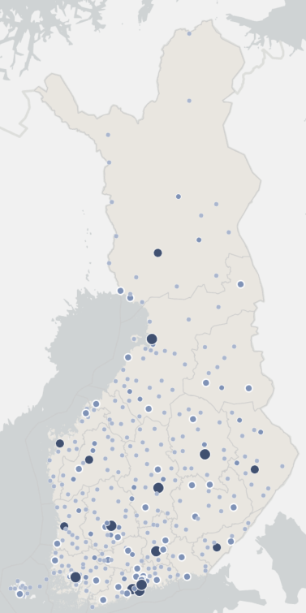
Statistics 2023
District heating networks in Finland
~33 TWh
energy sold annually
~3,0 million people
lives in houses with district heating
~16 500 km
district heating networks
~10,1 cent/kWh
The average price including taxes
~ 45 % market share*
~3 mrd. EUR the value of heat sold including taxes
*market share of heating in residential and apartment buildings

Slide 6
Market share of space heating in 2022 (Statistics Finland)
Includes residential, commercial and public buildings
Electricity: includes the electricity
consumption of heat distribution
equipment and electric sauna stoves
Wood: includes the wood used by
sauna stoves

Slide 7
District heat consumption and connected heat load of the customers

Slide 8
Temperature corrected heat consumption
District heat consumption 33,2 TWh (year 2023)
Temperature corrected heat consumption 33,8 TWh
Temperature corrected heat consumption decreased 0,3 % from 2022
Temperature correction takes into account annual temperature differences.

Slide 9
Number of customers and the length of networks

Slide 10
Specific heat consumption in district heated buildings
Specific heat consumption indicates how much energy has been used to heat premises and domestic water per building volume or surface area.
Specific heat consumption has been standardised to correspond to the comparison period 1991-2020

Slide 11
District heat supply and the share of cogeneration

Slide 12
District heat supply and the fuels used for DH and cogeneration
Total district heat supply | 36,7 TWh
District heat production by fuels | 29,7 TWh
Net production of electricity in CHP production | 5,9 TWh
Fuel energy consumed | 43,2 TWh
Heat recovery and heat produced by heat pumps | 7,0 TWh

Slide 13
Energy sources for district heat supply in 2023 by fuel category
Carbon neutral*: 70 %
Renewables + Heat recovery + electricity usage of electric boilers
Share of imported fossil fuels in district heat supply 17 %
*Carbon neutral energy sources include those energy sources whose carbon dioxide impact is not reported in heat production. The climate impact of bioenergy is included in the land use sector and emissions from electricity used in district heat production in electricity production.
Waste category includes municipal waste, recovered fuels, demolition wood, impregnated wood, plastic waste and hazardous waste.
Bio share of waste is 54 % and fossil share 46 %.
Other biofuels: other biofuels and mixed fuels
Others: steam, hydrogen

Slide 14
Energy sources for district heat supply in 2023 by fuels

Slide 15
Energy sources for district heat supply in 2023 and 2022
Heat recovery: energy that would otherwise go to waste, e.g. heat recovery from wastewater, flue gases, return water from district cooling.
Waste category includes municipal waste, recovered fuels, demolition wood, impregnated wood, plastic waste and hazardous waste.
Bio share of waste is 54 % and fossil share 46 %. Other biofuels: other biofuels and mixed fuels
Others: steam, hydrogen

Slide 16
Heat generated by electric boilers
Electric boilers reduce the use of fuels when electricity price is low. Alongside electric boilers, there is usually a heat storage.

Slide 17
Energy sources for district heat supply 1990-2023
Fossil fuels have increasingly been replaced by biomass, recovered heat and electric boilers.
The use of biomass has increased 2.5-fold since 2010. The amount of recovered heat has increased fivefold since 2010. Fuel consumption is avoided by making use of surplus heat.
*includes heat pumps and heat recovery and electric boilers

Slide 18
Energy sources for district heat supply 1976-2023
*includes heat pumps and heat recovery and electric boilers

Slide 19
Energy sources for district heat by region in 2023
The share of district heat energy sources in combined heat and power plants has been estimated using general coefficients that have not been adjusted to the county-specific level.

Slide 20
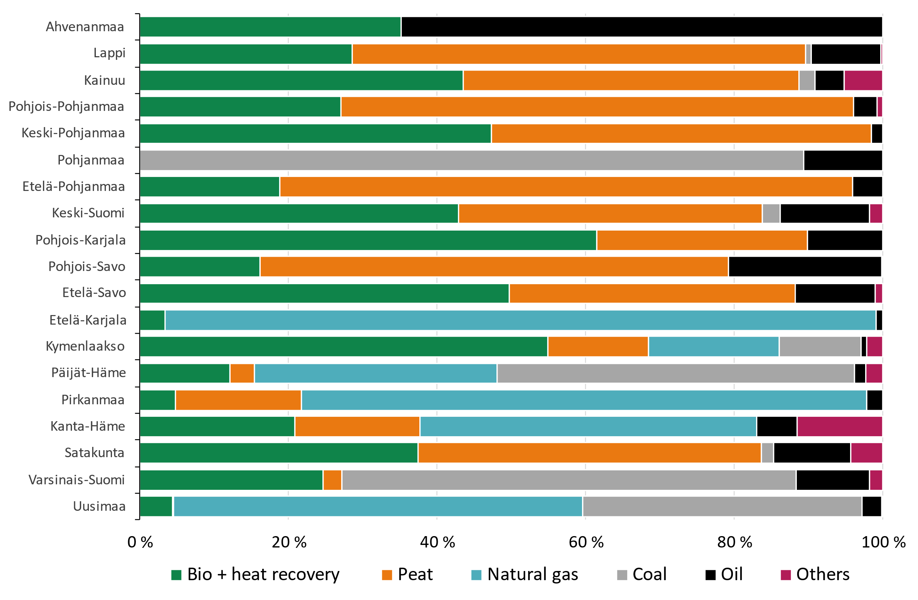
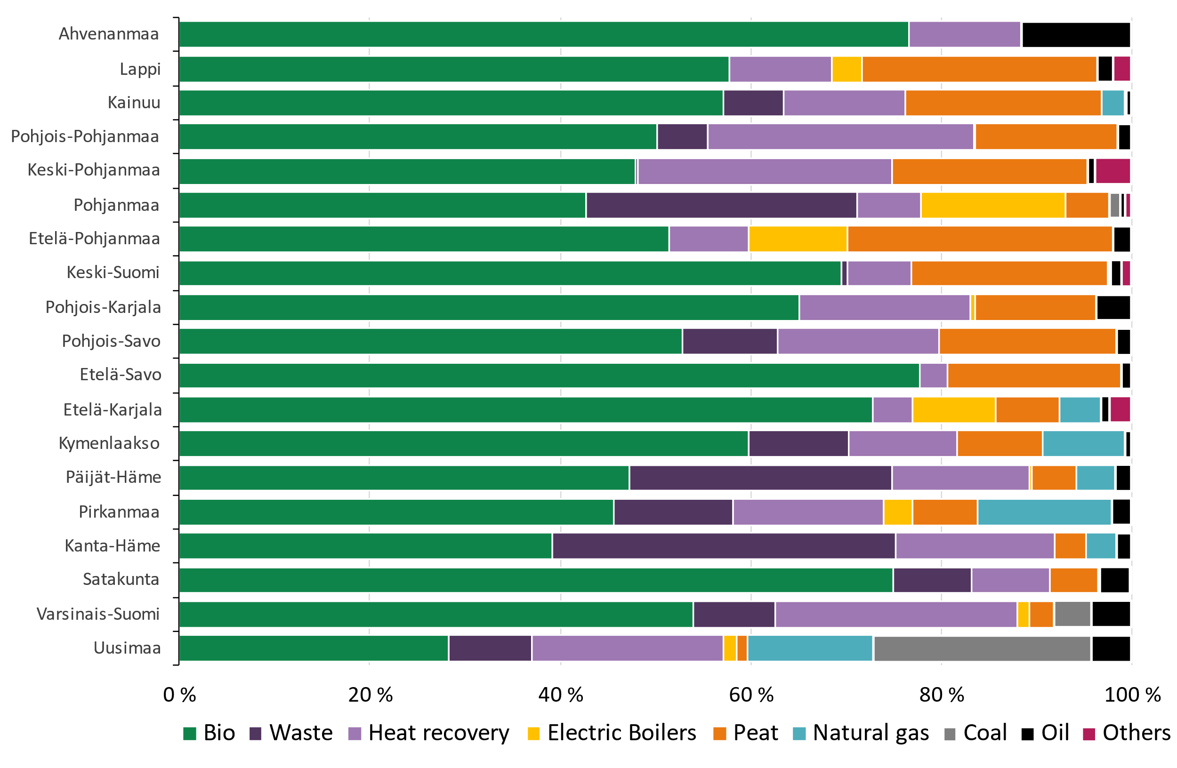
Energy sources for DH by region in 2005 and in 2023
Year 2005
Year 2023

Slide 21
Renewable fuels in the production of district heat and cogeneration

Slide 22
Heat recovery and electric boilers
The electric boilers produced 750 GWh of heat in 2023.
6 249 GWh of district heat was produced by heat recovery
Heat recovery by heat exchangers 4 230 GWh
The most significant heat sources: flue gases, industrial processes and geothermal energy
Heat produced by the heat pumps 2 020 GWh
The most significant heat sources: sewage, district cooling return water and data centers

Slide 23
Total emissions from district heating
CO₂-emissions from district heat production in 2023 were 3,1 Million tons and decreased by 22 % from the previous year

Slide 24
CO₂ -emissions from the district heat supply
Specific emissions from district heat production in 2022 were 85 gCO₂/kWh, which
Decreased by 26 % from the previous year
Decreased by 58 % since 2010
Fuels used in combined heat and power production were allocated according to the benefit allocation method
Sources :
Statistics Finland (2000…2022)
Finnish Energy (1976…1999, 2023)

Slide 25
Price of district heat (incl. VAT) Average, minimum and maximum values
The price includes all taxes, demand and energy charges as well as other possible annual charges. Connection fees are excluded.
Weighted average price: 100,69 €/MWh
Arithmetical average price: 96,26 €/MWh

Slide 26
The share of district heating companies according to the average heat sales price in 2023 (incl. VAT)
The price includes all taxes, demand and energy charges as well as other possible annual charges. Connection fees are excluded.
The graph represents only enterprises that responded to the sales section of the statistics.

Slide 27
Price of district heat in new buildings (€/MWh) Fixed price + energy fee, incl. taxes
The price includes all taxes, demand and energy charges as well as other possible annual charges. Connection fees are excluded.
Source: Finnish Energy, District heating prices 07/2023

Slide 28
Development of the real price of district heat Corrected with cost-of-living index
Source: Finnish Energy, District heating prices 07/2023

Slide 29
District heat consumption in 2023

Slide 30
Distribution of customers according to connected heat load
Number of customers: 160 000
130 000 customers in residential buildings
3,0 million inhabitants

Slide 31
Production capacity and connected heat load of the customers

Slide 32
Analysis

Slide 33
Estimated monthly district heat demand
Year 2023 was 0,3 warmer than the normal period of 1991-2020.
However, monthly temperatures differed from the average year.
The January, February and summer months were warmer than normal, but March and the rest of the year were colder than normal.
The cold winter months exemplify the need for a wide palette of fuels to ensure the security of supply of heating.

Slide 34
Comparison 2021 - Peak consumptions of district heat and electricity are close to each other
1 | 2 | 3 | 4 | 5 | 6 | 7 | 8 | 9 | 10 | 11 | 12
Heat demand
Electricity demand
Source: Finnish Energy, estimation is based on
Helen open data 2021
Hourly consumption of district heat and electricity in 2021
Despite a significant difference in overall demand for electricity and heat, peak consumptions are relatively close to each other

Slide 35
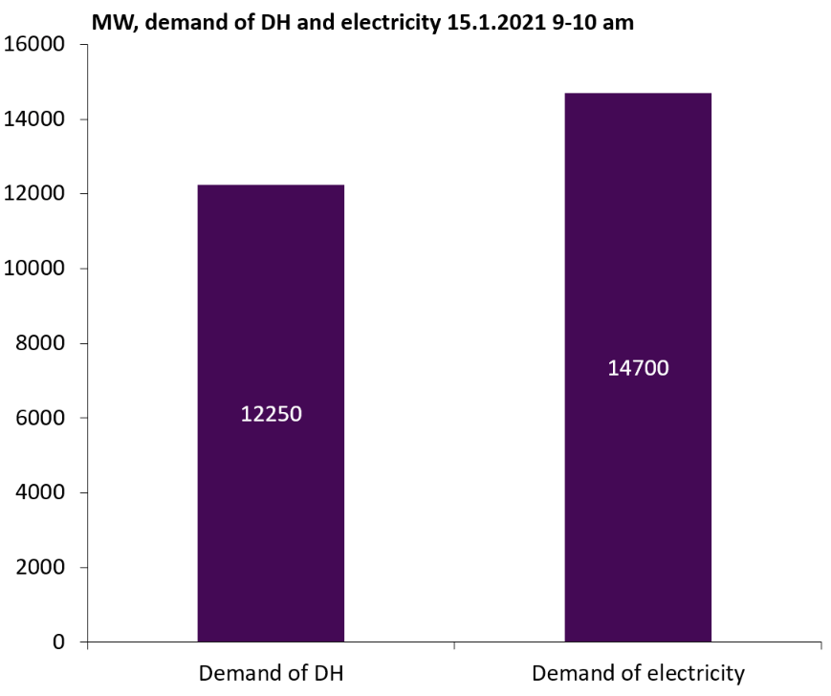
Electricity vs heat demand in winter in 2021
Demand of district heating (DH) at the time of the peak consumption is about the same magnitude as the demand for electricity. On annual basis the demand of electricity is higher than DH (ca. 85 TWh vs. 35 TWh)
Combined Heat and Power (CHP) plants produce a significant amount of electricity (2 500 MW) while producing heat.
District heating reduces electricity demand peaks, in addition to electricity production

Slide 36
Impact of electric boilers on fuel use – The electric boiler significantly reduced the fuel usage of the Seinäjoki district heating network
-31 %
Although the need for district heating in the network grew slightly in Seinäjoki, 30% less fuels were used in the production of electricity and heat. The electric boiler produced about 20% of the heat demand of the network. In Seinäjoki, the commissioning of an electric boiler together with the falling market prices of electricity also decreased electricity production significantly.

Slide 37
Future scenarios

Slide 38
Use of fossil fuels and peat is declining rapidly

Slide 39
The share of biomass and waste in district heating will decrease slightly towards the end of the decade

Slide 40
Electrifying district heat production replaces fossil fuels and peat and reduces the need for energy use of biomass

Slide 41
Energy sources for district heat supply 1990-2030
Source for 2024-2030: Member survey in spring 2024
*includes heat pumps and heat recovery

