Slide 1
Energy Year 2022
Electricity
Finnish Energy
12.1.2023

Slide 2
Electricity total consumption 82 TWh, 6 % decrease compared to 2021

Slide 3
Electricity consumption decreased from the previous year
5,4 TWh change 2021-2022

Slide 4
Electricity consumption 2022

Slide 5
Electricity consumption of industry decreased 6 percent
Consumption total 36 TWh

Slide 6
Industrial electricity consumption 2021-2022: most of decrease in forest industry

Slide 7
Change of Industrial Electricity Consumption 2021-2022

Slide 8
Electricity by energy source and net imports 2022

Slide 9
The share of CO₂-neutral electricity 89 percent
2022
2021
Renewable: 54 % (53 % in year 2021)
CO₂-neutral: 89 % (87 % in year 2021)
Domestic: 57 % (57 % in year 2021)

Slide 10
Electricity production in Finland and net imports decreased
2022
2021

Slide 11
The end of imports from Russia and Energy crisis changed Energy procurement compared to 2021

Slide 12
Net imports of electricity decreased almost 30 percent (5.3 TWh)
Imports from Russia ended in May 204 %
Imports from Nordic countries increased 3% (0.4TWh)
Exports to Estonia increased 2 % (+0.1 TWh)

Slide 13
Net imports of electricity
12.5 TWh in year 2022

Slide 14
Electricity imports changed significantly after May

Slide 15
Wind power grows rapidly:
Capacity increased 76 percent and production 41 percent

Slide 16
Hydropower generation
Average year
= hydropower production calculated when flows of built rivers are in average level

Slide 17
Generation and capacity of CHP in district heating
*Peak load capacity is not included from year 2017
*Source: Statistics Finland, Energy 2022 table service, table 3.5

Slide 18
Generation and capacity of CHP in industry
*Source: Statistics Finland, Energy 2022 table service, table 3.5

Slide 19
Generation and capacity of condensing power
*Peak load capacity is not included from year 2017
*Source: Statistics Finland, Energy 2022 table service, table 3.5

Slide 20
Electricity Generation with Coal total of moving 12 months

Slide 21
CO₂-emissions of power generation-downward trend continues
CO₂-emissions of power generation:
4.4 Mt in year 2022
4.7 Mt in year 2021
4.3 Mt in year 2020
6.9 Mt in year 2015
19 Mt in year 2010
→ 2022 vs. 2021 -6 %
→ Emissions -39 % in last 5 years
→ Emissions -77 % vs 2010
EU-27, v. 2020: 229 g CO₂ / kWh
Source: EEA

Slide 22
Peak loads of electricity maximum electricity MW

Slide 23
Electricity supply hourly in year 2022 peak load day 11.1.

Slide 24
Variation of Electricity Production and Imports in 2022 average week power

Slide 25
Electricity spot markets are in an unprecented rise and change

Slide 26
In 2022, wholesale electricity price in Finland was considerably higher than in the previous years
Source: Nord Pool

Slide 27
Price of electricity in Finland was the second-lowest in the entire EU ̶ great price differences compared to Central Europe
Source: Nord Pool

Slide 28
Electricity prices rose in Europe mainly due to the reduced amounts of Russian natural gas and other energy in the market
Society starts to open up after COVID-19 restrictions and the demand for electricity increases. Exceptionally low prices come to an end.
Cold December raised gas and electricity prices.
Russia attacks Ukraine.
Gas and electricity imports from Russia are reduced considerably during spring and summer.
Russia starts to limit gas imports to Europe.
Lähde: Nord Pool

Slide 29
Price of electricity has followed the price of natural gas, which has multiplied in Central Europe
The price of natural gas has increased 20–30-fold from the low prices in 2020.
About 20% of electricity in the EU is produced with natural gas. In many countries this share is much higher.
For the time being, gas is a necessary fuel with respect to sufficient electricity supplies.
The wholesale price of electricity in Finland partly follows the Central European prices, but not in full. When there is plenty of Nordic production on offer, our price level falls considerably lower.
Sources: Nord Pool & Trading Economics

Slide 30
In addition to gas, the hot and dry summer and challenges in nuclear power plants also contributed to the crisis
The rise in electricity prices is also partly explained by the reduced supply of nuclear and hydro power.
There are a number of faults and maintenance issues especially in French nuclear power plants, due to which production has plummeted.
The dry year has reduced the supply of hydro power.
Reduced use of electricity and increased production of wind and solar power have not been enough to meet the shortfall in nuclear and hydro power.
It has been necessary to utilise more coal power in electricity production, and even the hugely expensive natural gas has been slightly more in demand than in the previous year.
Sources: Bruegel & Ember

Slide 31
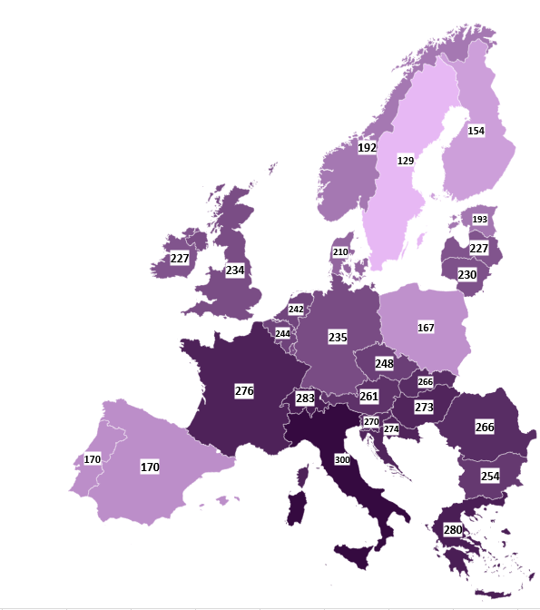
High prices are not only a Finnish phenomenon
Electricity spot prices by country 2022
Prices in Norway, Denmark, Sweden and Italy are from the price areas of the capital cities
Prices have been very high throughout Europe.
  The electricity wholesale market is common, i.e. pricing takes place according to supply and demand in the entire region.
  Electricity is transmitted in the grid towards a higher price.
  Electricity transmission links are not enough to ensure the same price in all areas.
The prices have been highest in countries that have a lot of production based on fossil fuels or not enough own production capacity.
Sweden has had the lowest prices, and Finland has imported a lot of electricity from Sweden. Correspondingly, electricity has been exported from Finland to Estonia.
Source: Nord Pool

Slide 32
Electricity price fluctuations have been high this year – highest prices seen in August and in early December
In January–April, Finland had the lowest wholesale electricity prices in Europe together with Sweden.
The prices increased when electricity imports from Russia stopped and gas became more expensive.
In late November and early December, the weather was widely cold with low winds in Central and North-West Europe.
Lähde: Nord Pool

Slide 33
Price difference between Finland and Sweden grew further
The reason for the price difference between Finland and Sweden is the insufficient transmission capacity to transmit lower-priced electricity to the neighbouring country.
In the past few years, Finland has usually imported a substantial volume of electricity from Sweden.
The challenge for Finland is that our production capacity is not sufficiently high. In sub-zero temperatures during high demand or low winds, the prices can rise extremely high even if electricity prices in Sweden were lower.
Increasing own power production and growing the transmission capacity will reduce the price difference.
Lähde: Nord Pool

Slide 34
Outlook for electricity prices is promising especially in terms of Finland and Sweden
Future electricity deliveries are traded on the electricity derivatives market.
The price outlook is declining in Finland and Sweden.
In Germany, high prices seem to be continuing.
The situation in Finland and Sweden is explained by the fact that we have a constant plentiful supply of new electricity production. Moreover, we are not dependent on gas in electricity production which would keep prices at a constantly high level.
Futuure prices from 29.12.2022
Sources: Nord Pool, Nasdaq OMX & EEX

Slide 35
The low carbonization of traffic is progressing

Slide 36
Petrol and diesel car sales in Finland
(new passenger cars, plug-in hybrid cars not included)

Slide 37
Alternative power sources for the first registration of passenger cars

Slide 38
Alternative power sources in passenger cars in traffic by end of the year

