Slide 1
District heating in Finland 2021

Slide 2
Statistics 2021
Heat sales (incl. taxes) 2 920 M€
Sold heat energy 35,3 TWh
Average price of DH (incl. taxes) 8,28 c/kWh
Inhabitants in district heated apartments 3,00 million
Market share of DH 46 %
Length of the network 16 090 km

Slide 3
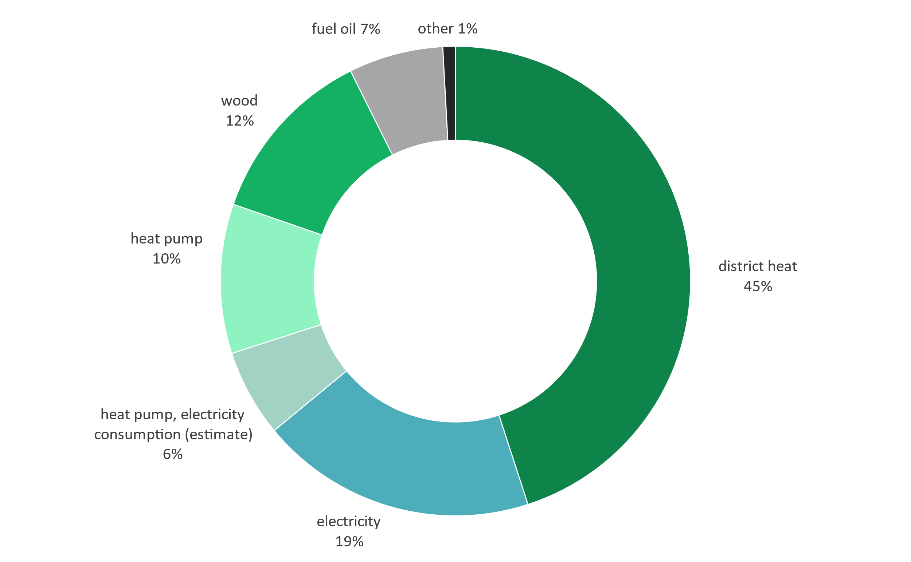
Market share of space heating in 2020 (Statistics Finland)
Includes residential, commercial and public buildings

Slide 4
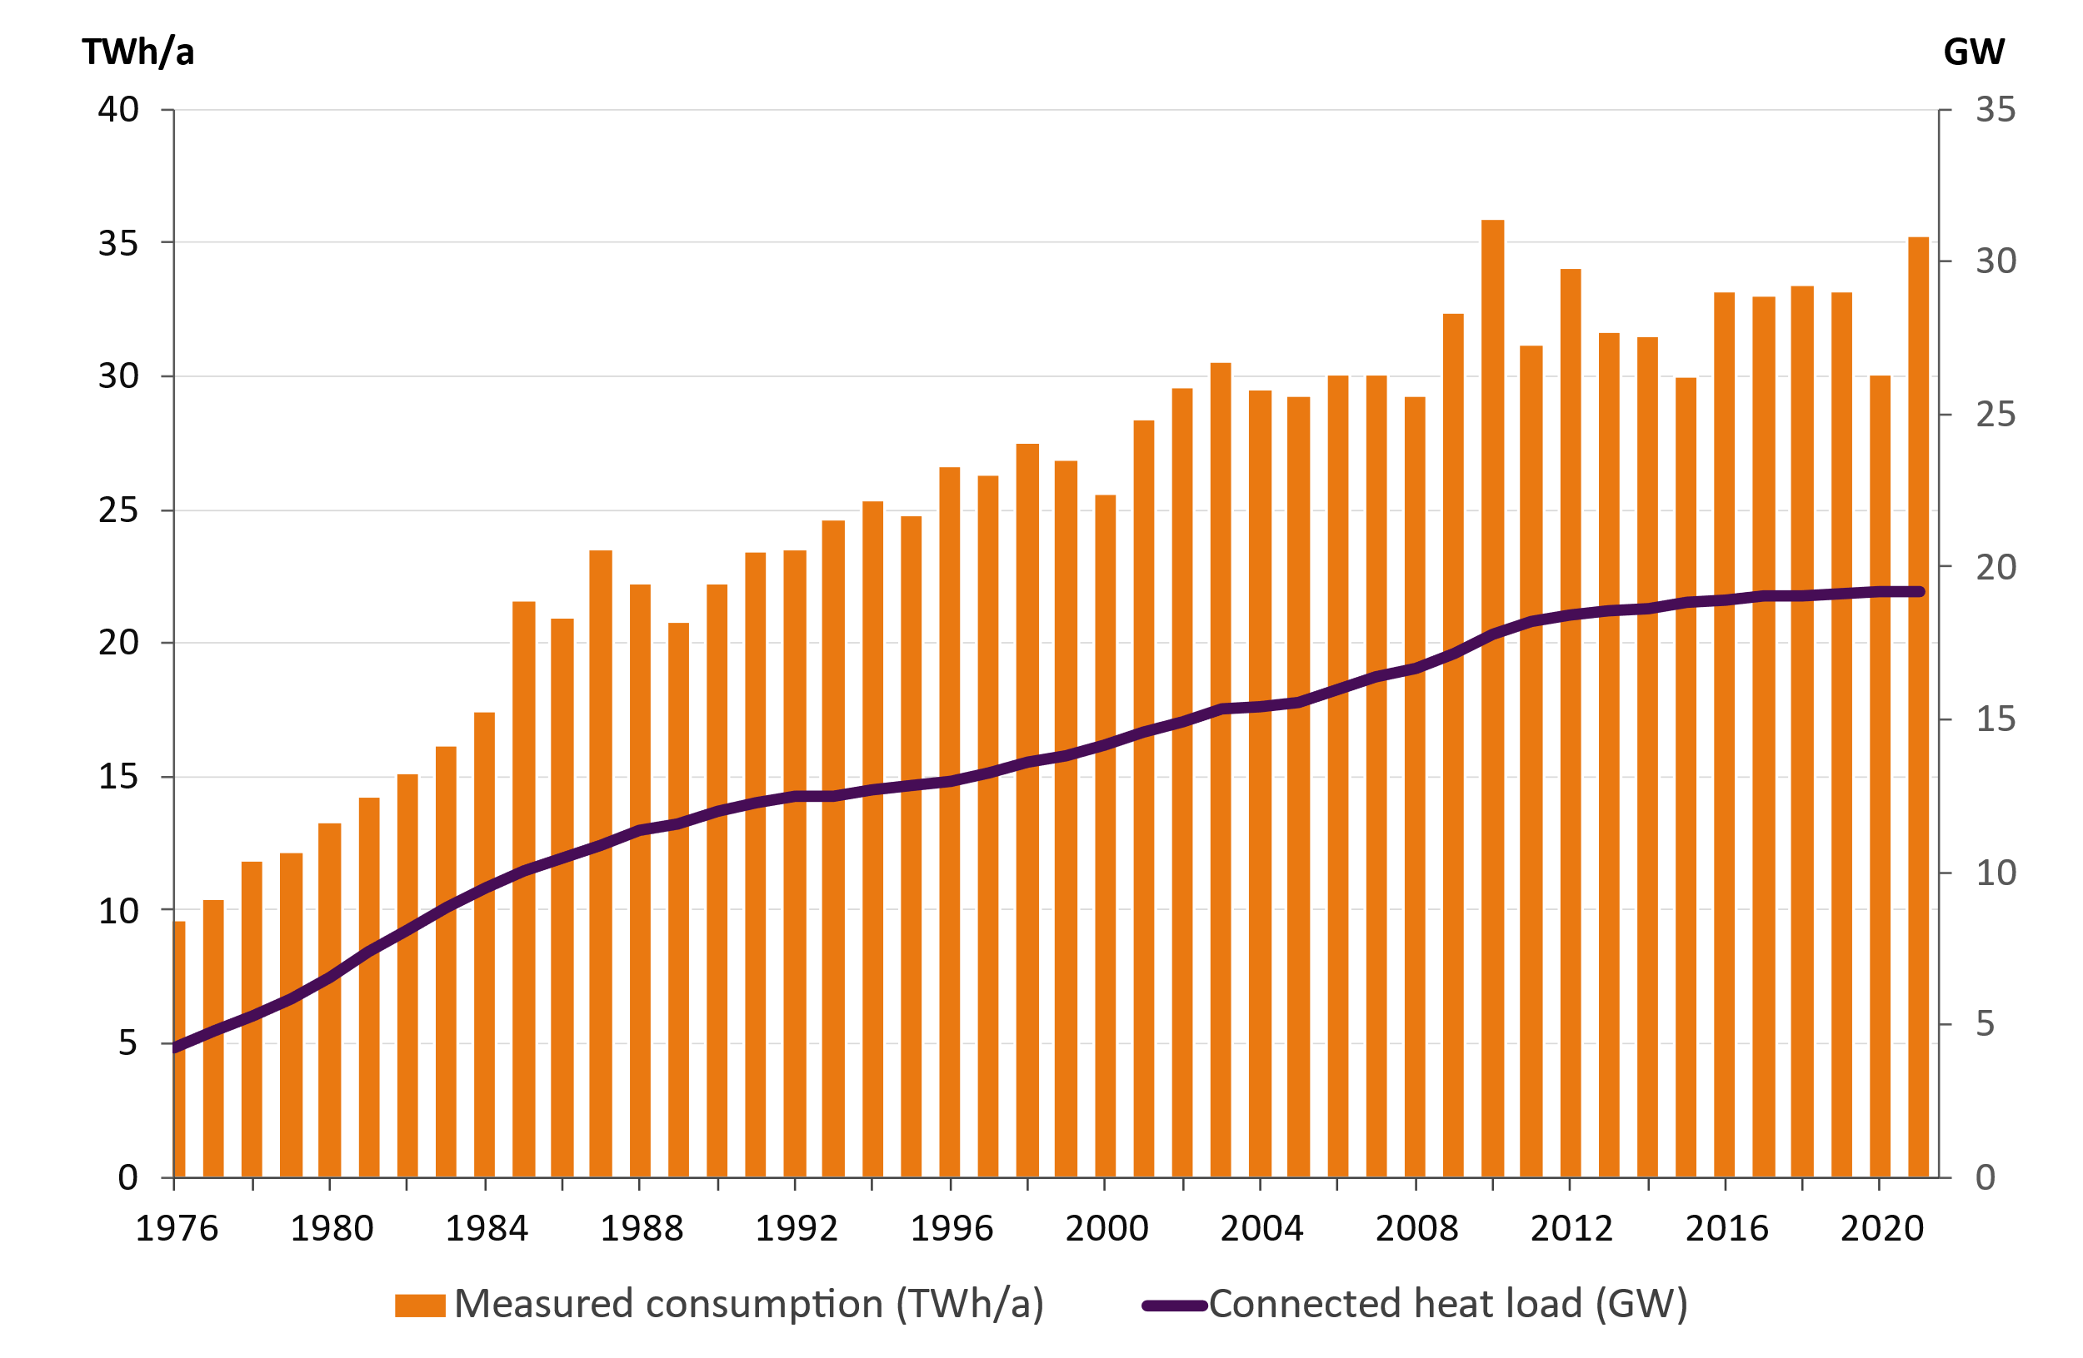
District heat consumption and connected heat load of the customers

Slide 5
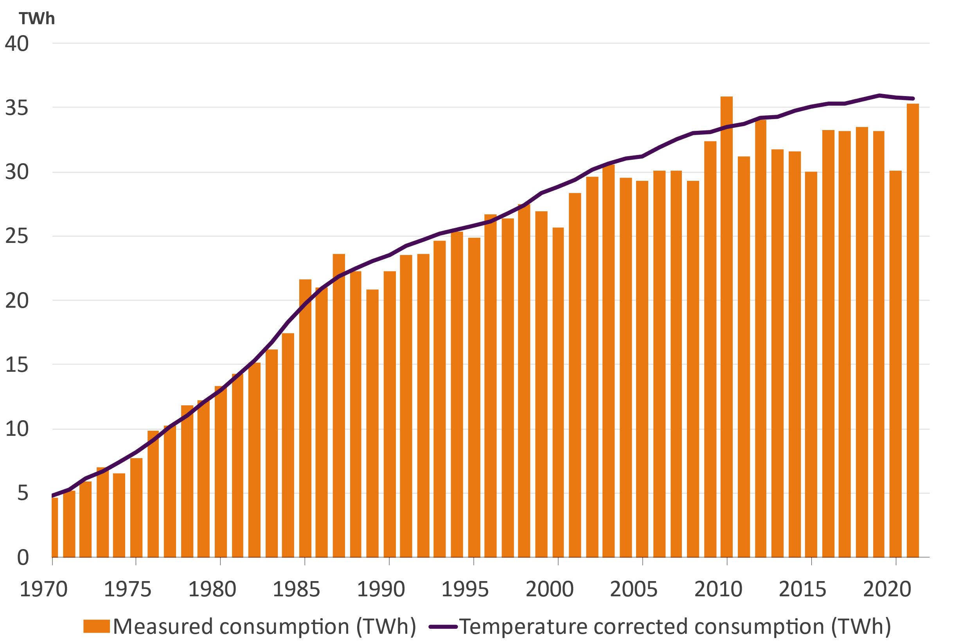
Temperature corrected heat consumption
District heat consumption 35,3 TWh (year 2021)
Temperature corrected heat consumption 35,7 TWh
Temperature corrected heat consumption decreased 0,2 %

Slide 6
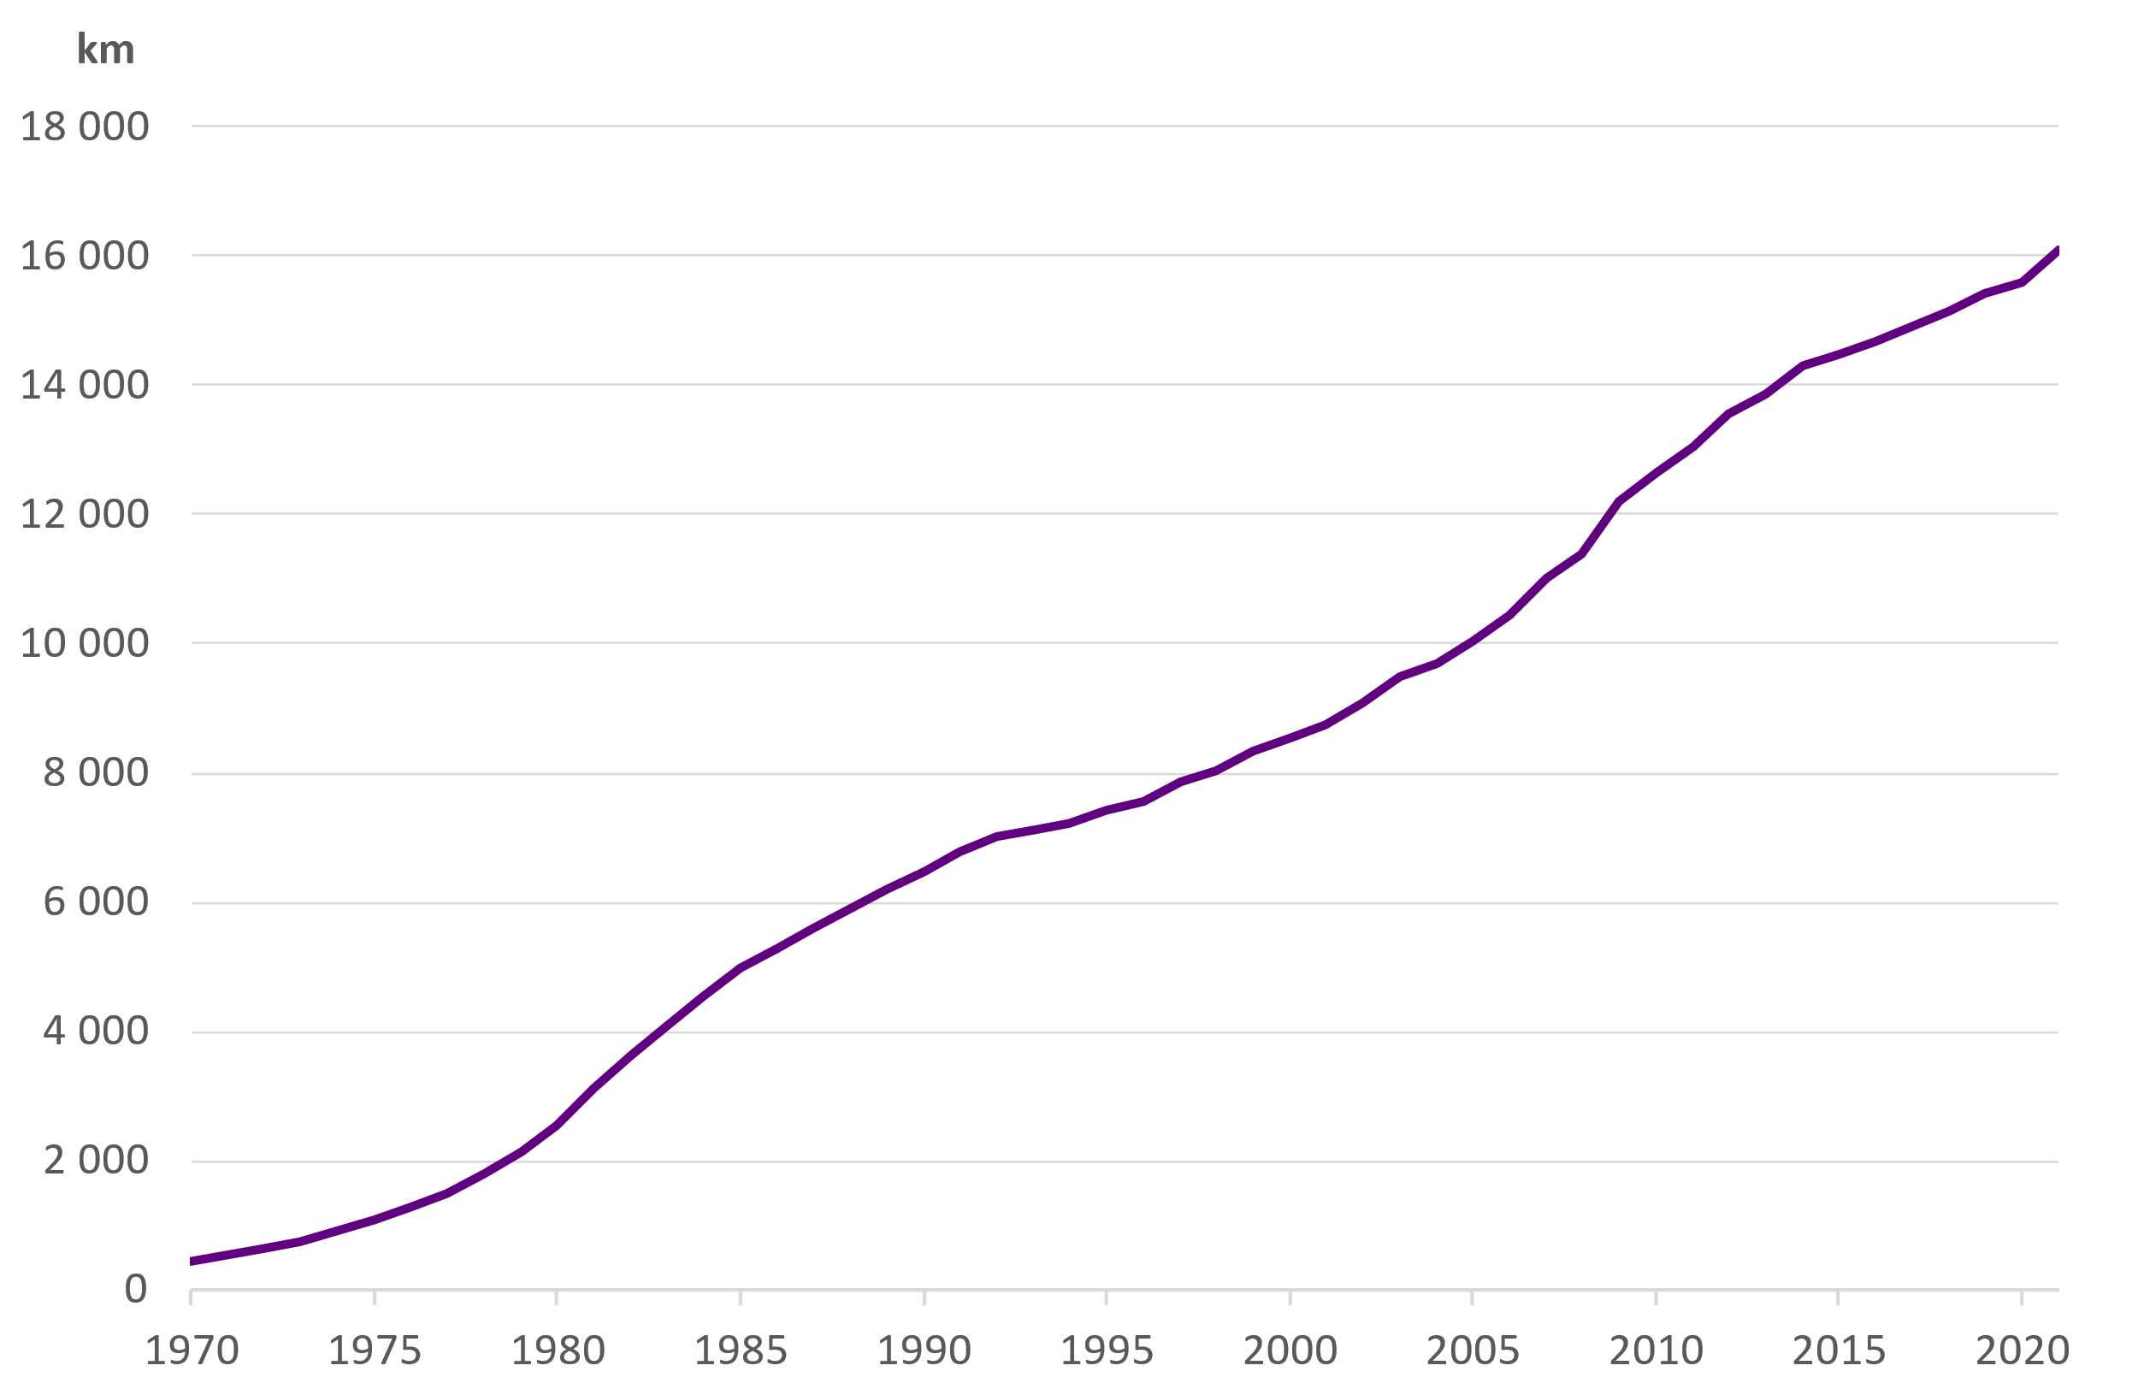
Length of networks

Slide 7
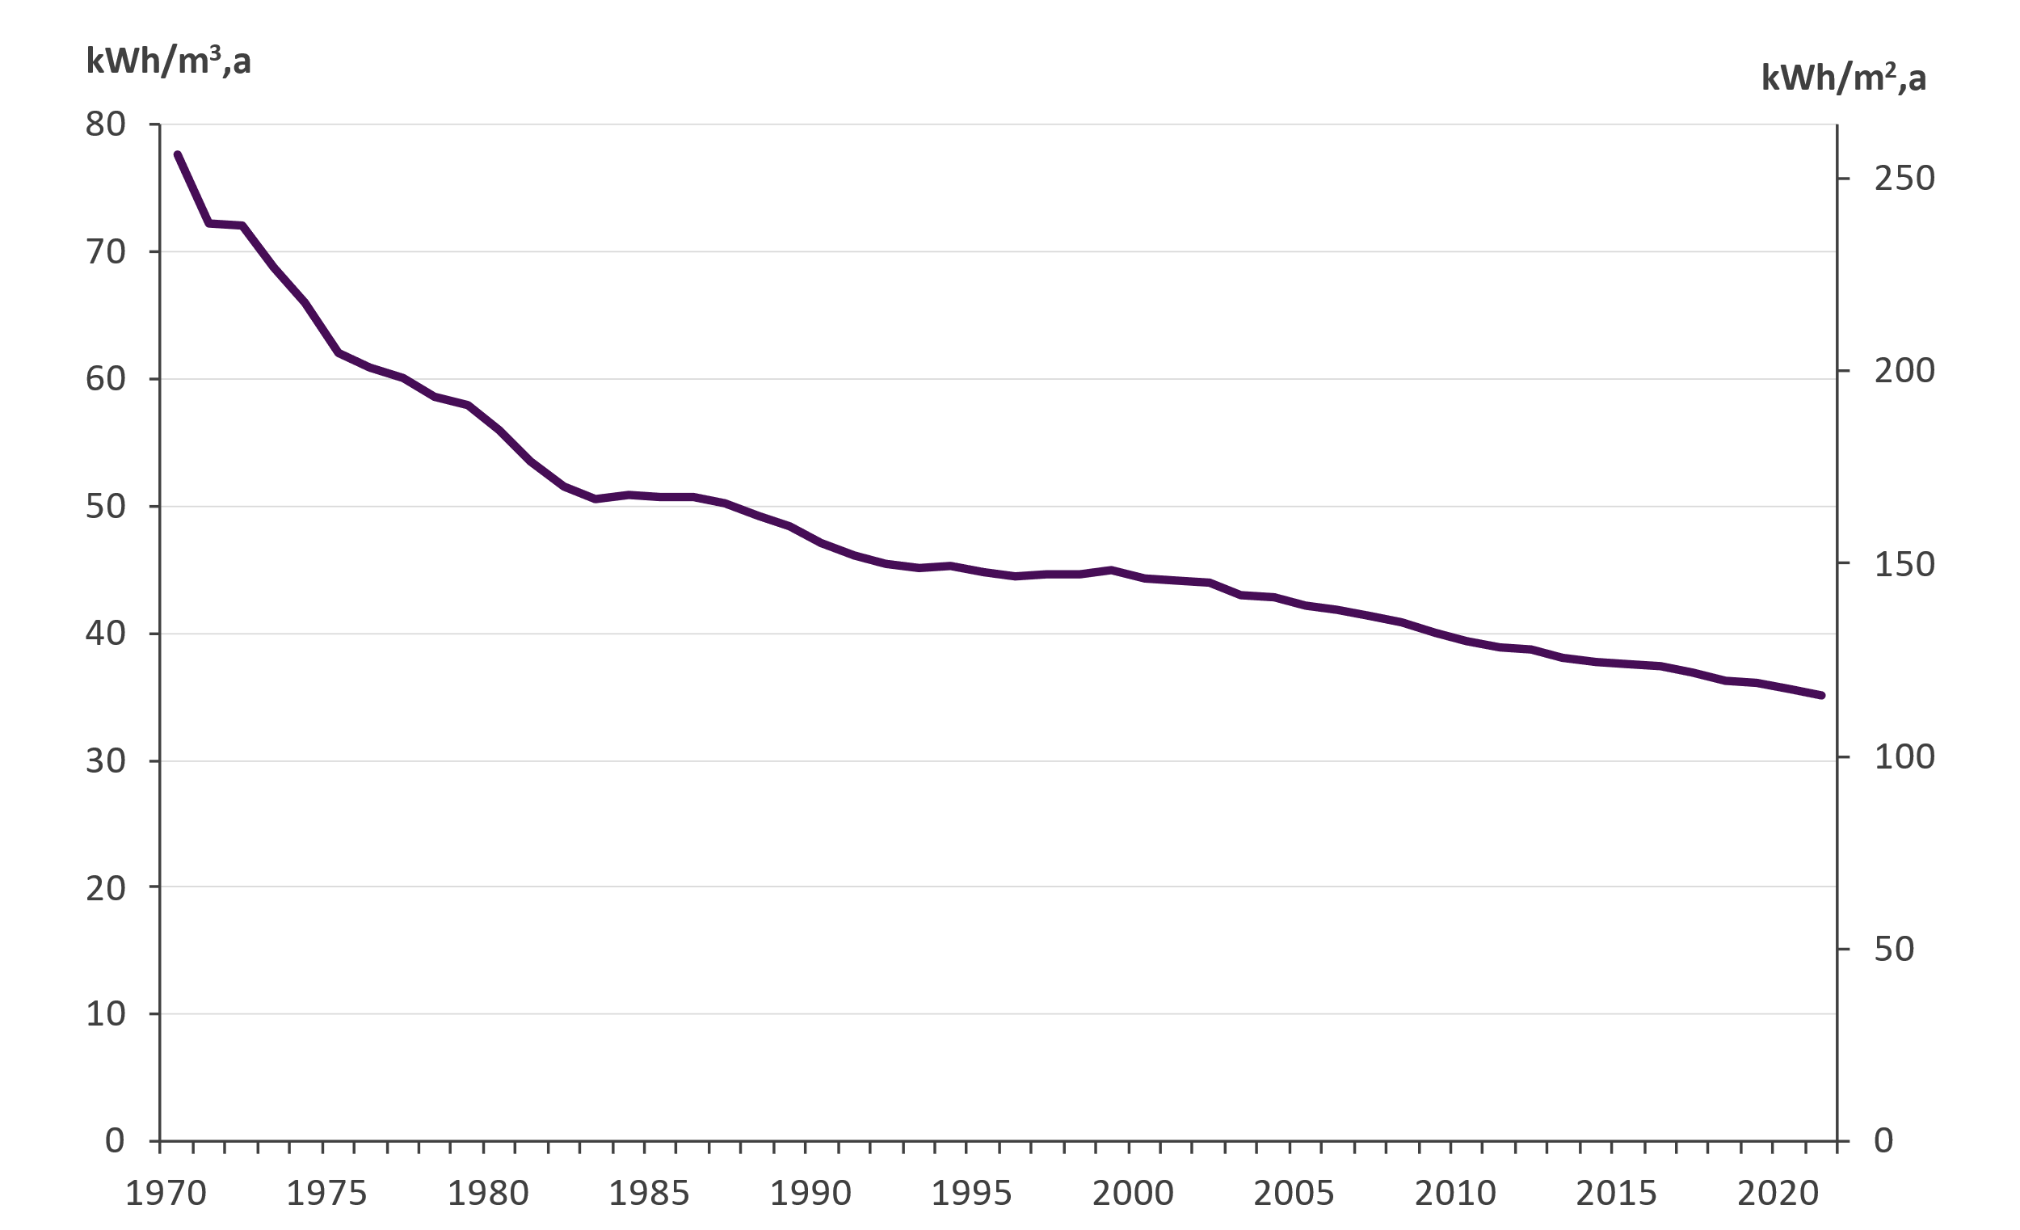
Specific heat consumption in district heated buildings
Includes energy for heating hot tap water

Slide 8
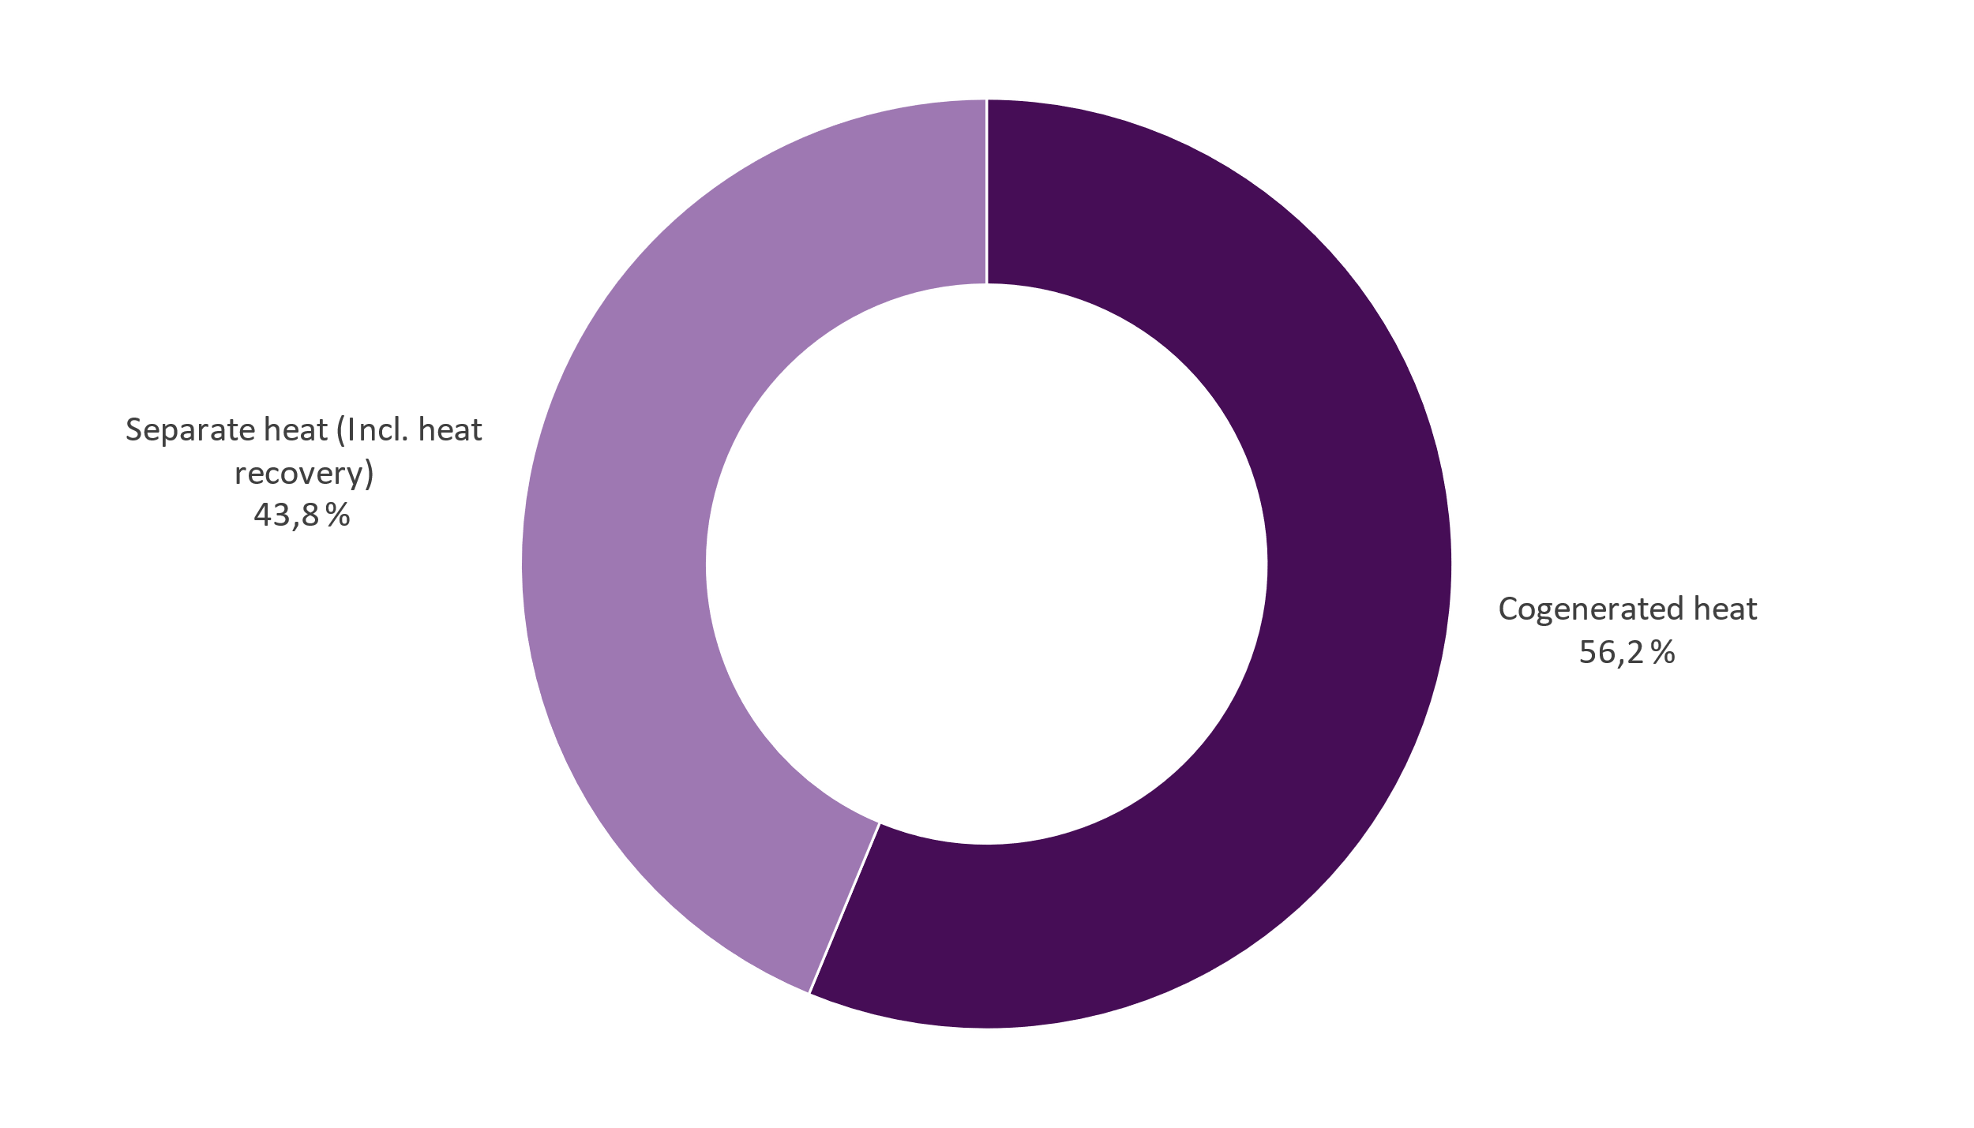
District heat supply 2021 Total 35,3 TWh

Slide 9
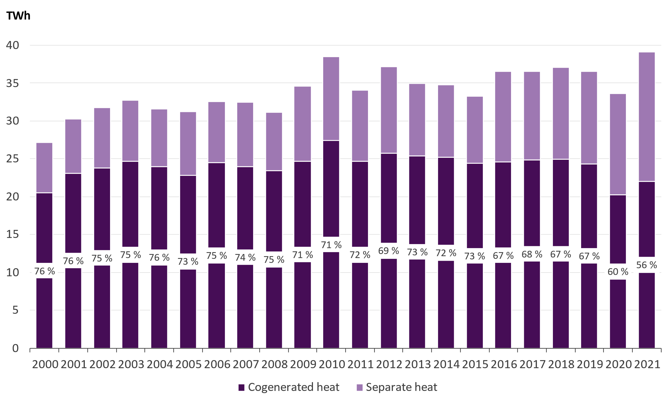
District heat supply and the share of cogeneration

Slide 10
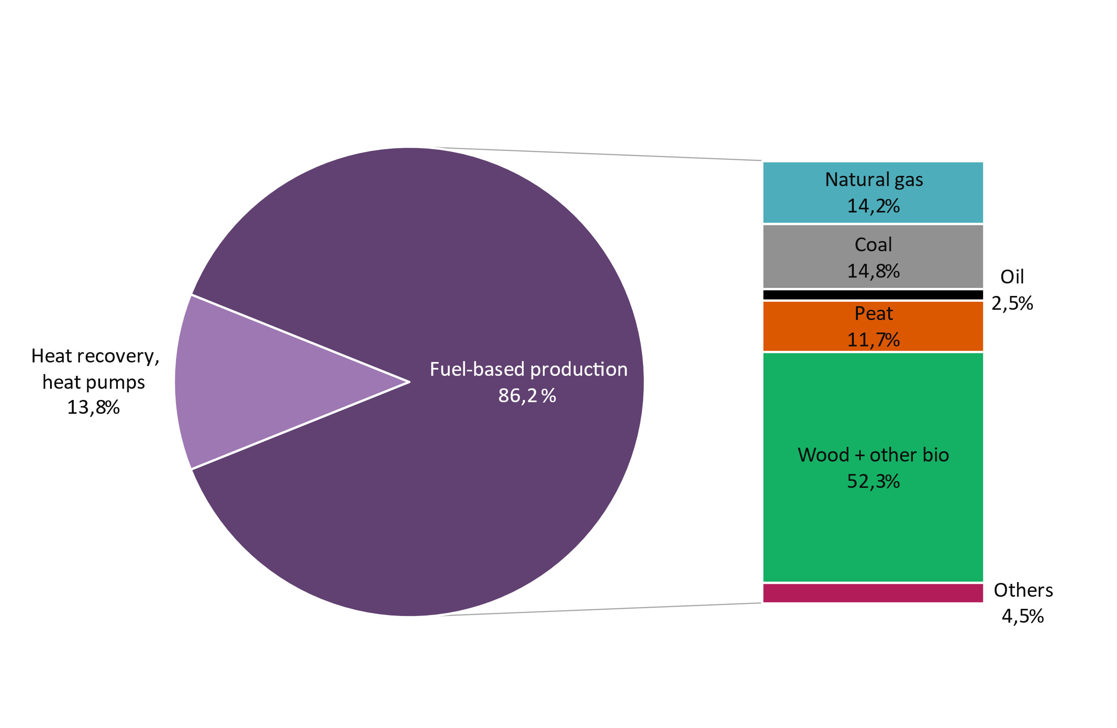
District heat supply as well as the fuels used for DH and cogeneration
Total district heat supply | 39,1 TWh
District heat production by fuels | 33,7 TWh
Net production of electricity in CHP production | 9,9 TWh
Fuel energy consumed | 52,0 TWh
Heat recovery and heat produced by heat pumps | 5,4 TWh

Slide 11
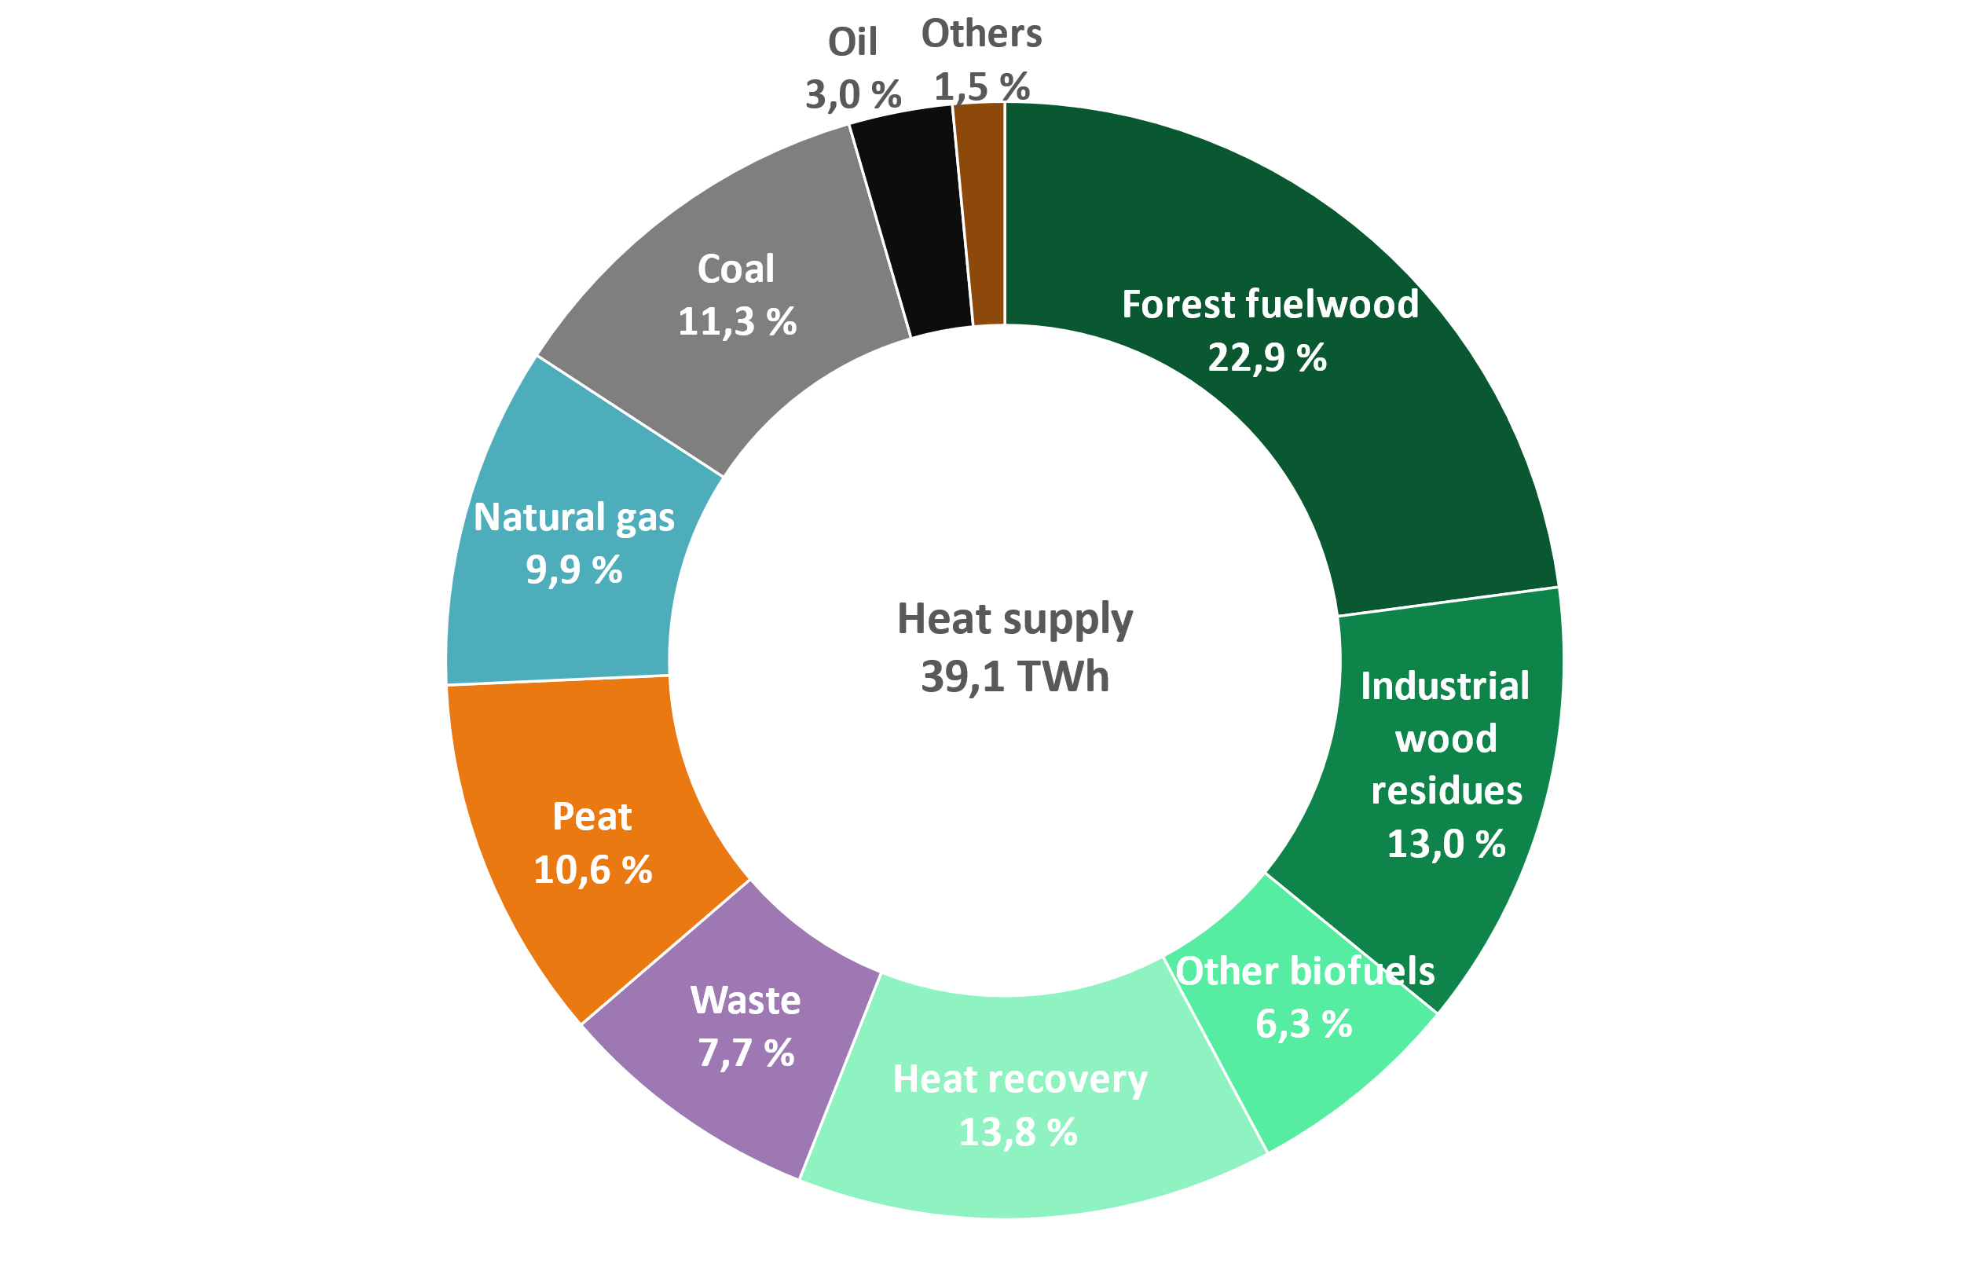
Energy sources for district heat supply in 2021 by fuel category
Waste category includes municipal waste, recovered fuels, demolition wood, impregnated wood, plastic waste and hazardous waste.
Bio share of waste is 55 % and fossil share 45 %.
Other biofuels: other biofuels and mixed fuels
Others: electricity, steam, hydrogen

Slide 12
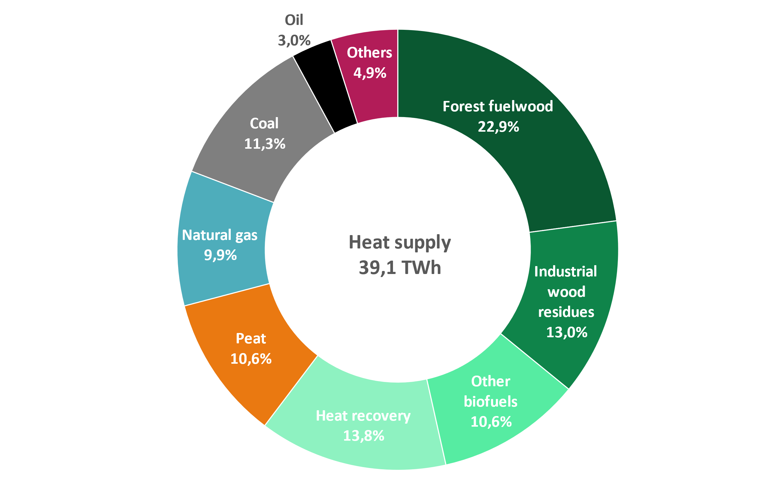
Energy sources for district heat supply in 2021
Carbon neutral: 60 %
Renewables + Heat recovery
Domestic*: 76 %
Carbon neutral + Peat + share from ”Others”
Share of imported fossil fuels in district heat supply 24 %
Heat recovery: Heat energy which would be wasted otherwise, e.g. from the sewage, flue gases or from the district cooling return water
Other biofuels: Biodegradable share of the municipal and industrial waste and other bio-based fuels
Others: Non-biodegradable share of municipal and mixed waste, plastic and hazardous waste, electricity, steam, hydrogen
* = All biomass is considered domestic. From ”Others” all waste, steam, hydrogen and 80 % of electricity are considered domestic.

Slide 13
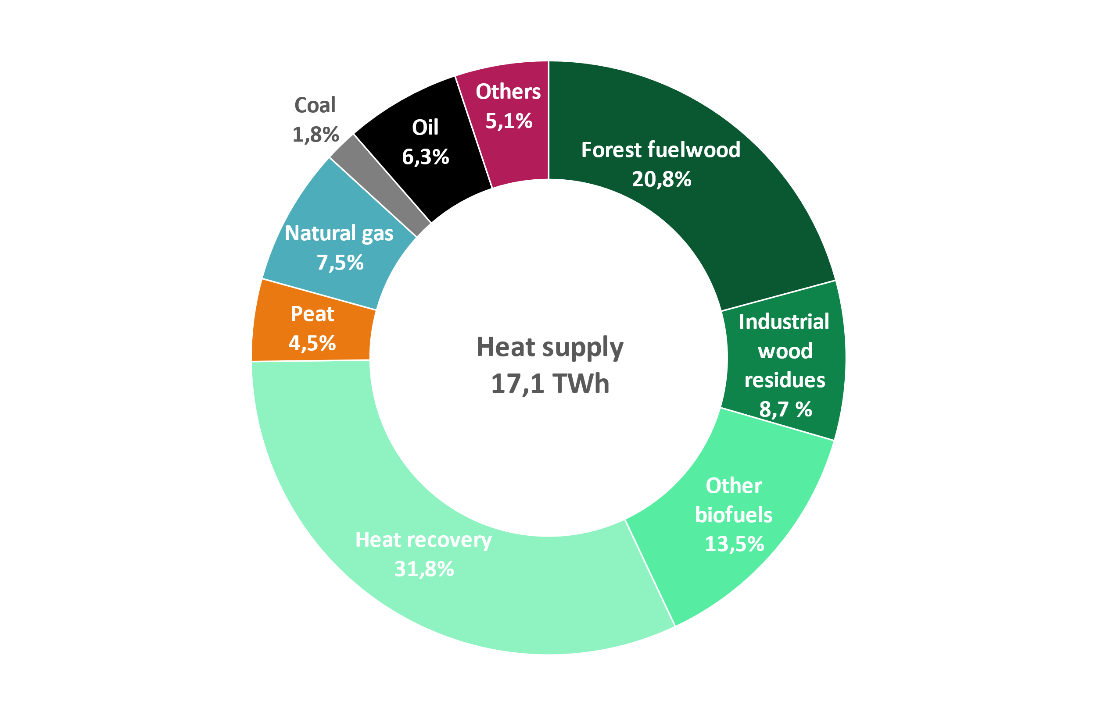
Energy sources for separate DH production in 2021
Carbon neutral: 75 %
Renewables + Heat recovery
Domestic*: 84 %
Carbon neutral + Peat + share from ”Others”
Share of imported fossil fuels in separate district heat production 16 %
Heat recovery: Heat energy which would be wasted otherwise, e.g. from the sewage, flue gases or from the district cooling return water
Other biofuels: Biodegradable share of the municipal and industrial waste and other bio-based fuels
Others: Non-biodegradable share of municipal and mixed waste, plastic and hazardous waste, electricity, steam, hydrogen
* = All biomass is considered domestic. From ”Others” all waste, steam, hydrogen and 80 % of electricity are considered domestic.

Slide 14
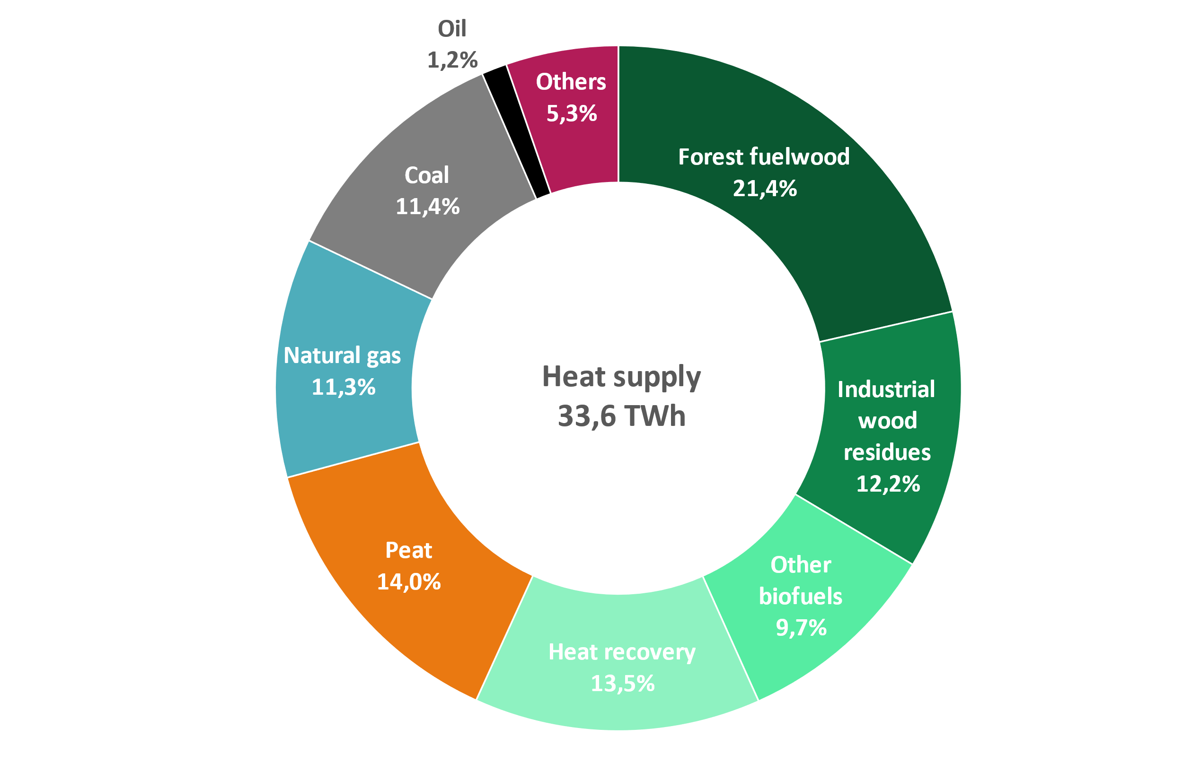
Energy sources for district heat supply in 2021 and 2020
2021
2020
Recovered (recycled) heat: energy that would otherwise go to waste
Other biofuels: includes also the bio share of municipal waste
Other: non-bio share of municipal waste, plastic or hazardous waste, electricity, steam, hydrogen

Slide 15
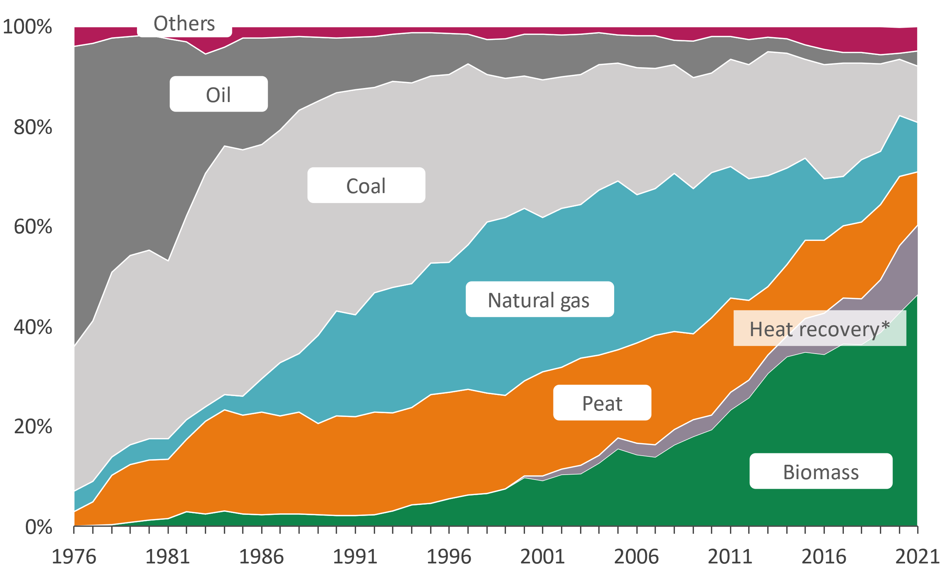
Energy sources for district heat supply
*includes heat pumps and heat recovery

Slide 16
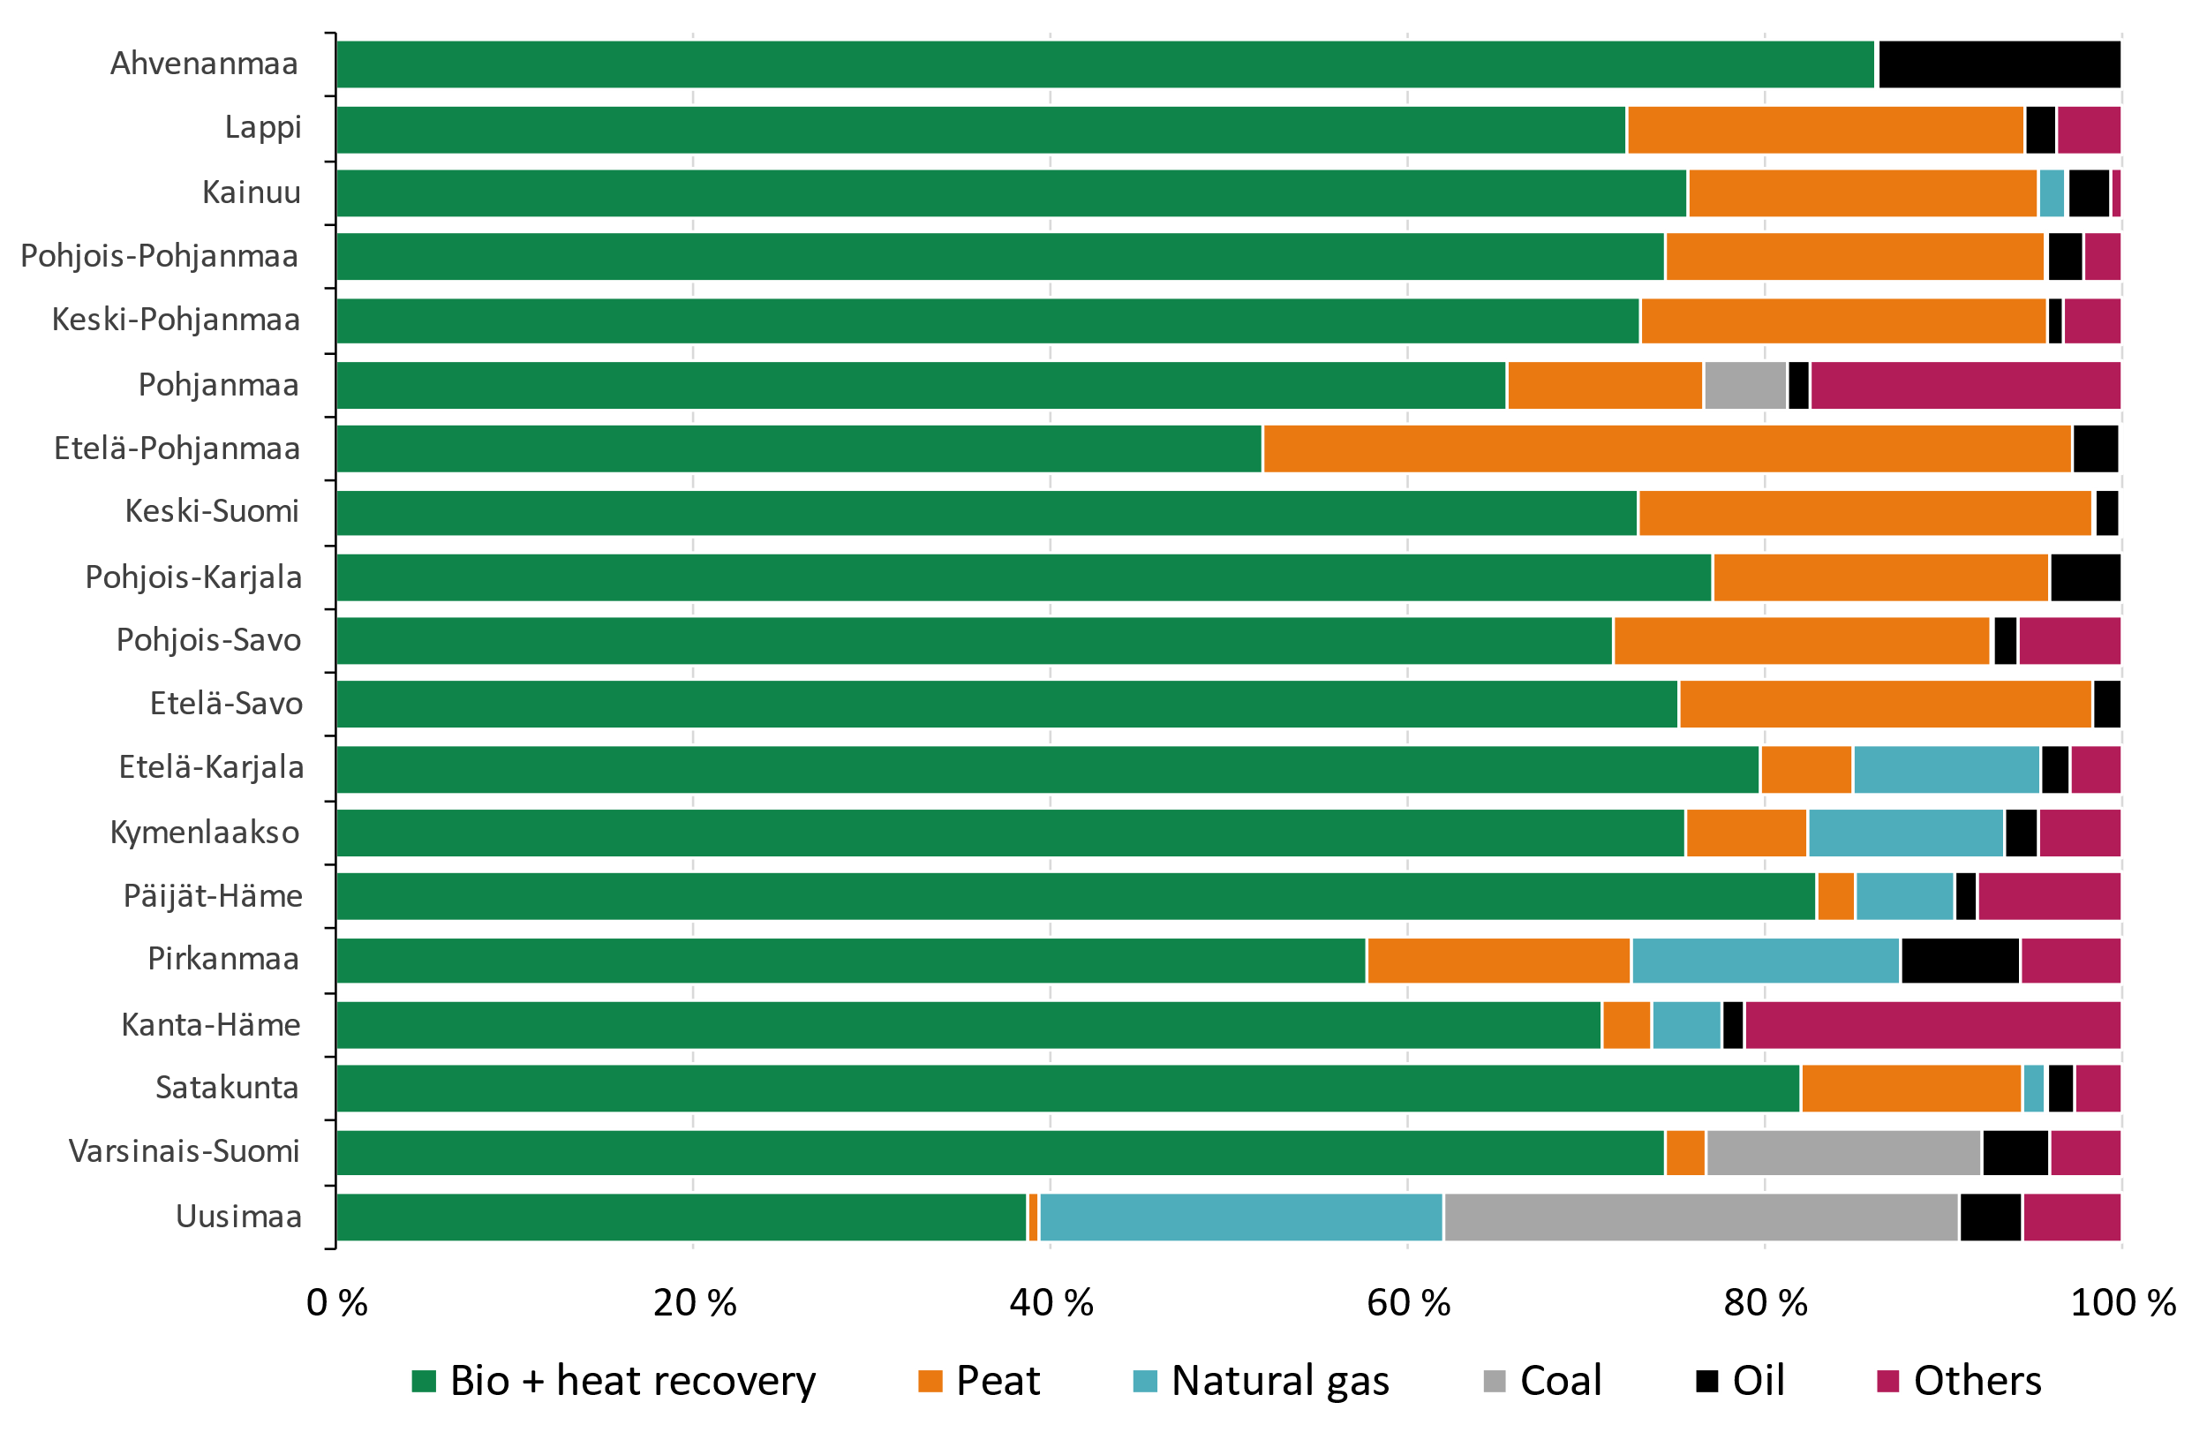
Energy sources for district heat and cogeneration by region in 2021

Slide 17
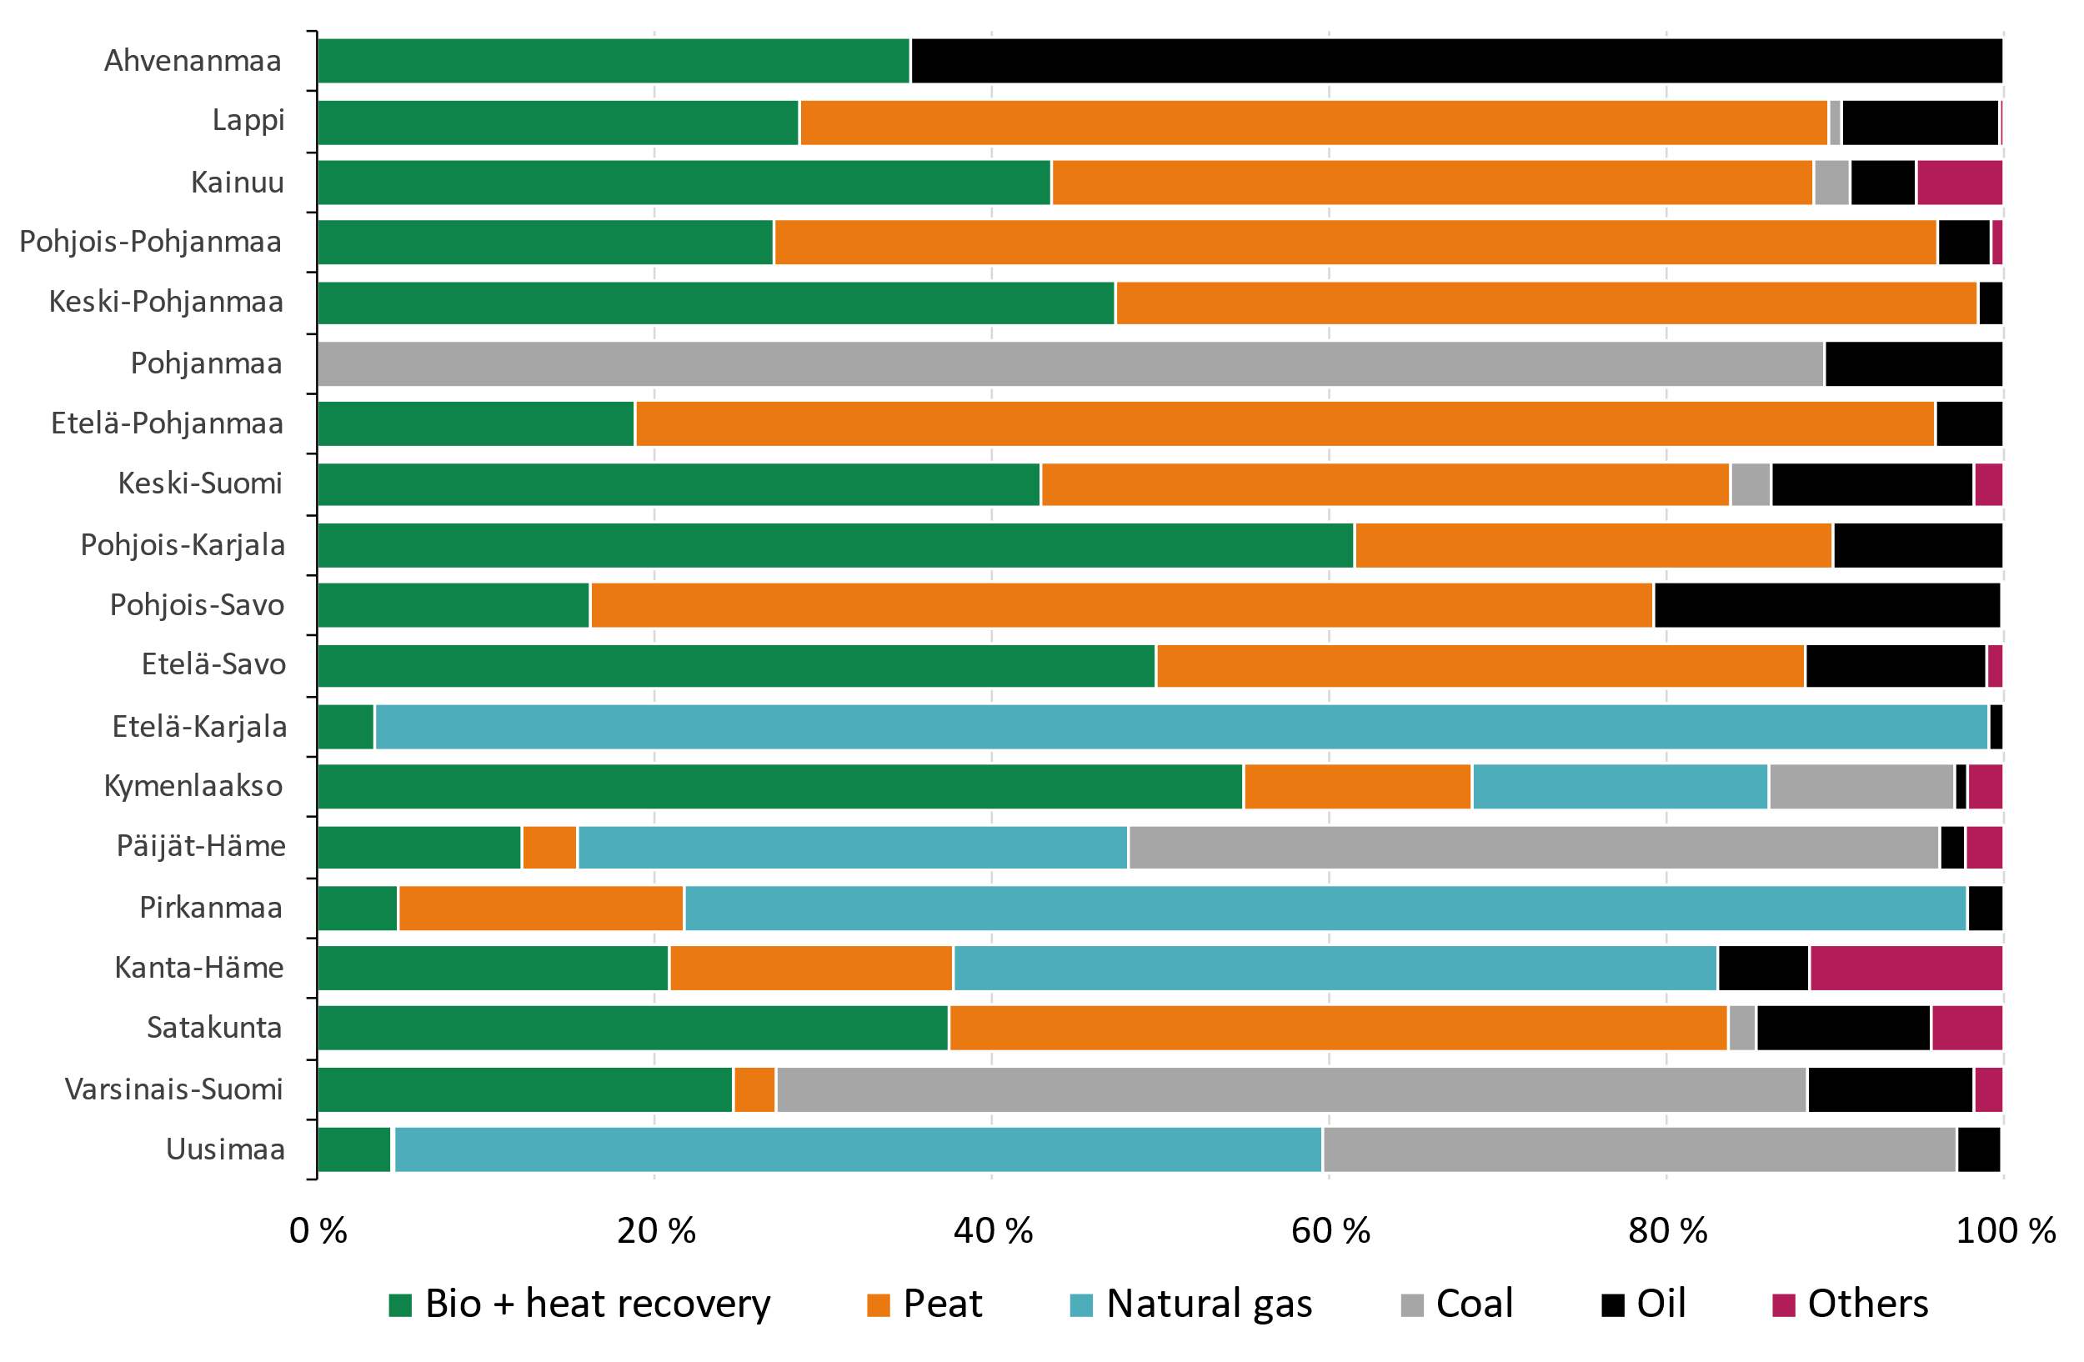
Energy sources for DH and cogeneration by region in 2005 and in 2021
Year 2005
Year 2021

Slide 18
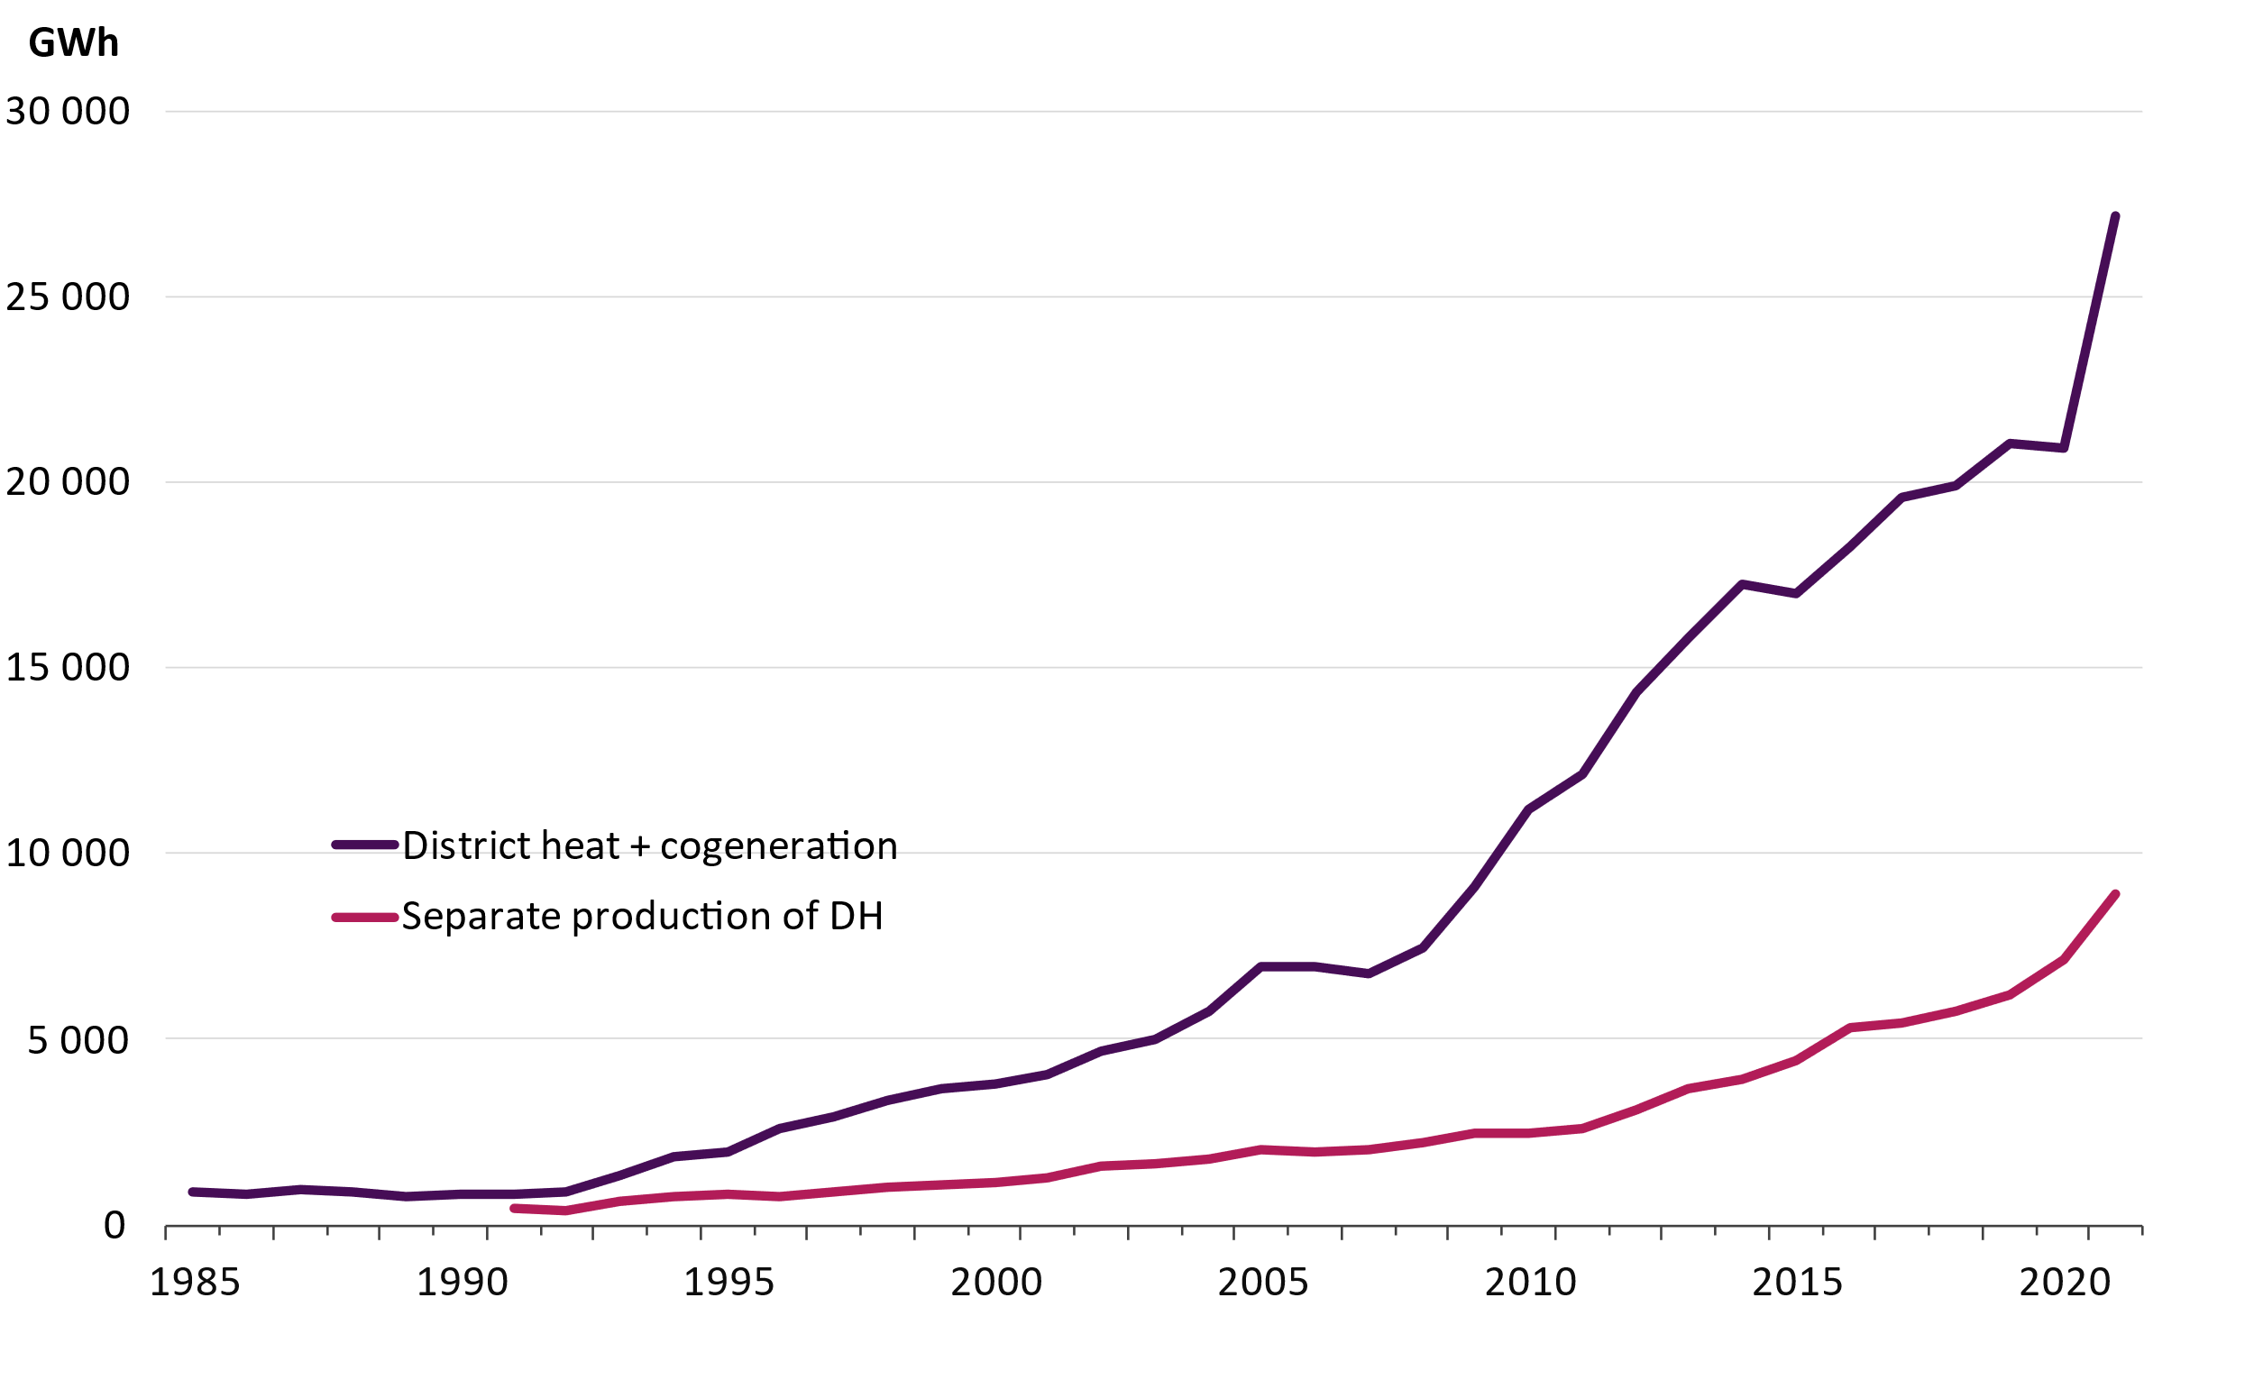
Renewable fuels in the production of district heat and cogeneration

Slide 19
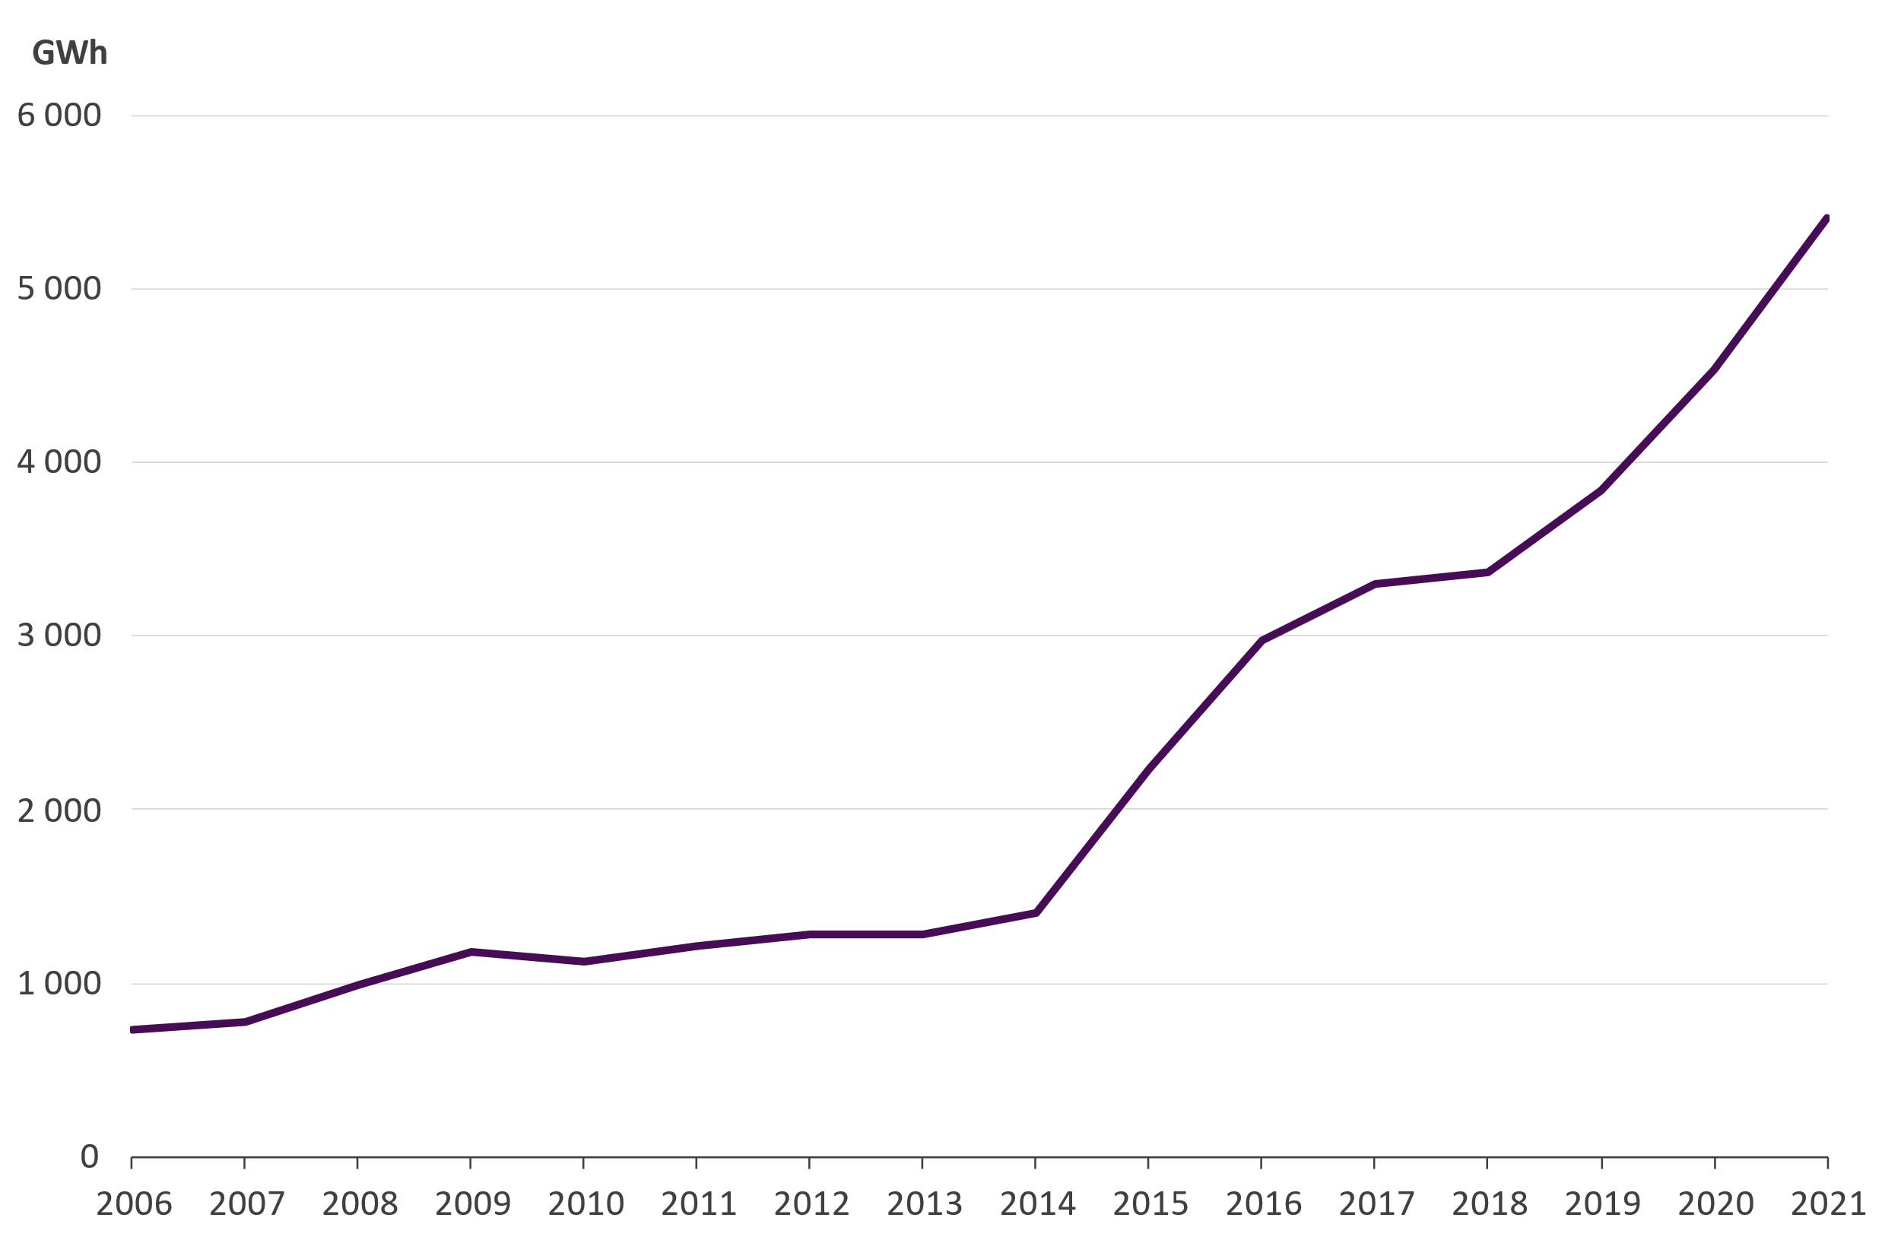
Heat recovery
5 410 GWh of district heat was produced by heat recovery
Heat recovery by heat exchangers 3 770 GWh
The most significant heat sources: flue gases, industrial processes and geothermal energy
Heat produced by the heat pumps 1 630 GWh
The most significant heat sources: sewage, district cooling return water and data centers

Slide 20
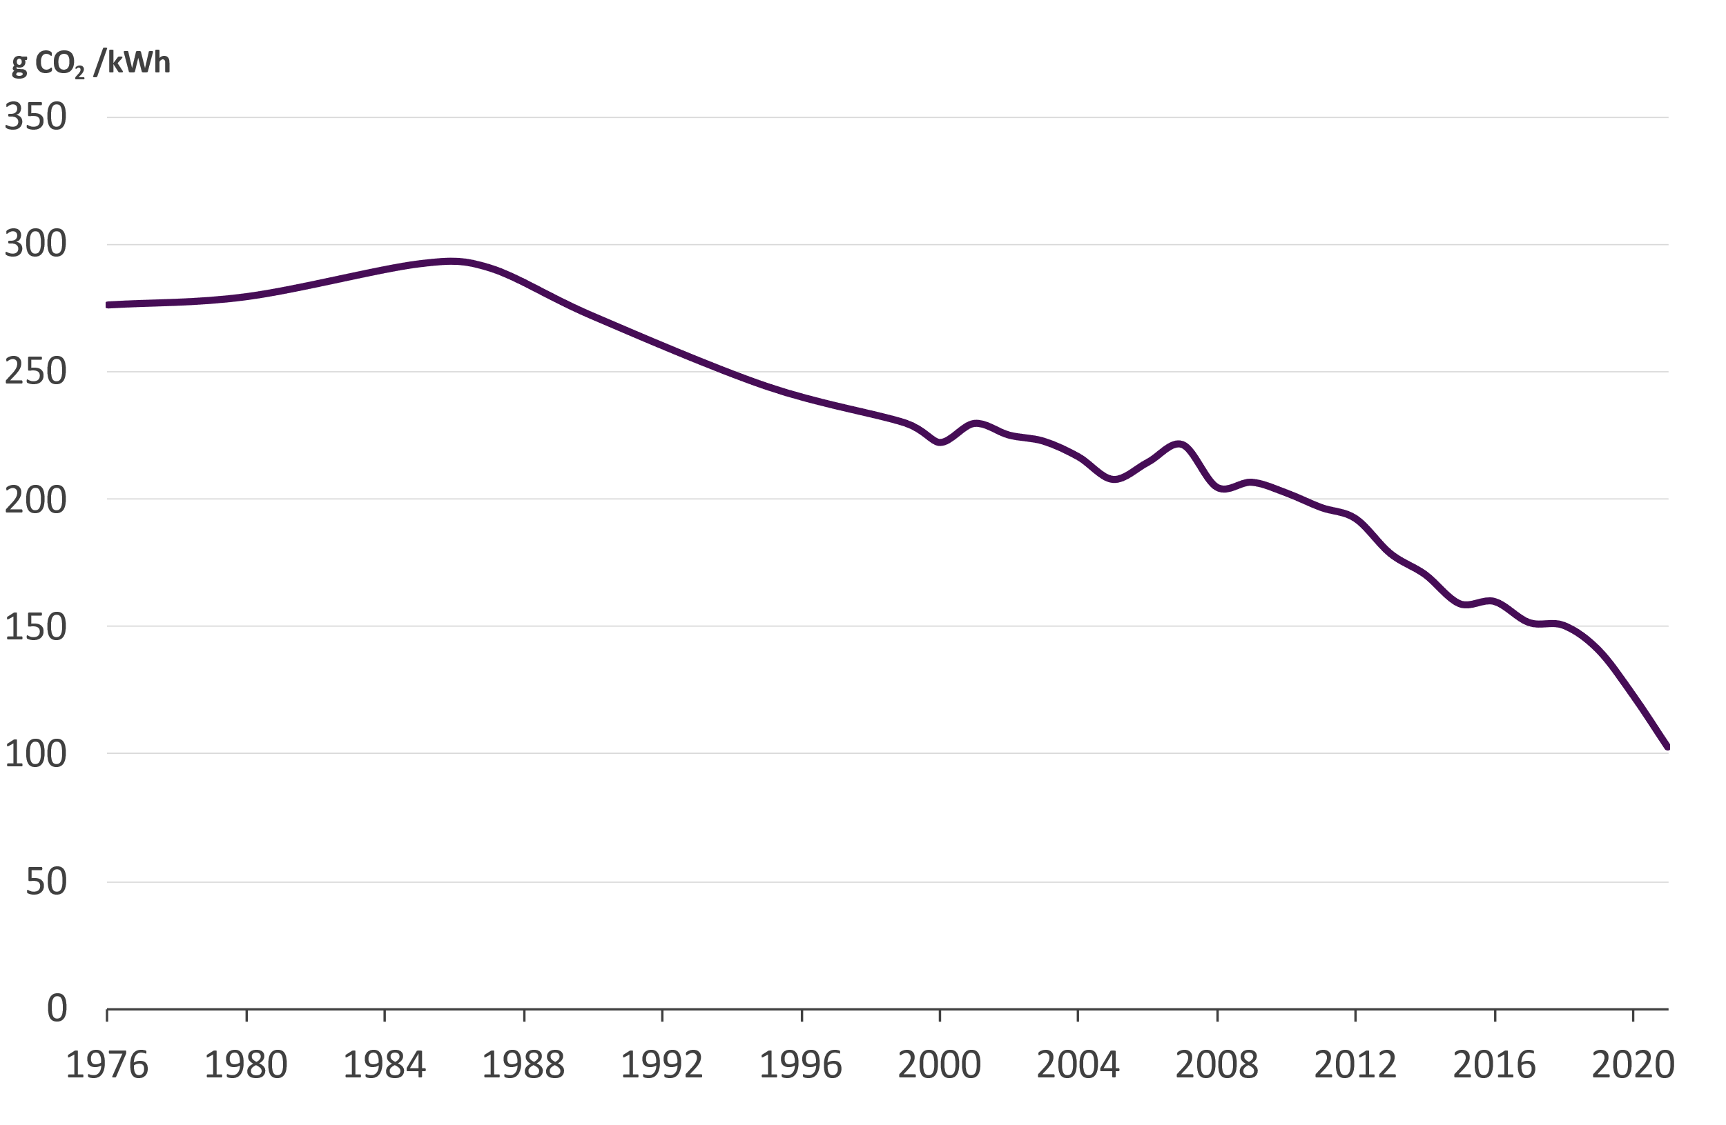
CO₂ -emissions from the district heat supply
Specific emissions from district heat production in 2021 were 102,5 gCO₂/kWh, which
Decreased by 16,6 % from the previous year
Decreased by 48 % during this decade
Fuels used in combined heat and power production were allocated according to the benefit allocation method
Sources:
Tilastokeskus (2000…2019)
Energiateollisuus ry (1976…1999, 2020)

Slide 21
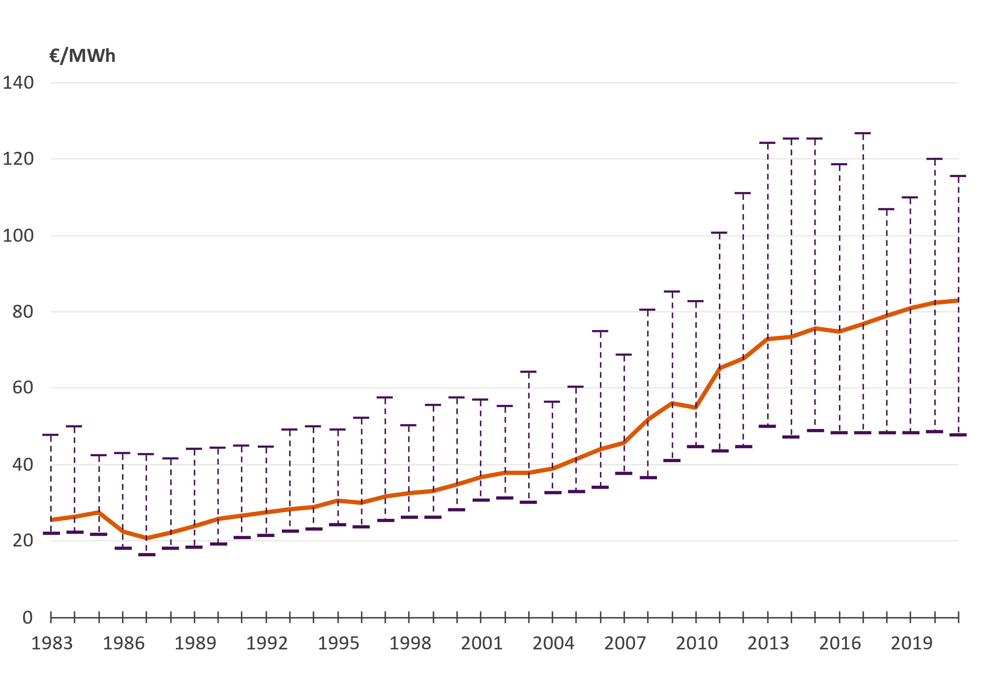
Price of district heat (incl. VAT) Average, minimum and maximum values
The price includes all taxes, demand and energy charges as well as other possible annual charges. Connection fees are excluded.

Slide 22
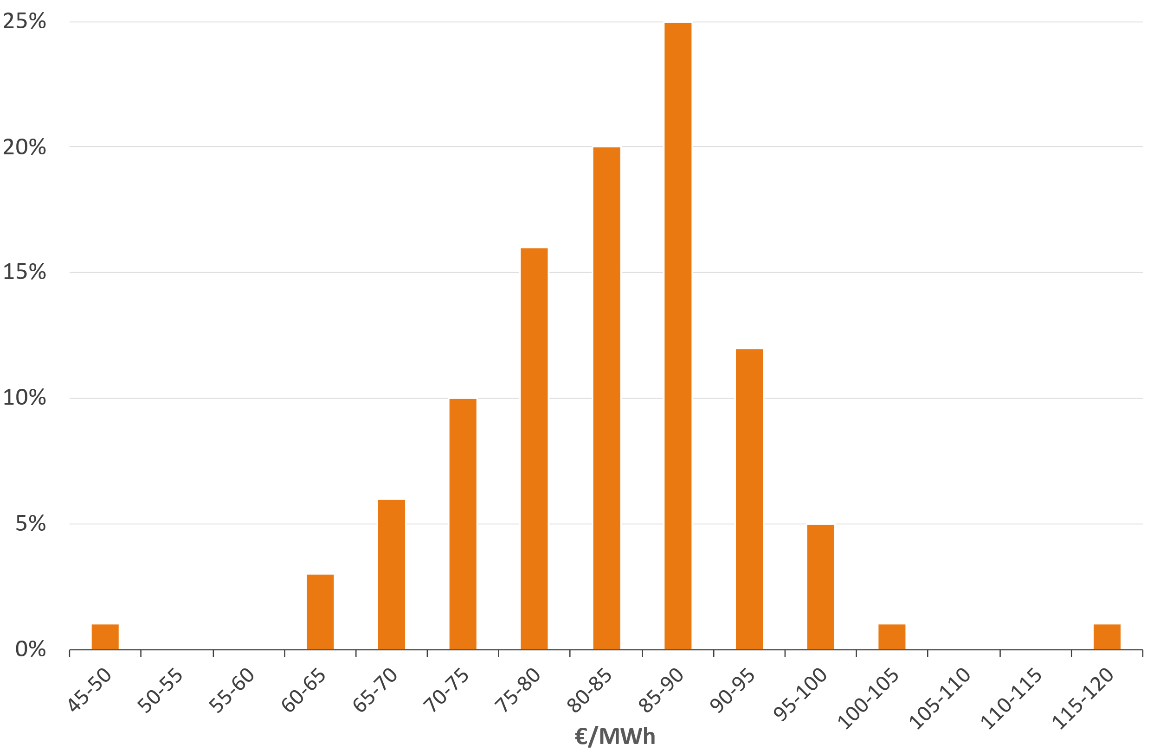
The share of district heating companies according to the average heat sales price in 2021 (incl. VAT)
The price includes all taxes, demand and energy charges as well as other possible annual charges. Connection fees are excluded.
Weighted average price: 82,83 €/MWh
Arithmetical average price: 82,78 €/MWh

Slide 23
Price of district heat in new buildings (€/MWh) Fixed price + energy fee, incl. taxes
The price includes all taxes, demand and energy charges as well as other possible annual charges. Connection fees are excluded.

Slide 24
Real price of district heat Corrected with cost-of-living index
Source: Finnish Energy, District heating prices 07/2021

Slide 25
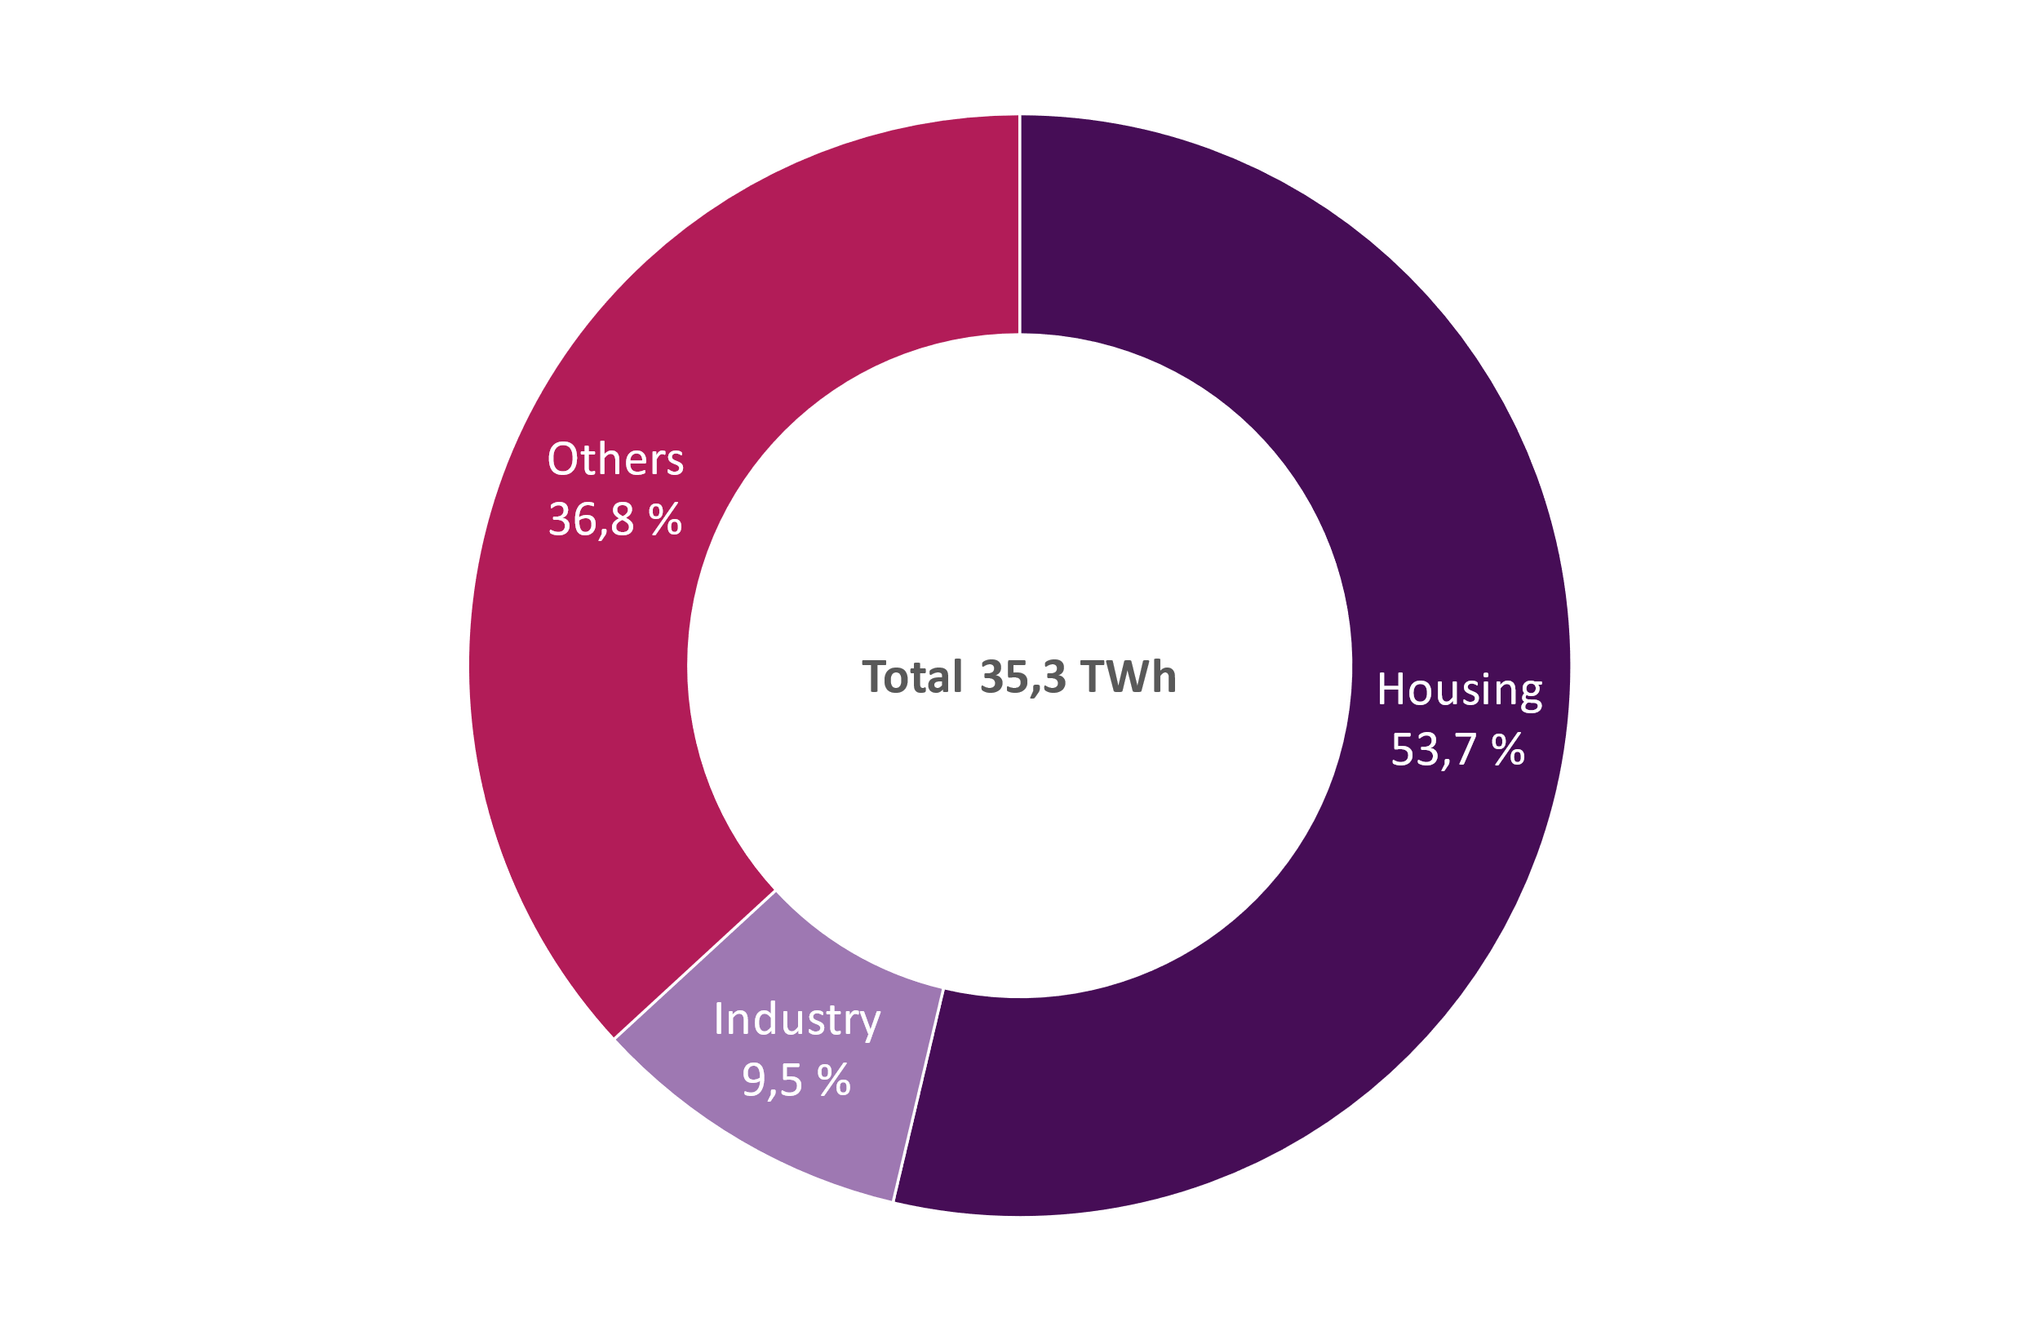
District heat consumption in 2021

Slide 26
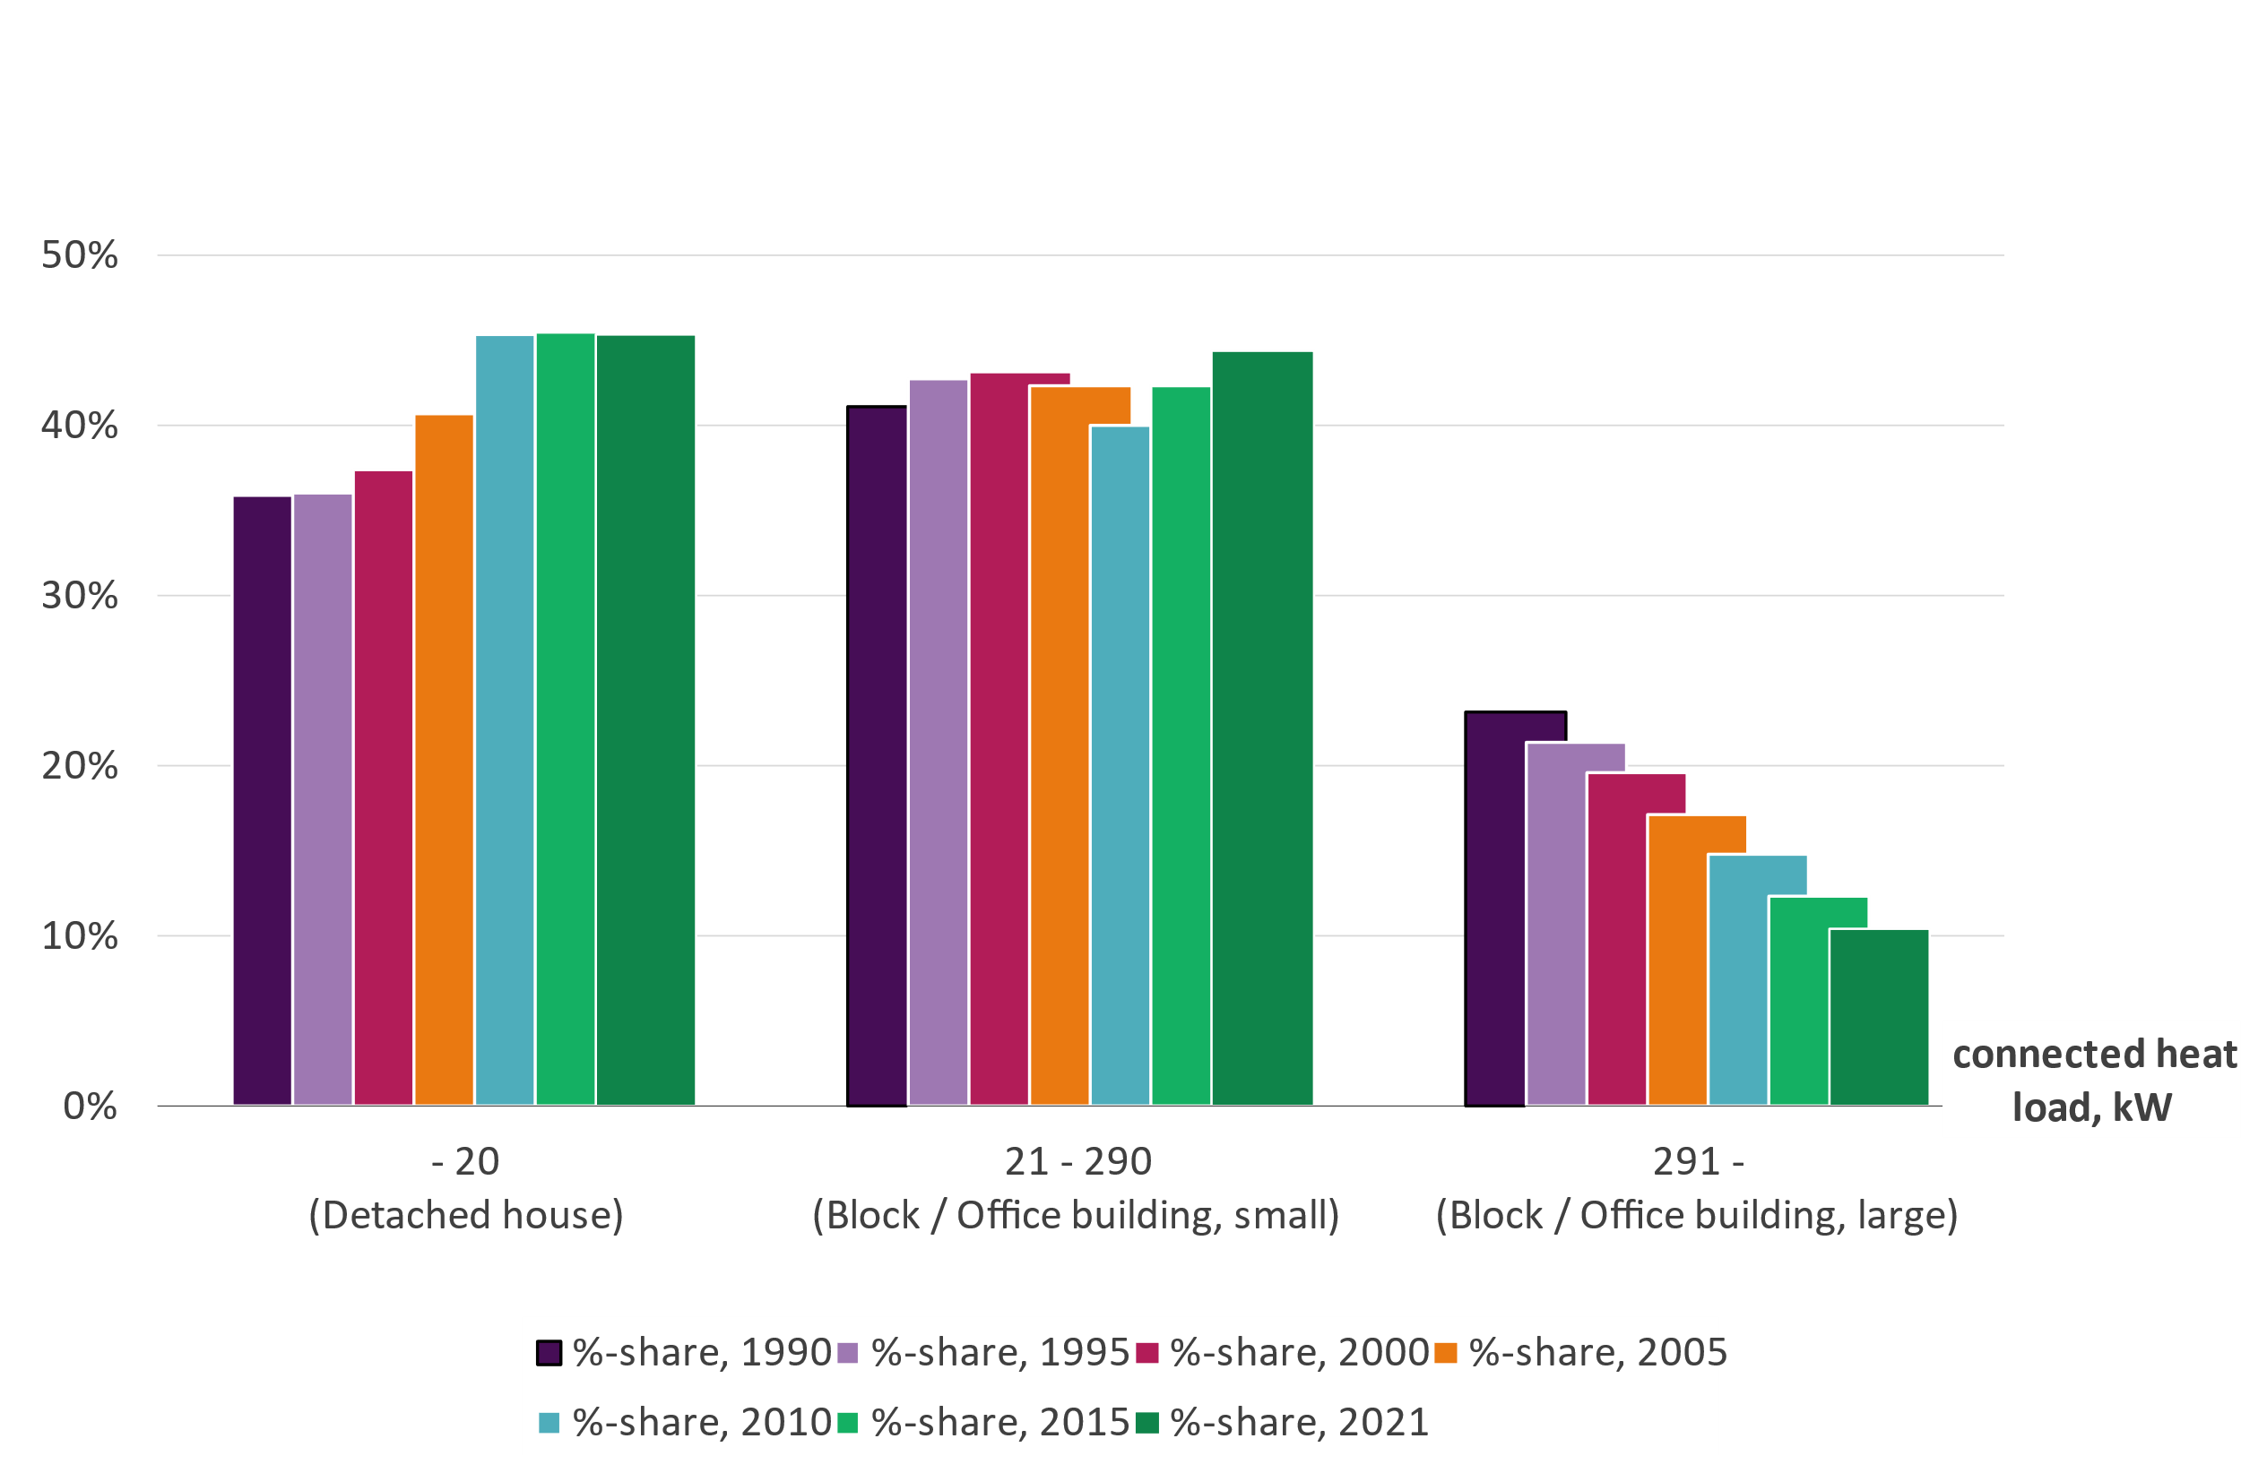
Distribution of customers according to connected heat load
Number of customers: 155 000
115 100 customers in residential buildings
3,0 million inhabitants

Slide 27
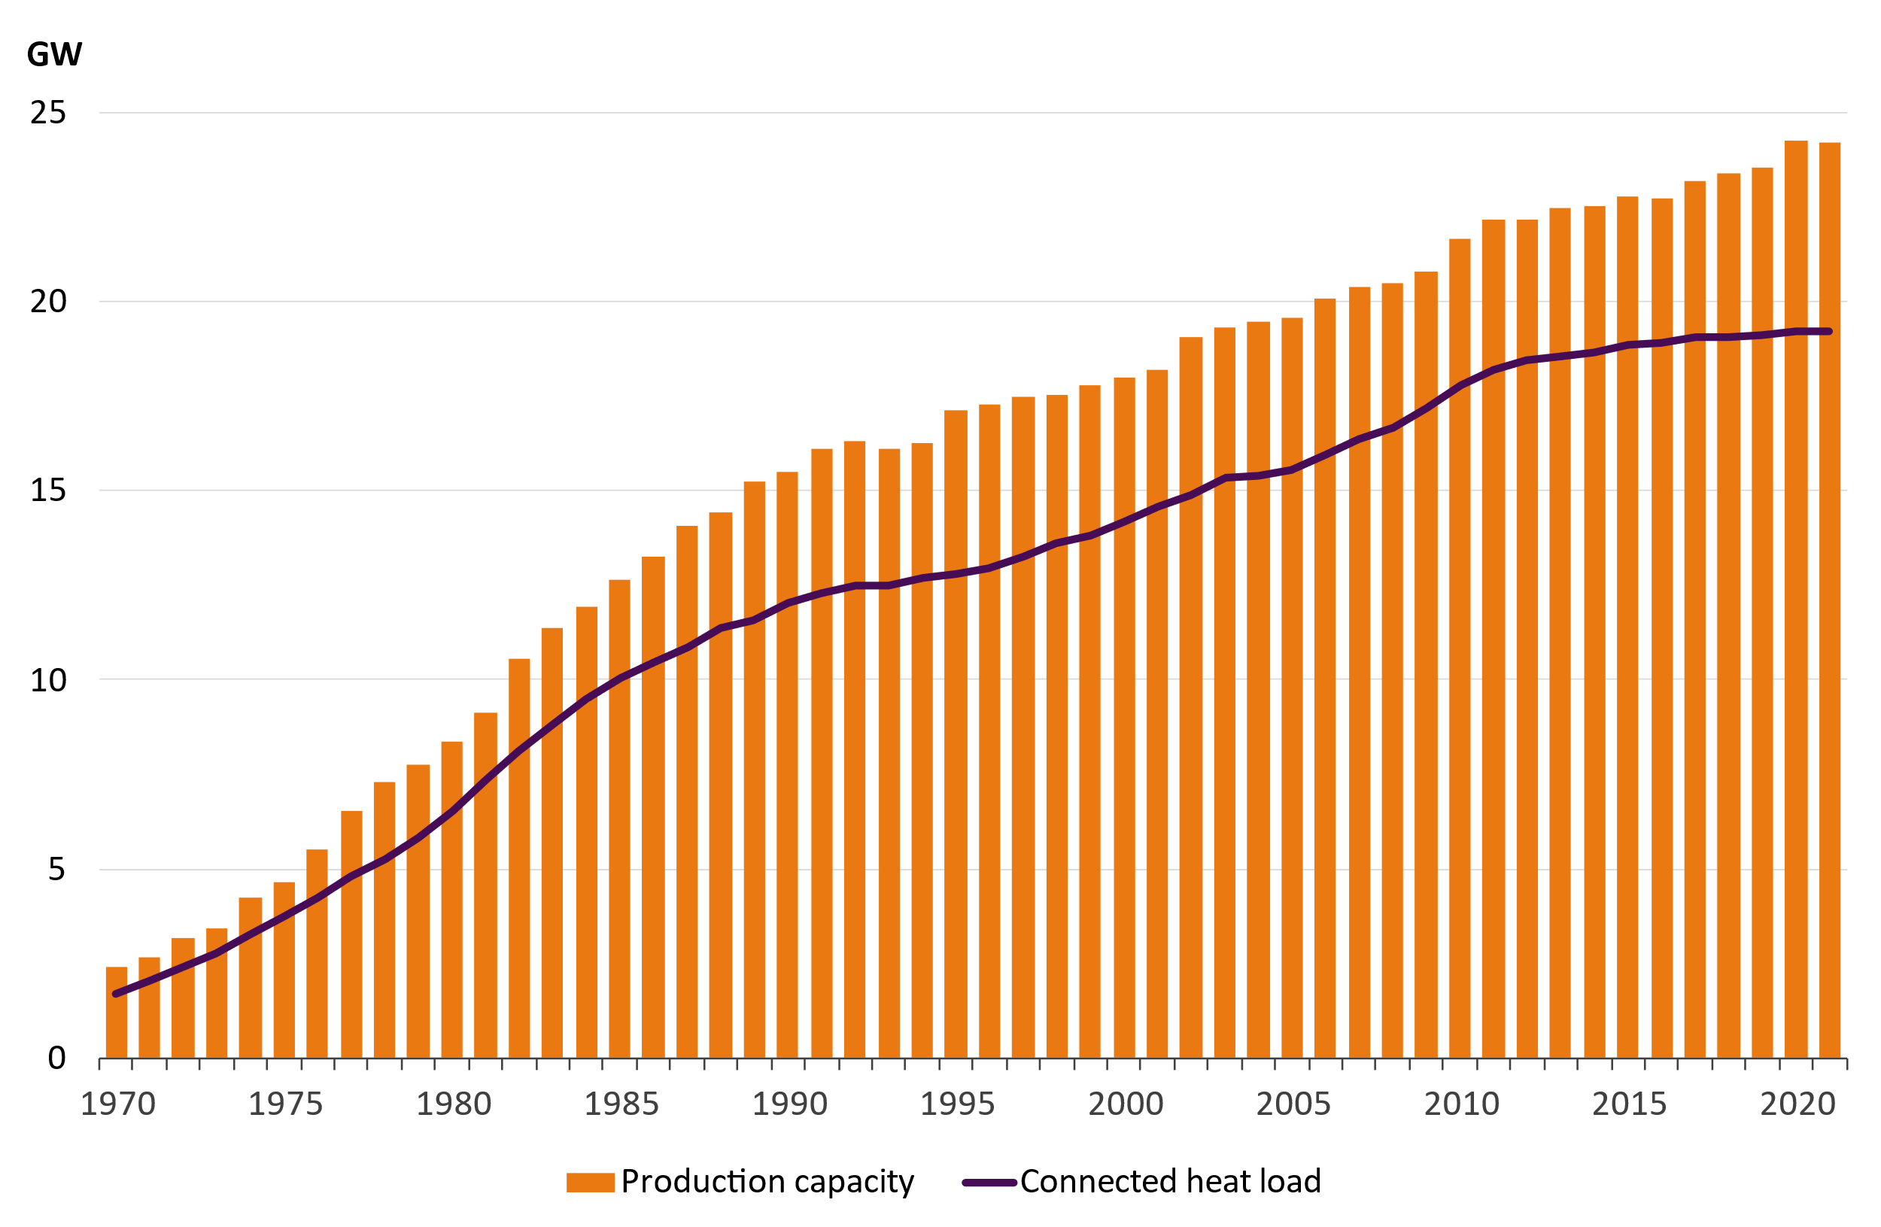
Production capacity and connected heat load of the customers

Slide 28
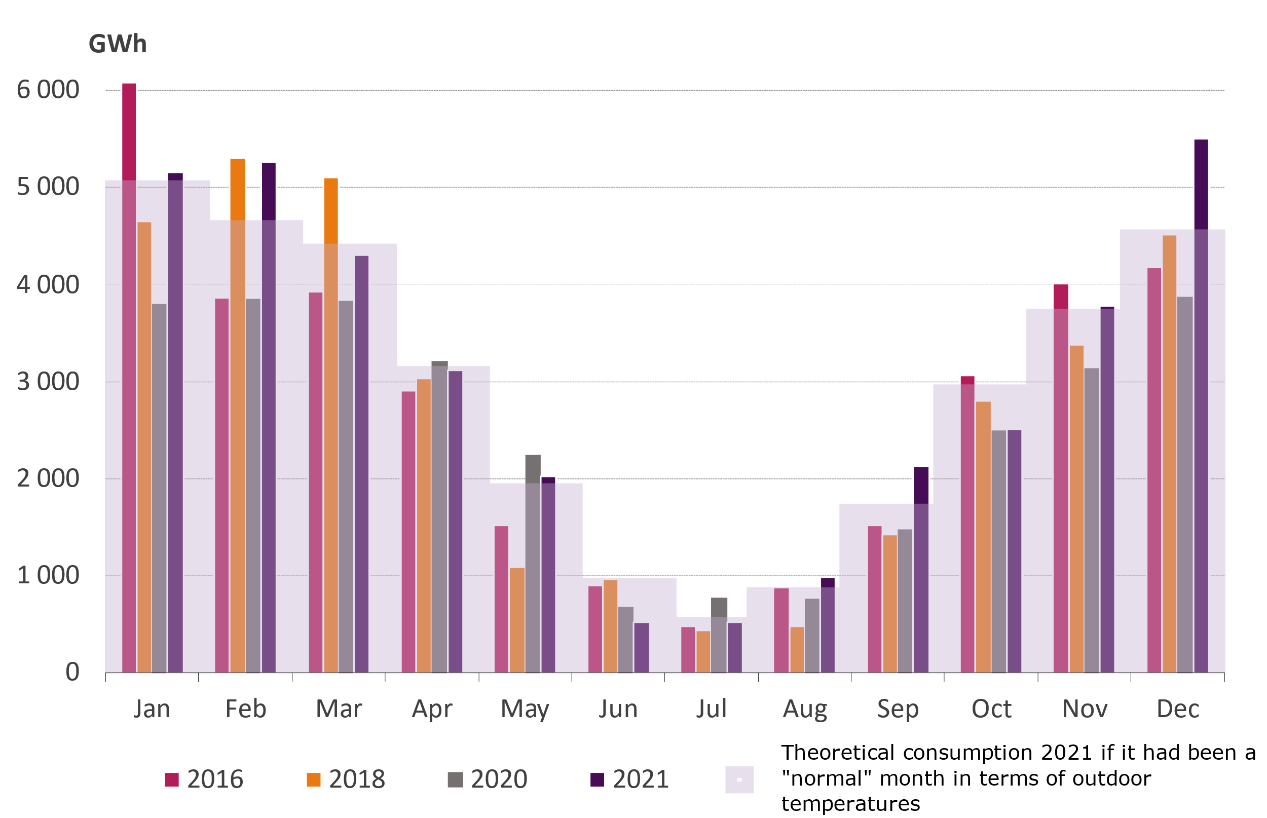
Estimated monthly district heat demand
Year 2021 was 0,5 ºC colder than the normal period of 1981-2010
Only two months, March and October, were warmer than normal months during the heating season.
December was 5 ºC colder than normal
The cold winter months exemplify the need for a wide palette of fuels to ensure the security of supply of heating.

