Slide 1
Energy Year 2018 District Heating
16.1.2019
Finnish Energy

Slide 2
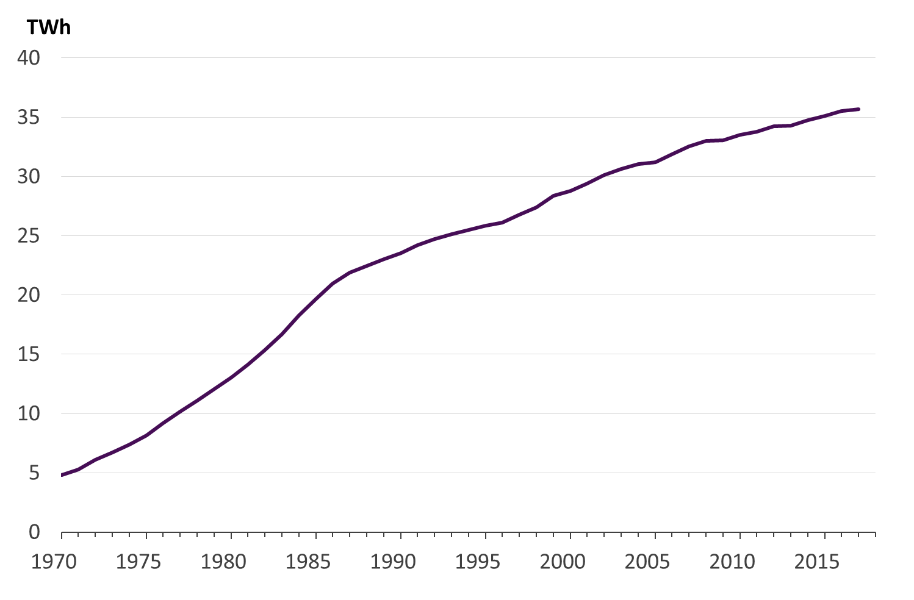
Temperature corrected district heat demand, TWh
District heat consumption 33,7 TWh (year 2018)
Temperature corrected consumption 35,5 TWh which was 0,3 % higher than previous year

Slide 3
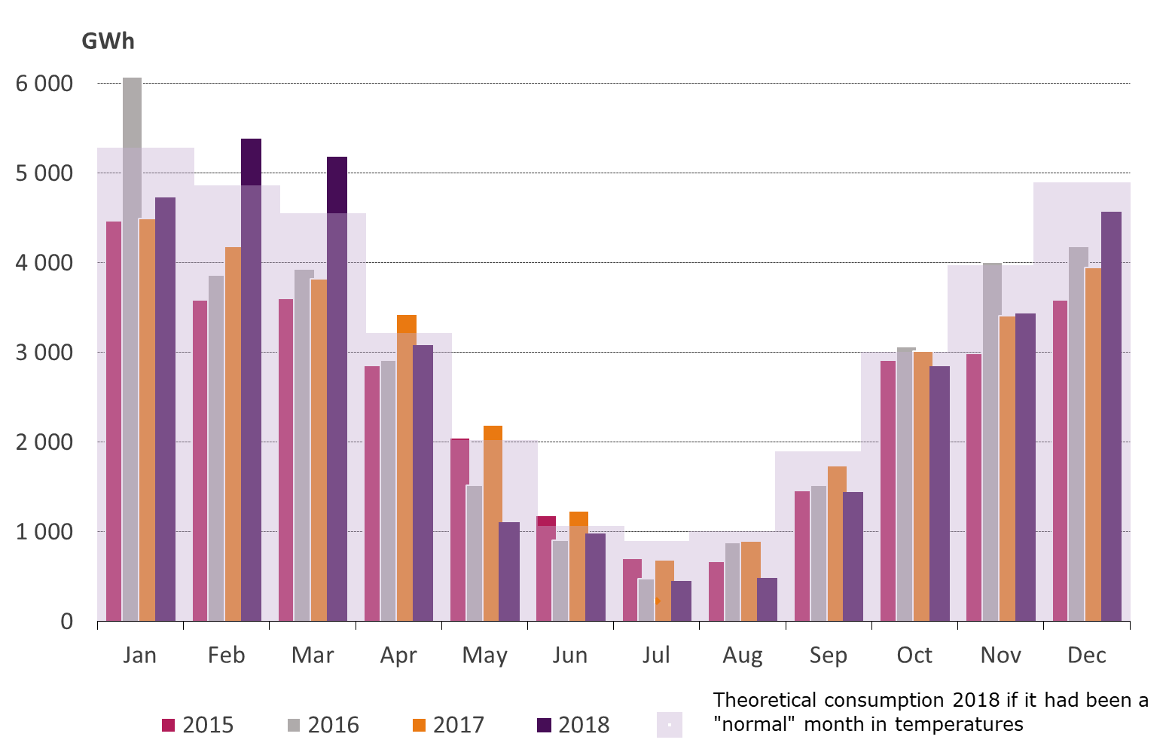
Monthly district heat demand - six times more heat needed in winter months than in summer months
Year 2018 was in average ca. 1 ºC warmer than 1981-2010 normal period
in the heating season only February and March were considerably colder than normal.
The cold winter months exemplify the need for a wide palette of fuels to ensure the security of supply of heating.

Slide 4
Energy sources of district heat

Slide 5
Energy sources for district heat supply 2018
CO₂-neutral 46%
Forest fuelwood, industrial wood residue, other biofuels, recovered heat
Renewable 36%
Forest fuelwood, industrial wood residue, other biofuels
Domestic 64%
Forest fuelwood, industrial wood residue, other biofuels, recycled heat, peat
Delivered heat
37,1 TWh
Recovered (recycled) heat: energy that would otherwise go to waste
Other biofuels: includes also the bio share of municipal waste
Other: non-bio share of municipal waste, plastic or hazardous waste, electricity.

Slide 6
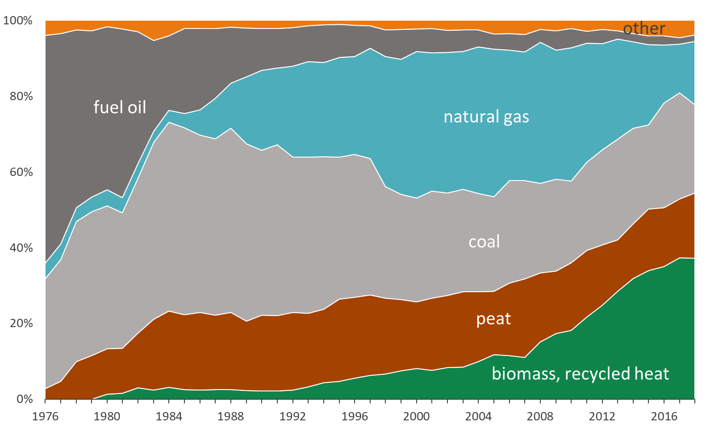
Fuels for district heat and cogeneration
Fossil fuels have increasingly been replaced by biomass. Use of biomass has doubled during last decade.
Recycled heat can be likened with renewable energy while fuel consumption is avoided by making use of surplus heat.

Slide 7
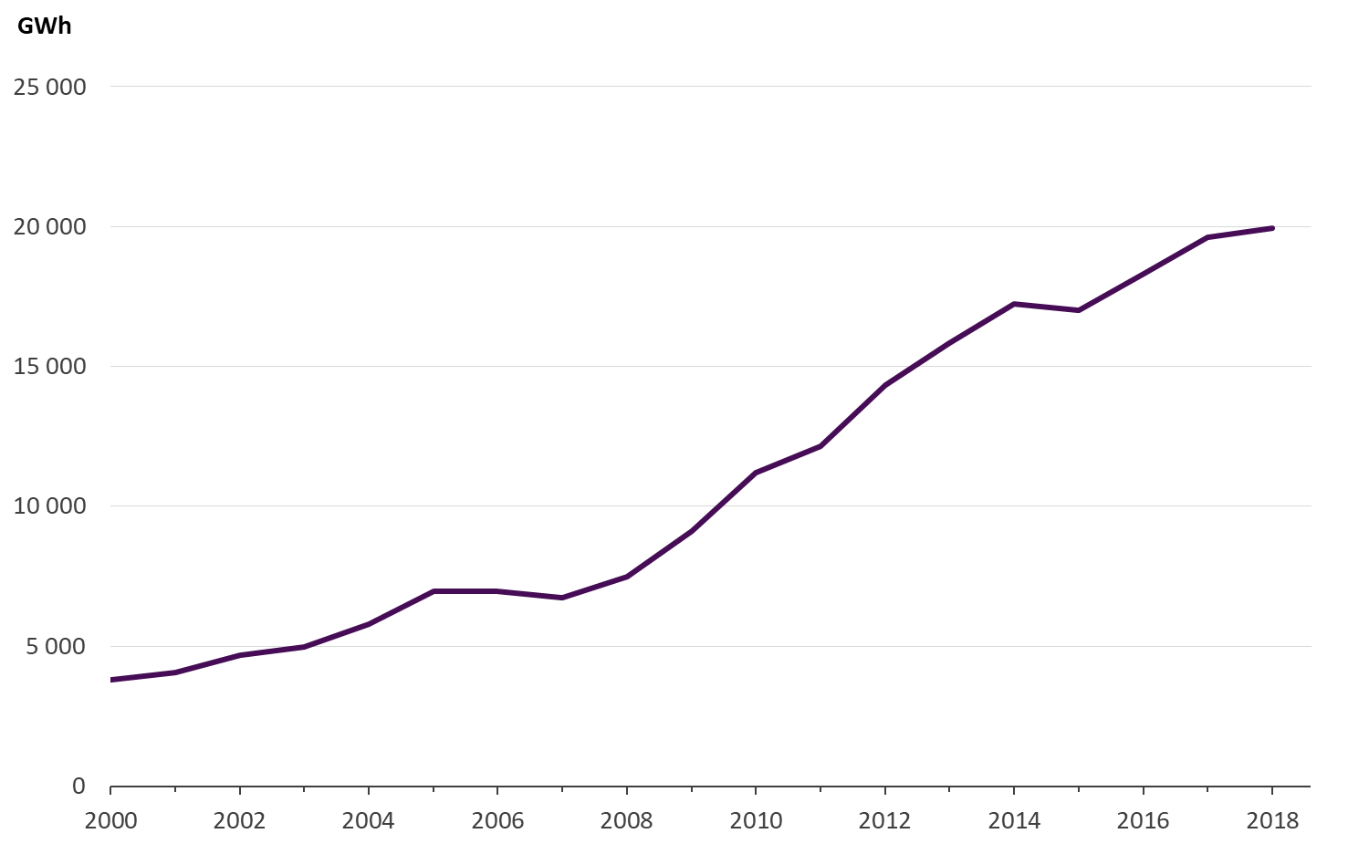
Renewable fuels in the production of district heat and cogeneration
In municipalities where district heating is provided
70 per cent of heat comes from renewable fuels or waste heat
90 per cent of heat comes from domestic energy sources.
Renewable fuels used in producing district heat are e.g. forest fuelwood, industrial wood residue, bio share of municipal waste, biogas, biofuel oil.

Slide 8
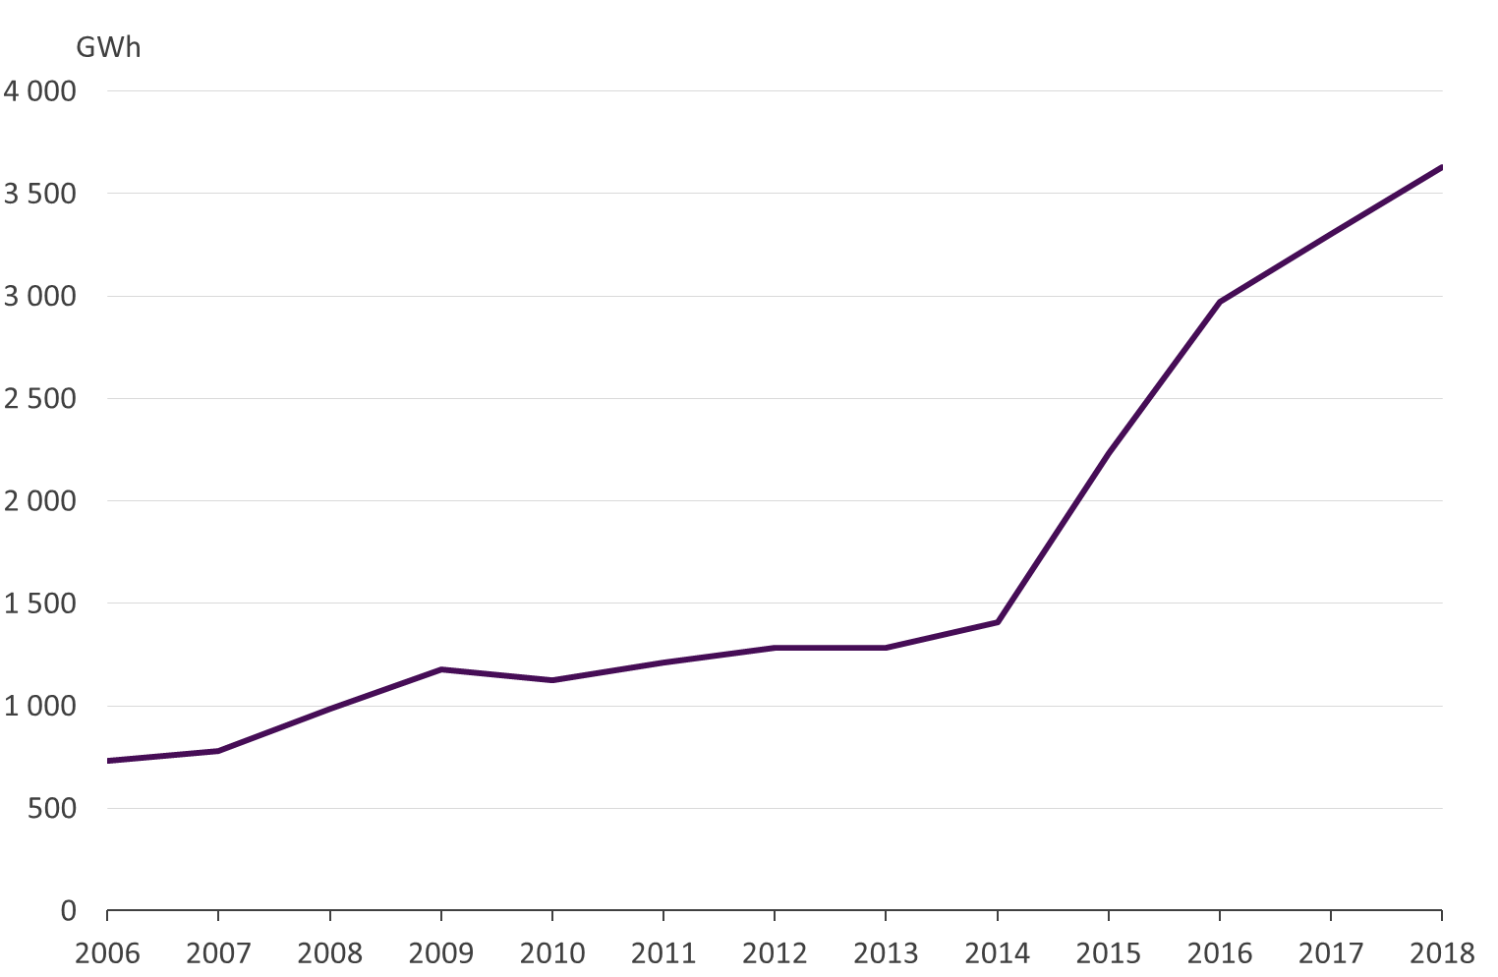
Recycled heat in district heating
Fuel consumption can be avoided by making use of surplus heat. Heat can be recovered from data centres, industrial processes, flue gases, sewage water etc.
The amount of recycled heat has more than trebled at 2010’s.

Slide 9
CO₂ emissions

Slide 10
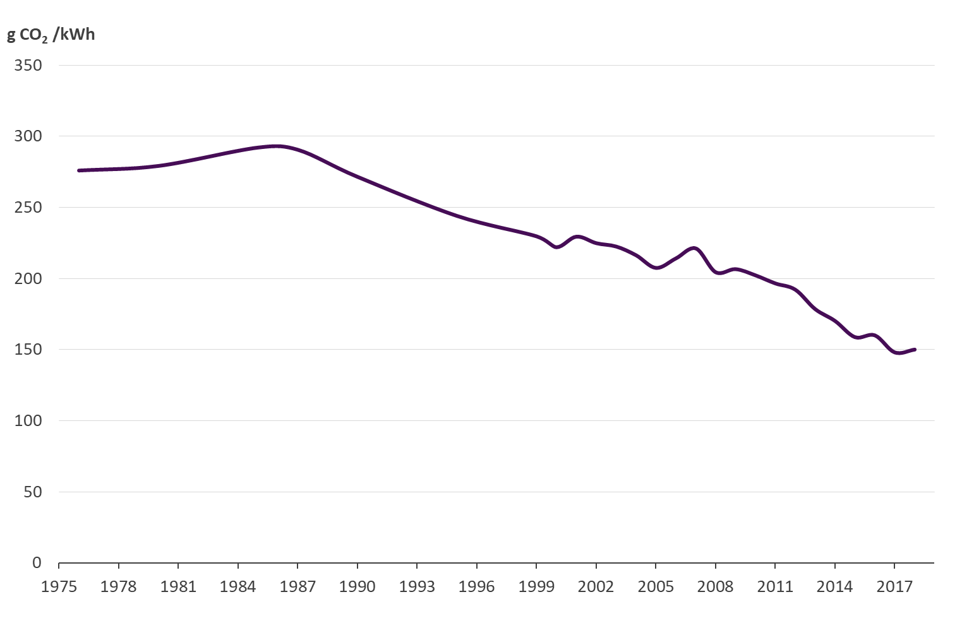
CO₂-emissions from district heat production
Carbon emissions from district heat production have fallen by 26% during this decade.
The emissions amounted to 150 grams per kilowatt hour year 2018.
Sources:
Statistics Finland (2000...2016)
Finnish Energy (1976...1999, 2017…2018)

Slide 11
Market share of space heating

Slide 12
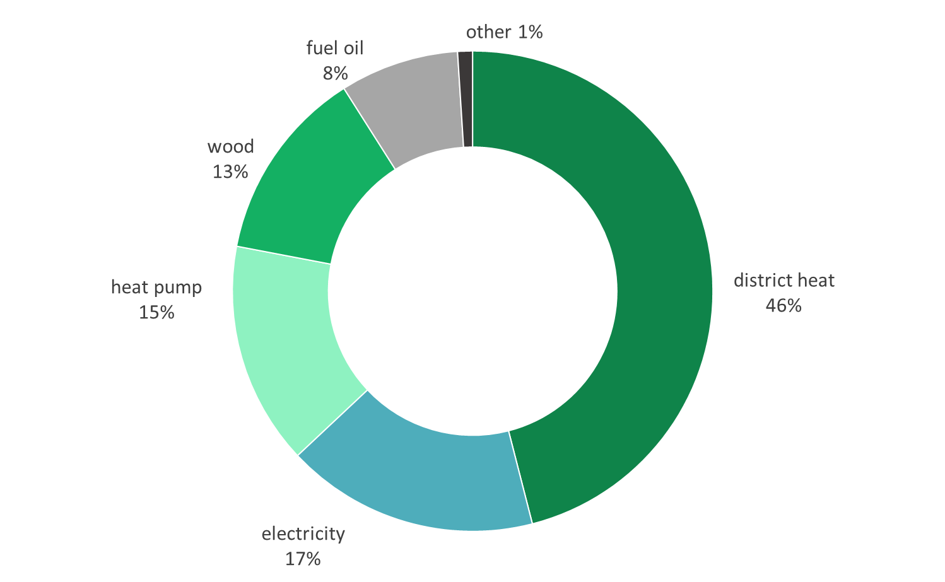
Market share of space heating
Heat pump: includes the electricity
consumption of heat pumps
Electricity: includes the electricity
consumption of heat distribution
equipment and electric sauna stoves
Wood: includes the wood used by
sauna stoves
Source: Statistics Finland

Slide 13
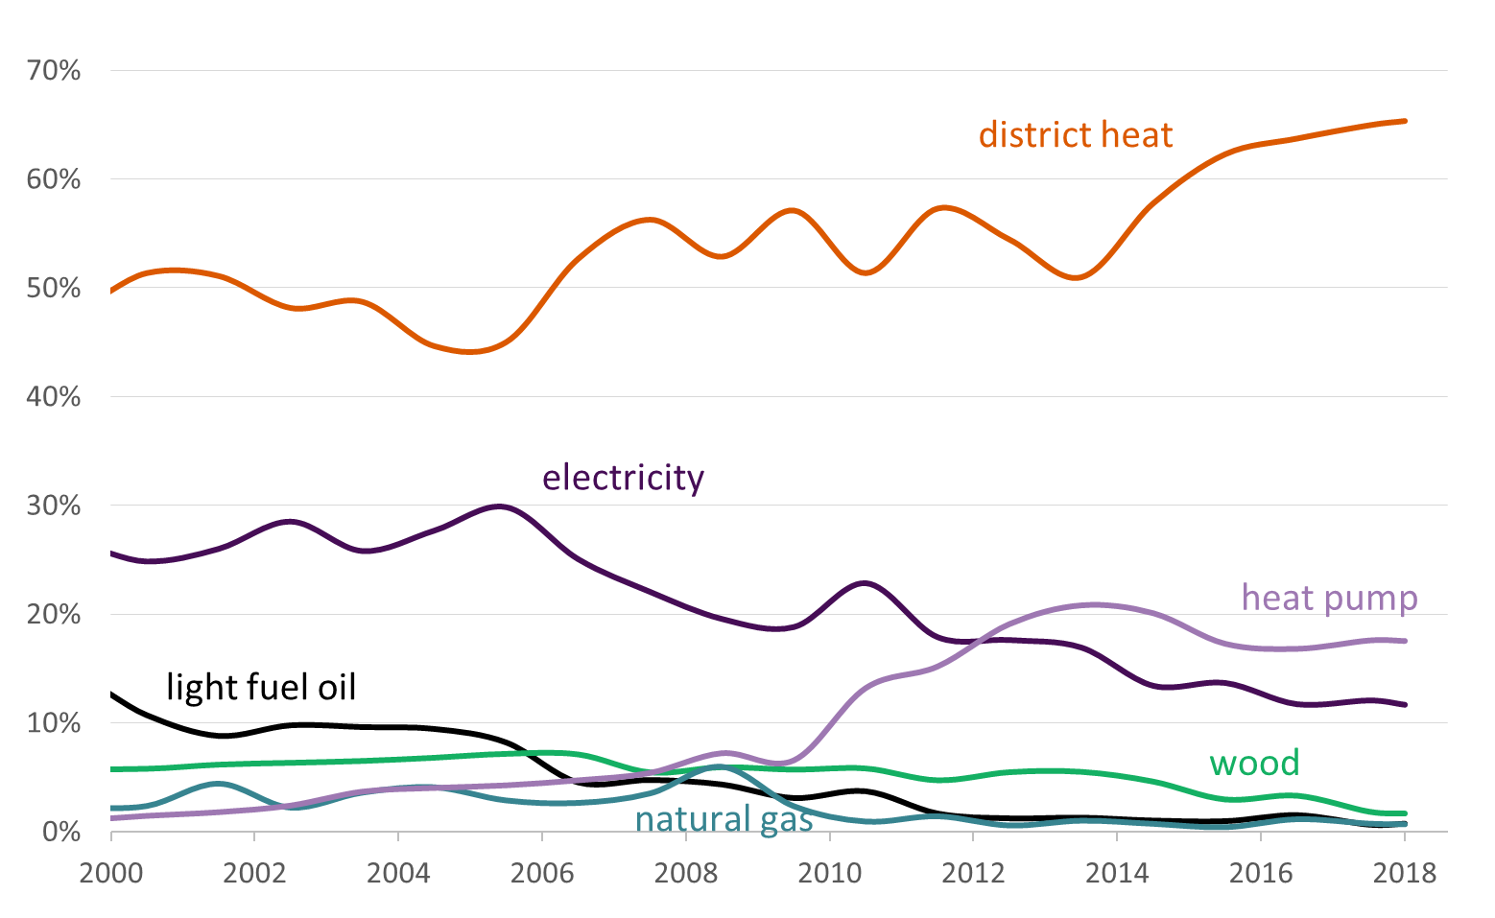
Market shares in new buildings
District heating is the most popular method of heating in new buildings.
Source: Statistics Finland, Granted building permits (heated cubic volume)

Slide 14
District cooling

Slide 15
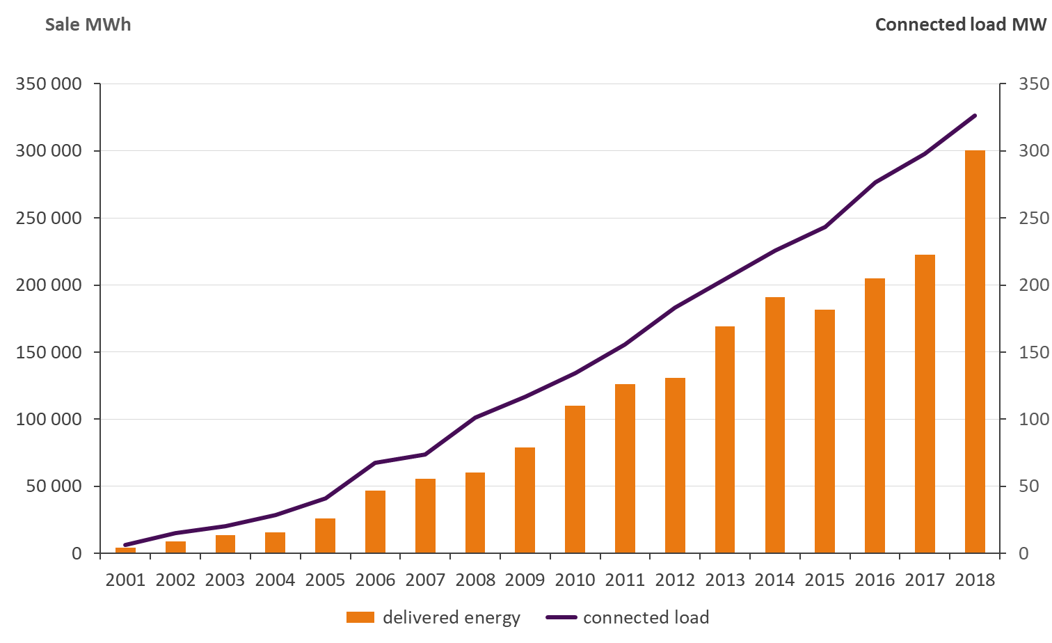
District cooling: delivered energy and connected load
Energy companies which sold district cooling 2018
Etelä-Savon Energia Oy
Fortum Power and Heat Oy
Helen Oy
Jyväskylän Energia Oy
Kuopion Energia Oy
Lahti Energia Oy
Lempäälän Lämpö Oy
Pori Energia Oy
Tampereen Sähkölaitos Oy
Turku Energia Oy
Vierumäen Infra Oy

Slide 16
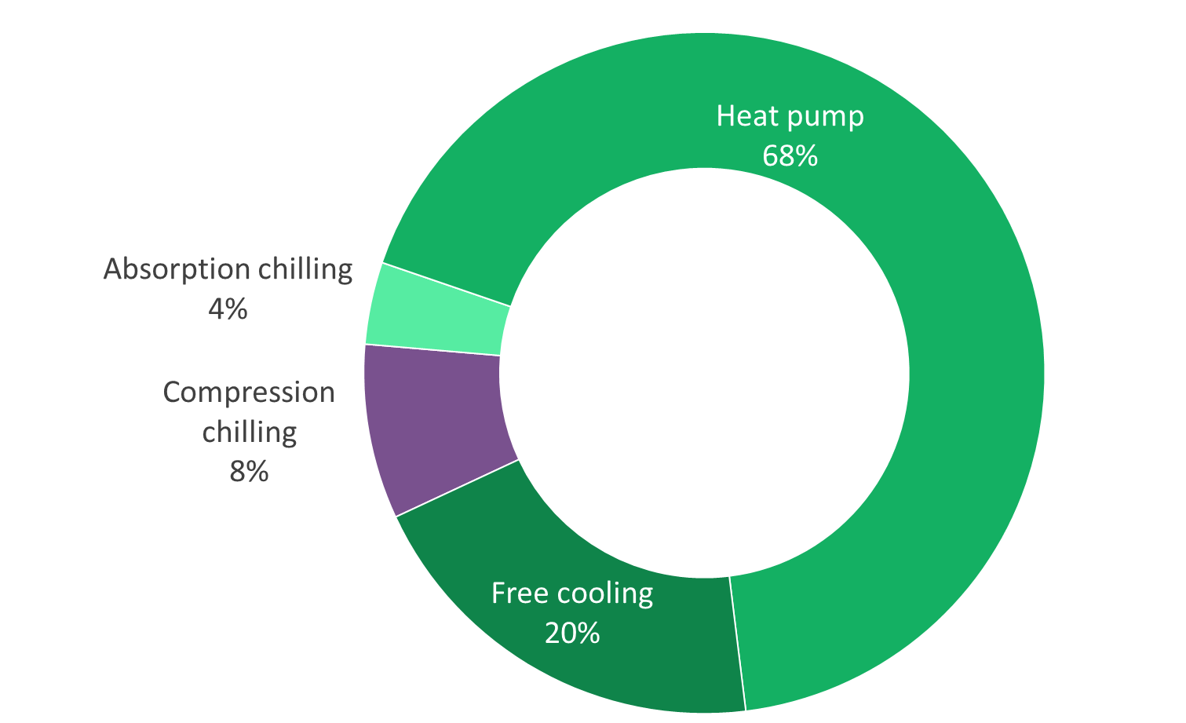
District cooling production 2018
More than 90% of district cooling energy is produced from energy sources that would otherwise be unutilized.
Same heat pumps often produce both heat and cooling energy
the cooling water is cooled and the district heating water is warmed up in the same process.
District cooling also utilizes the ambient energy from sea, lakes and rivers as well as outdoor air whenever the temperature is low enough.
301 GWh

