Slide 1
District heating in Finland 2022

Slide 2
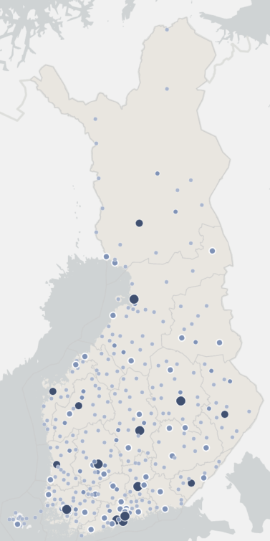
Statistics 2022
District heating networks in Finland
~33 TWh
Annual energy sold
~2,9 million people
live in district-heated houses
~16 200 km
District heating networks
~9,1 cent/kWh
the average price incl. taxes
~46 % market share
~3 mrd EUR the value of sold heat,
incl. taxes

Slide 3
Unusual year 2022
The year 2022 was unusual in Finnish energy system due to the Russia–Ukraine war and the end of Russian fuel imports. In 2022, natural gas was used less in district heat production than in previous years. Natural gas was replaced especially by oil and coal.
Previously, natural gas was almost entirely imported from Russia. Its imports from Russia ended in May 2022.
Imports of electricity, wood and other fuels for energy production from Russia also ended during 2022, which was reflected in the prices of fuels and district heat. The year 2022 was warmer than the previous year, which reduced the consumption and production of district heat.

Slide 4
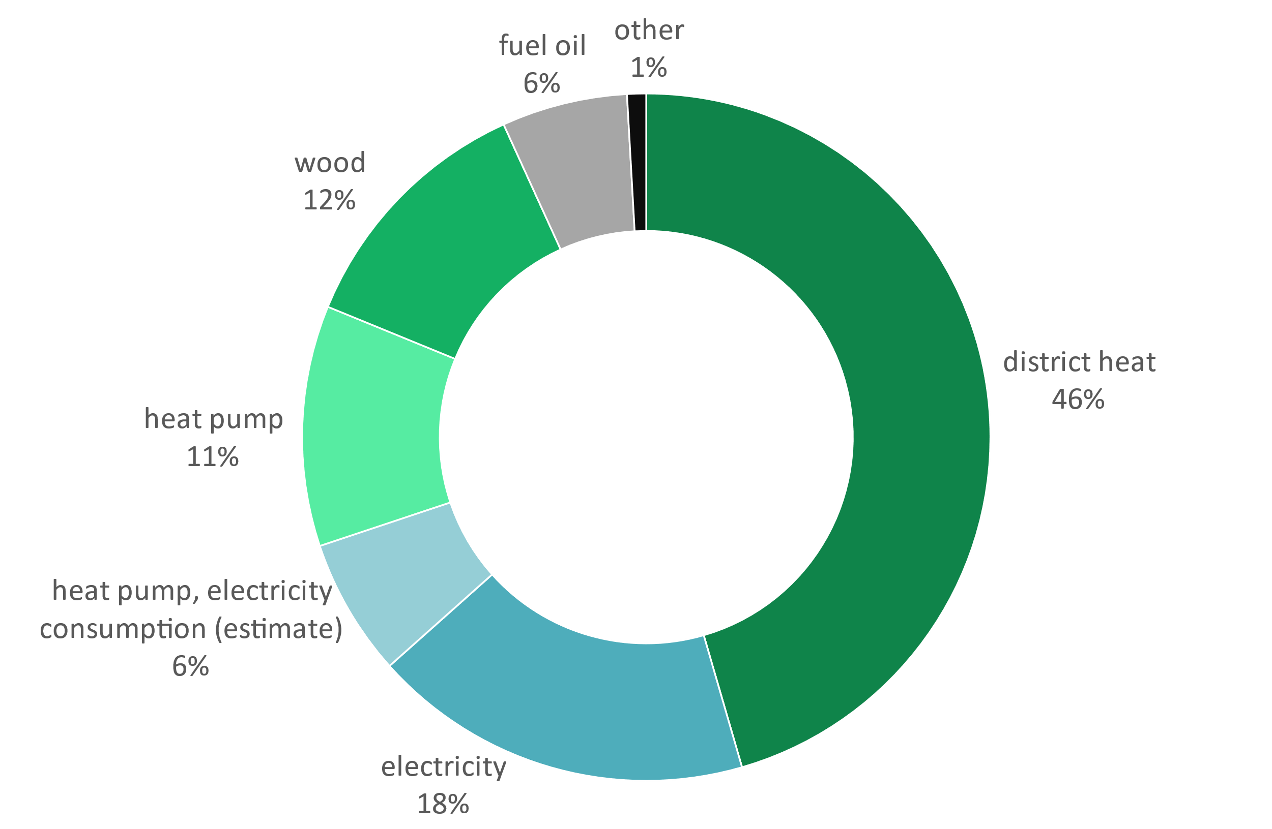
Market share of space heating in 2021 (Statistics Finland)
Includes residential, commercial and public buildings

Slide 5
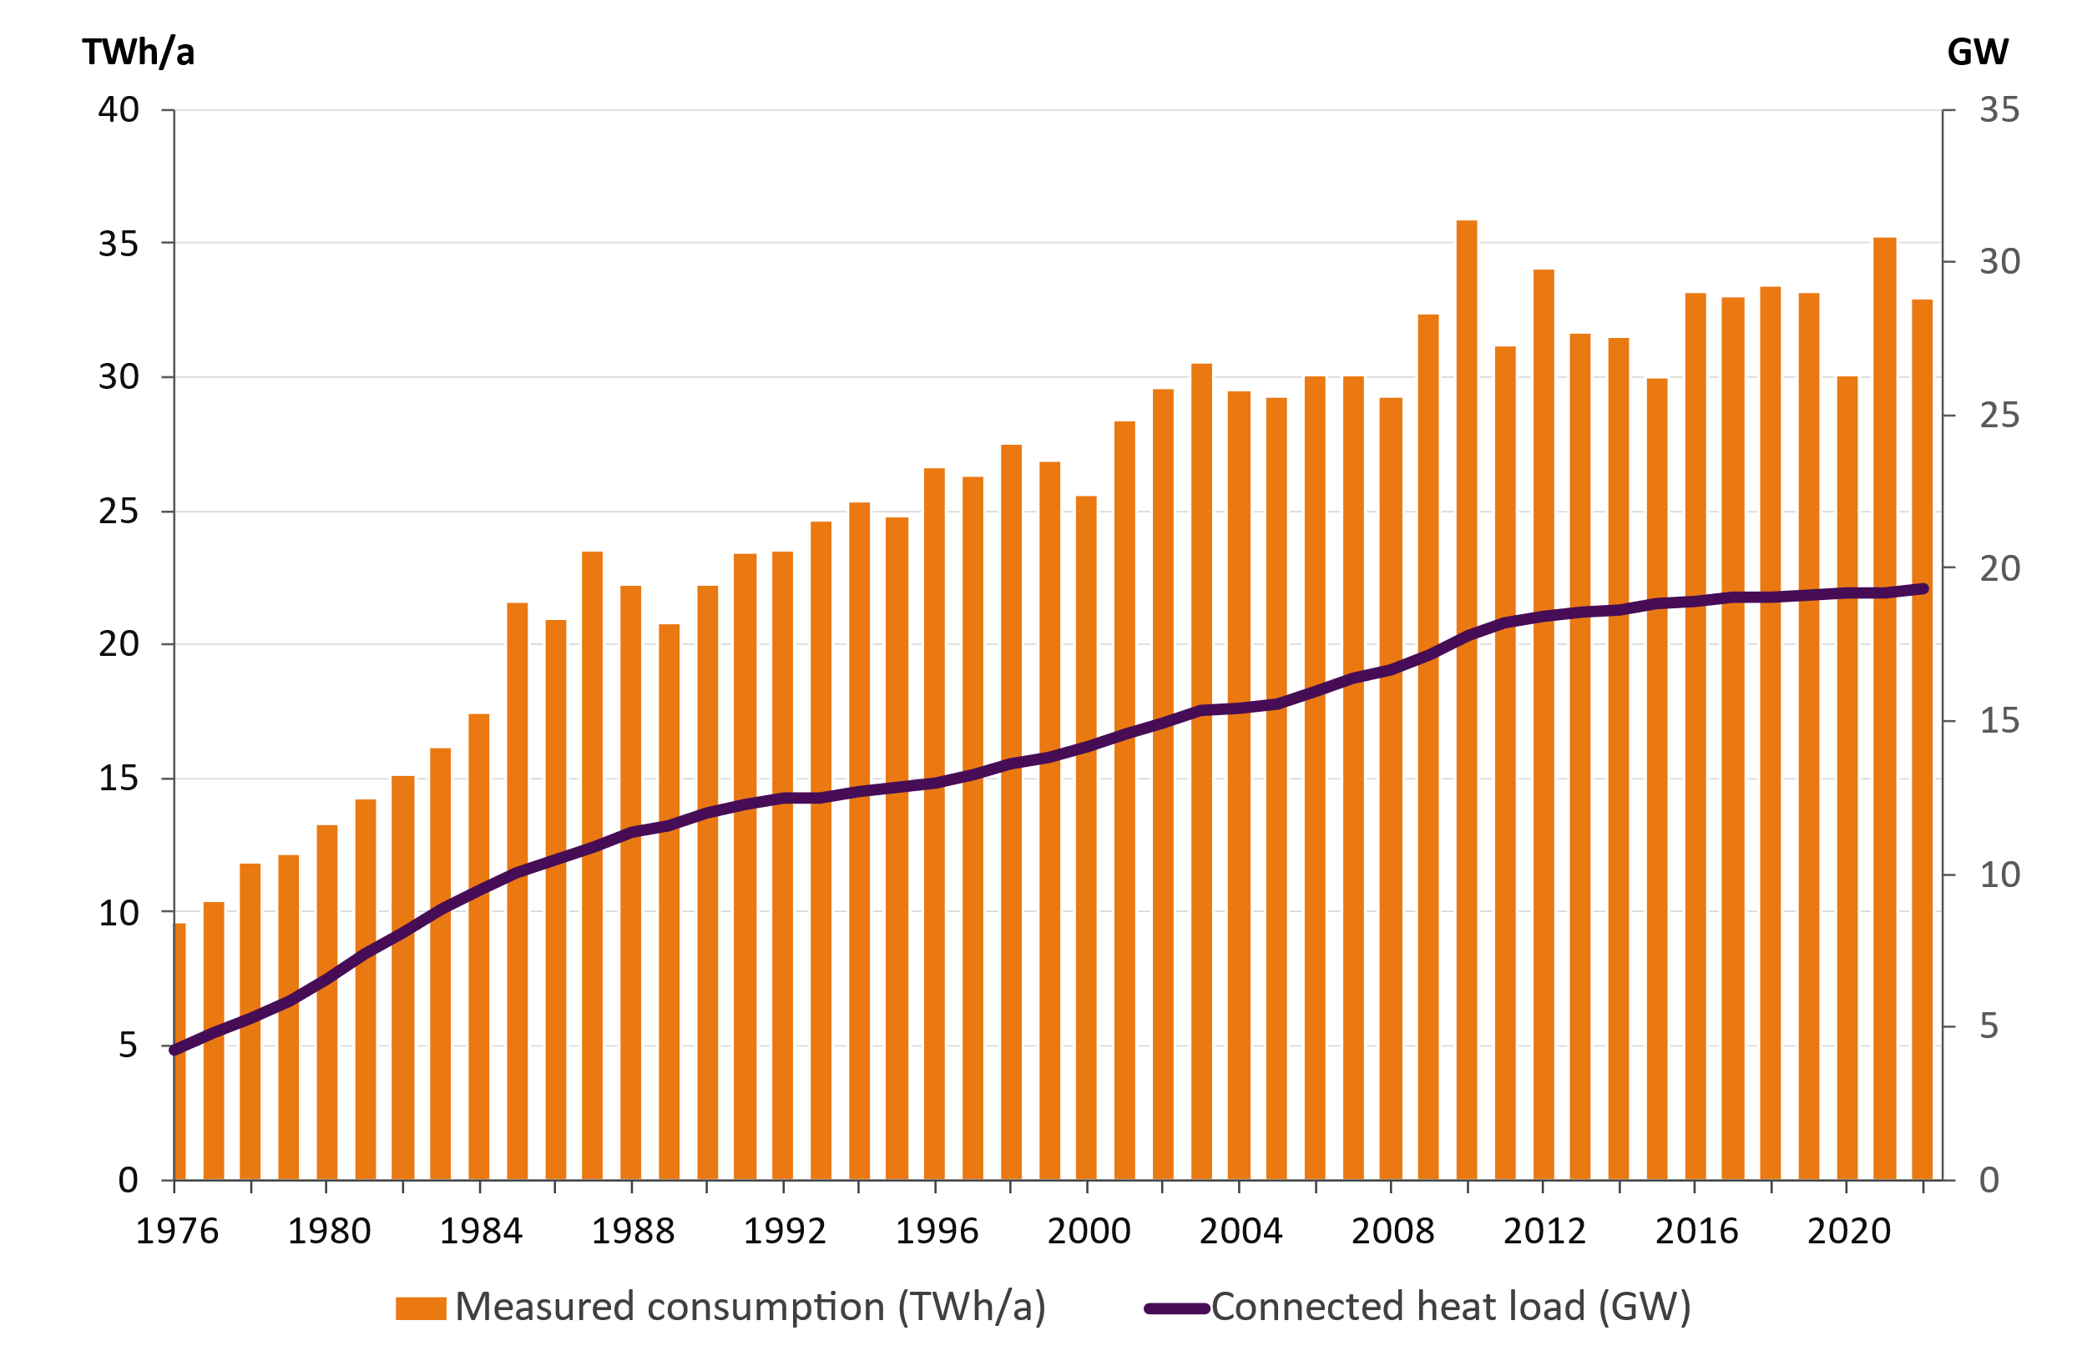
District heat consumption and connected heat load of the customers

Slide 6
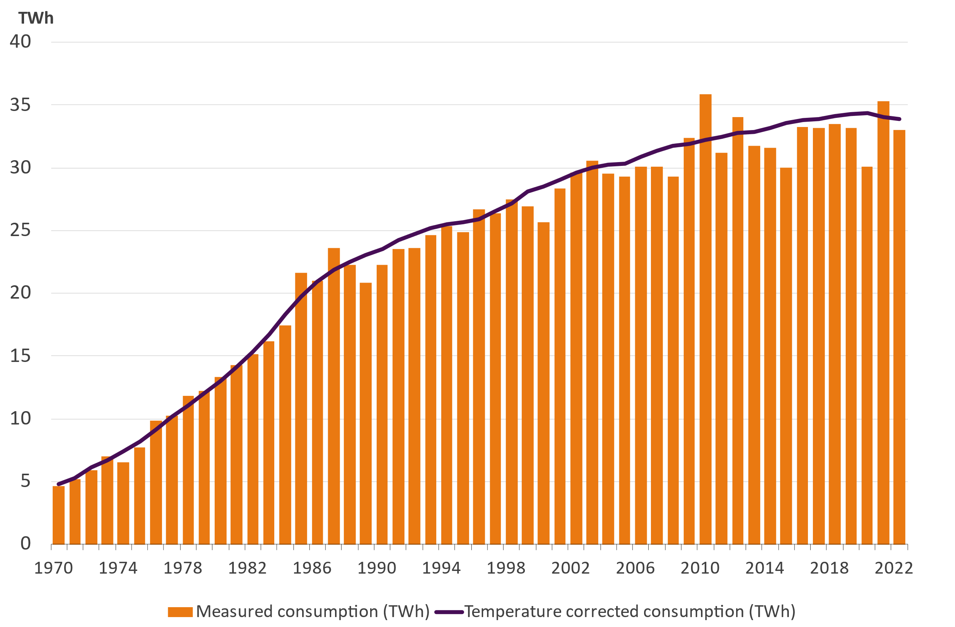
Temperature corrected heat consumption
District heat consumption 33,0 TWh (year 2022)
Temperature corrected heat consumption 33,9 TWh
Temperature corrected heat consumption decreased 0,6 %

Slide 7
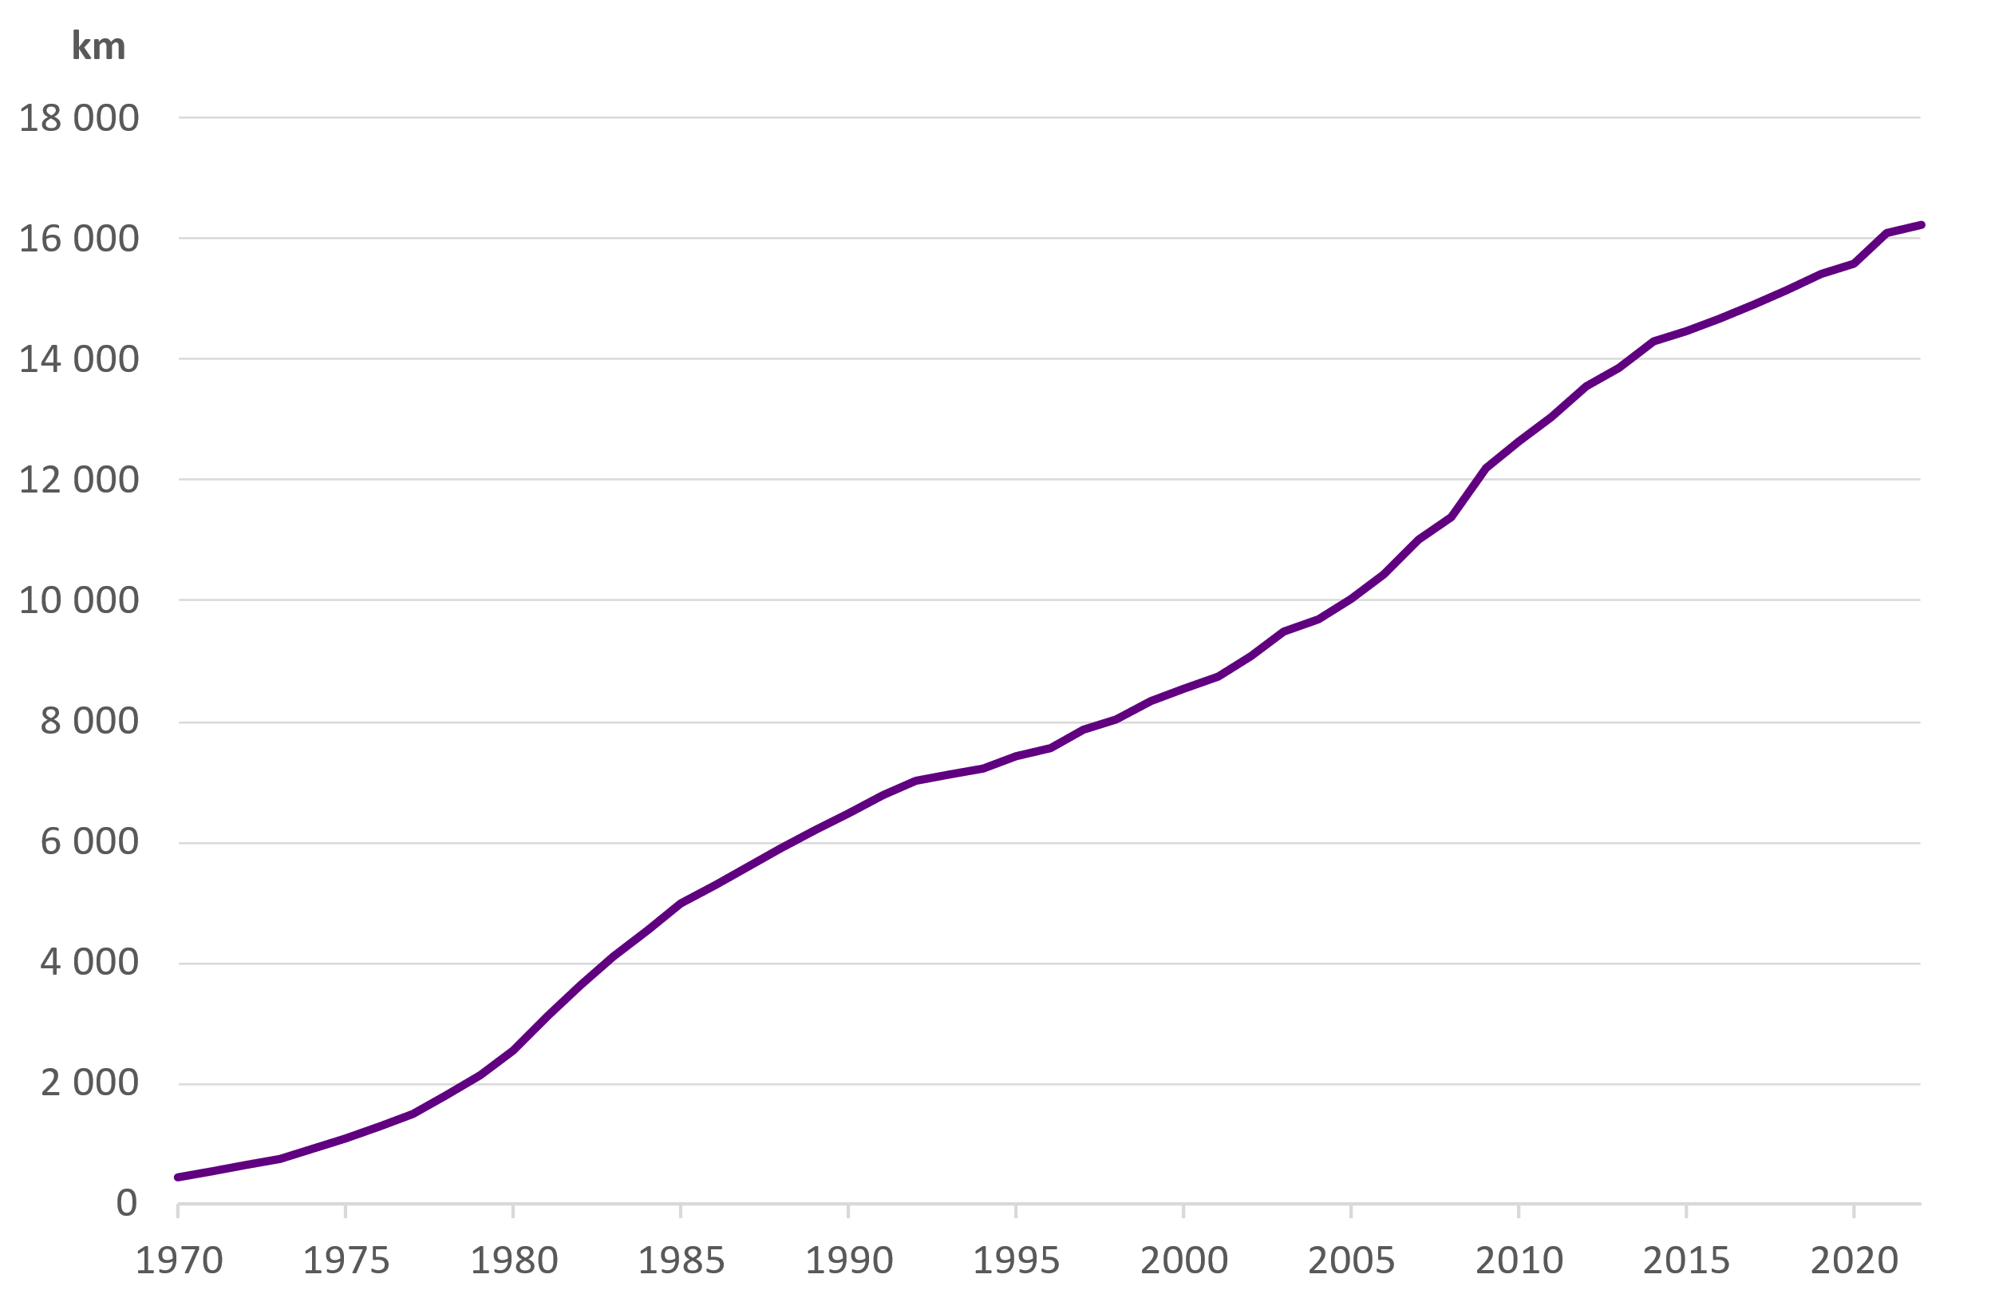
Length of networks

Slide 8
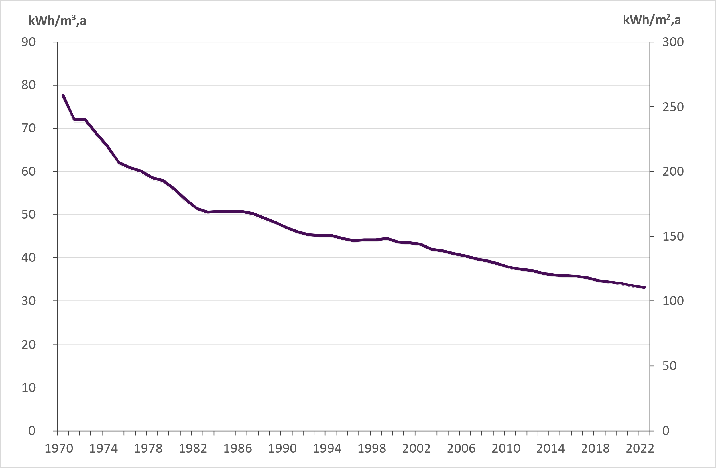
Specific heat consumption in district heated buildings
Includes energy for heating hot tap water

Slide 9
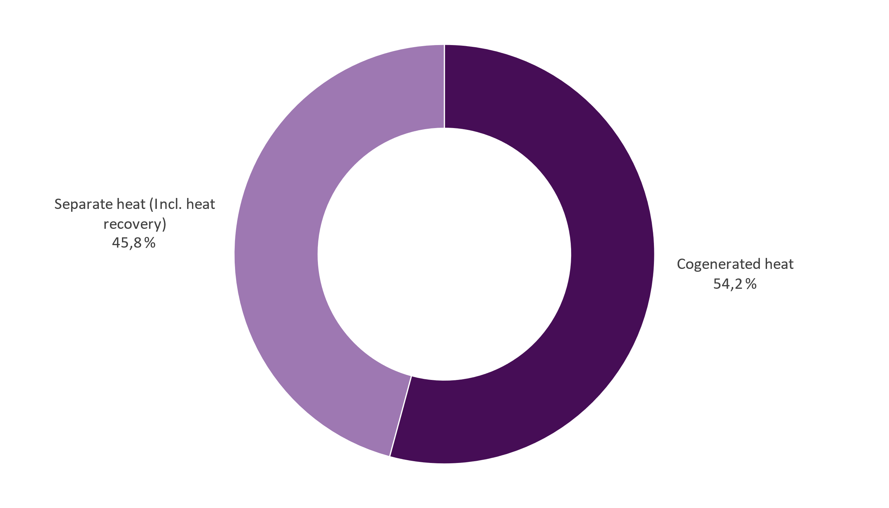
District heat supply 2022 Total 33,0 TWh

Slide 10
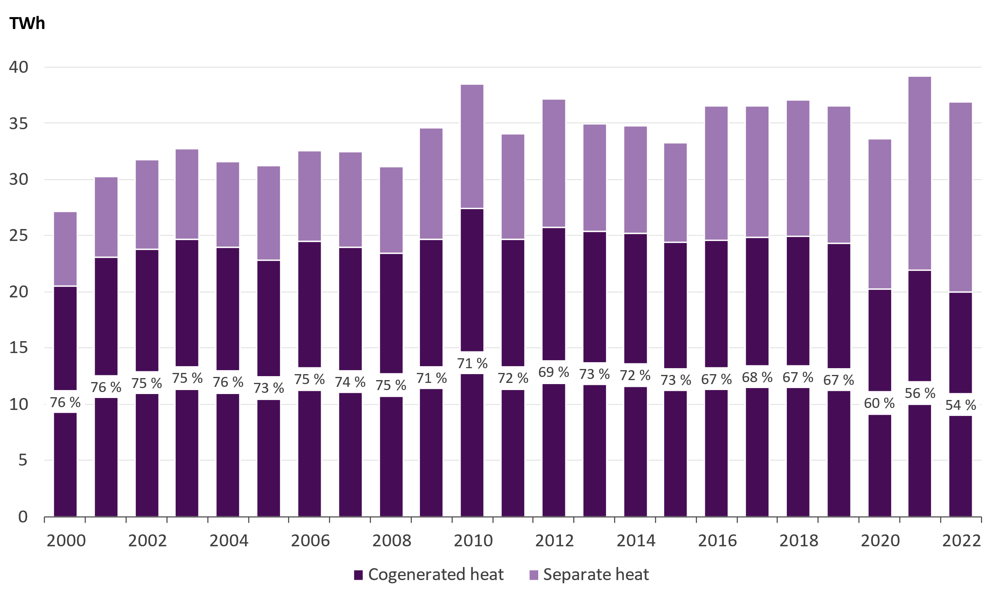
District heat supply and the share of cogeneration

Slide 11
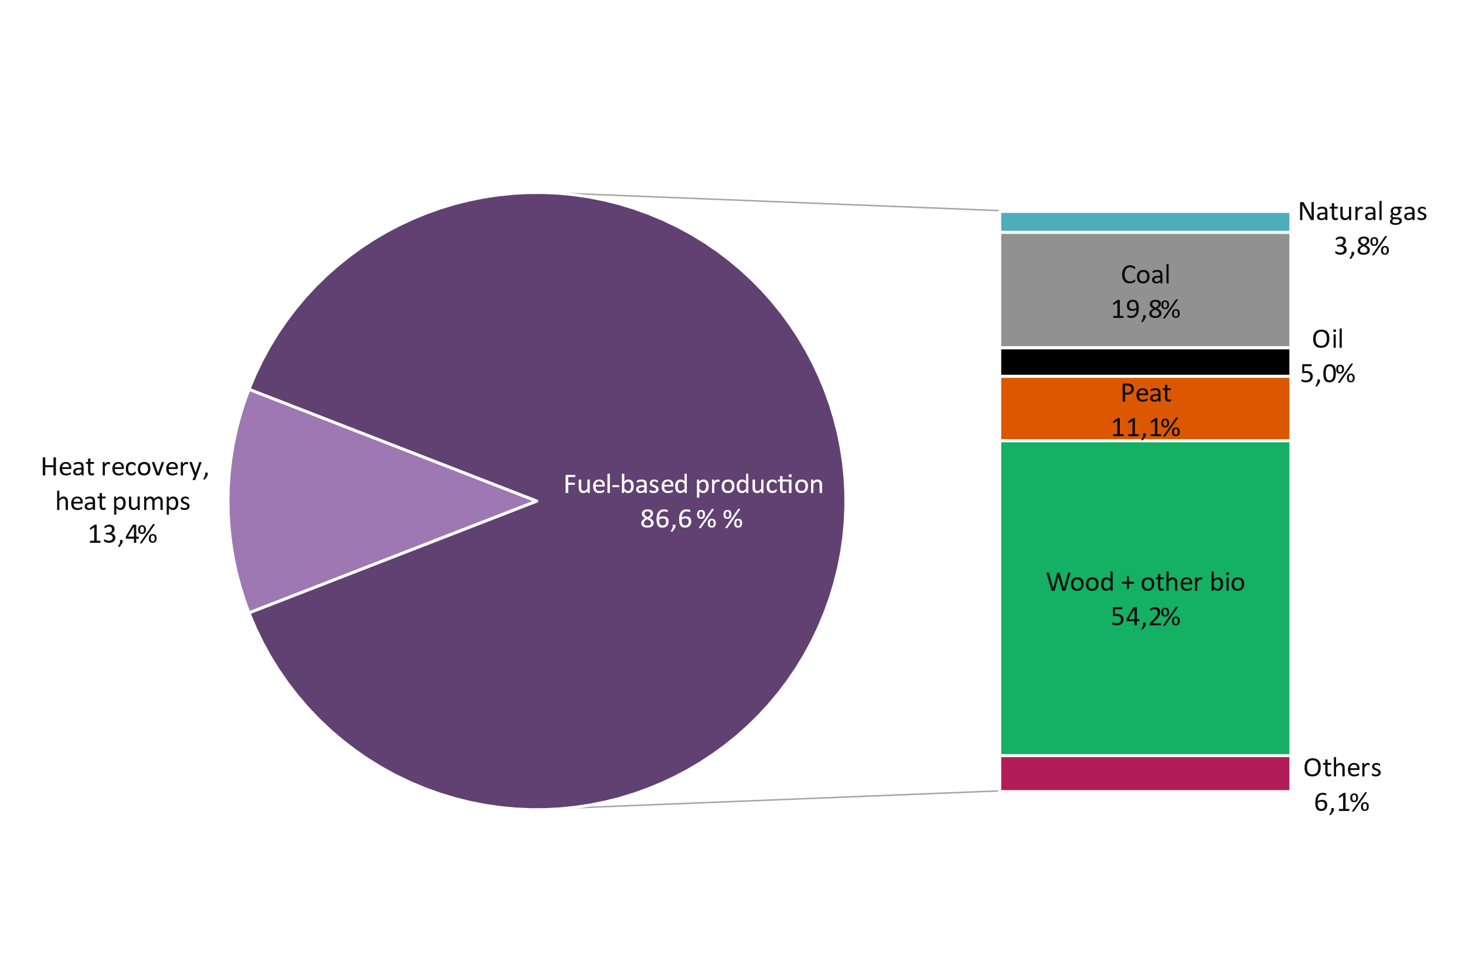
District heat supply as well as the fuels used for DH and cogeneration
Total district heat supply | 36,9 TWh
District heat production by fuels | 31,8 TWh
Net production of electricity in CHP production | 8,1 TWh
Fuel energy consumed | 48,6 TWh
Heat recovery and heat produced by heat pumps | 4,9 TWh

Slide 12
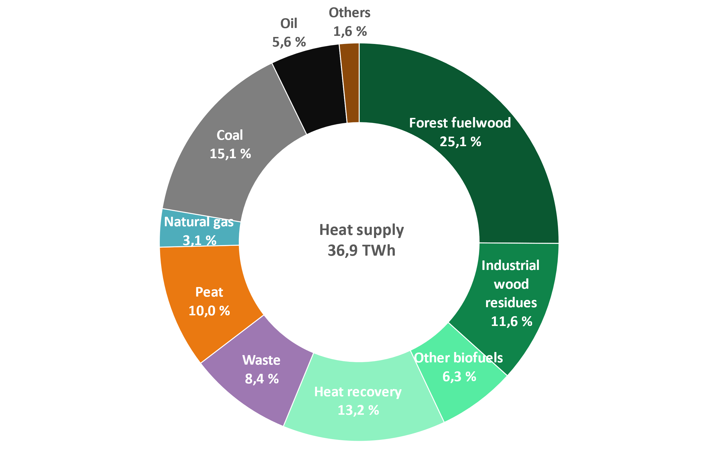
Energy sources for district heat supply in 2022 by fuel category
Waste category includes municipal waste, recovered fuels, demolition wood, impregnated wood, plastic waste and hazardous waste.
Bio share of waste is 54 % and fossil share 46 %.
Other biofuels: other biofuels and mixed fuels
Others: electricity, steam, hydrogen

Slide 13
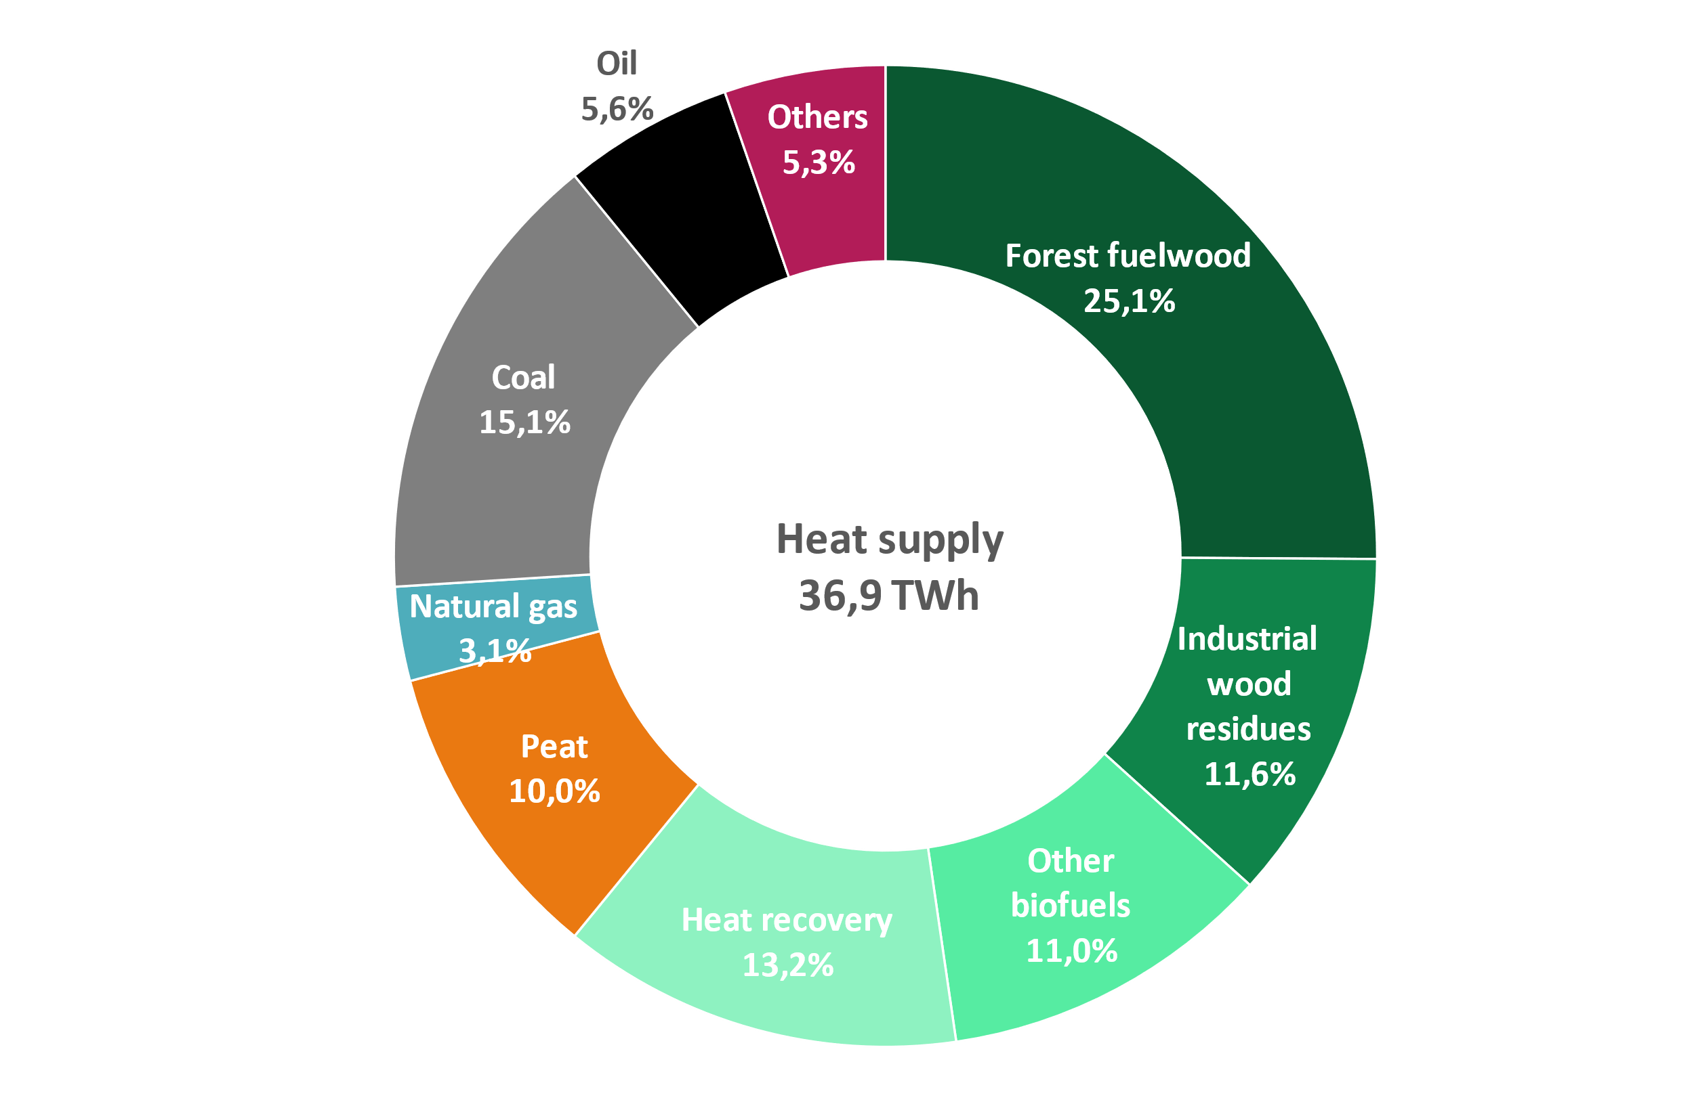
Energy sources for district heat supply in 2022
Carbon neutral: 61 %
Renewables + Heat recovery
Domestic*: 76 %
Carbon neutral + Peat + share from ”Others”
Share of imported fossil fuels in district heat supply 24 %
Heat recovery: Heat energy which would be wasted otherwise, e.g. from the sewage, flue gases or from the district cooling return water
Other biofuels: Biodegradable share of the municipal and industrial waste and other bio-based fuels
Others: Non-biodegradable share of municipal and mixed waste, plastic and hazardous waste, electricity, steam, hydrogen
* = All biomass is considered domestic. From ”Others” all waste, steam, hydrogen and 85 % of electricity are considered domestic.

Slide 14
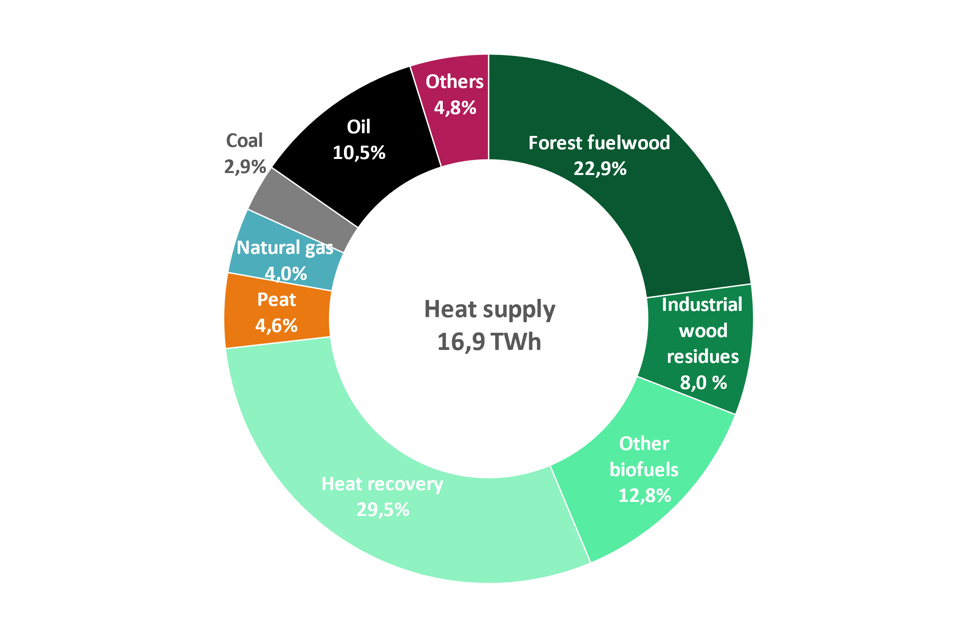
Energy sources for separate DH production in 2022
Carbon neutral: 73 %
Renewables + Heat recovery
Domestic*: 82 %
Carbon neutral + Peat + share from ”Others”
Share of imported fossil fuels in separate district heat production 18 %
Heat recovery: Heat energy which would be wasted otherwise, e.g. from the sewage, flue gases or from the district cooling return water
Other biofuels: Biodegradable share of the municipal and industrial waste and other bio-based fuels
Others: Non-biodegradable share of municipal and mixed waste, plastic and hazardous waste, electricity, steam, hydrogen
* = All biomass is considered domestic. From ”Others” all waste, steam, hydrogen and 85 % of electricity are considered domestic.

Slide 15
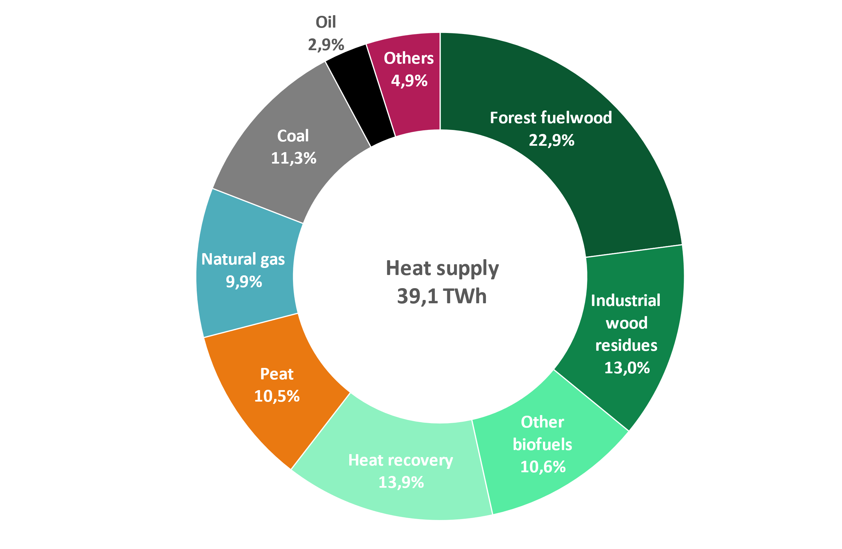
Energy sources for district heat supply in 2022 and 2021
2022
2021
Recovered (recycled) heat: energy that would otherwise go to waste
Other biofuels: includes also the bio share of municipal waste
Other: non-bio share of municipal waste, plastic or hazardous waste, electricity, steam, hydrogen

Slide 16
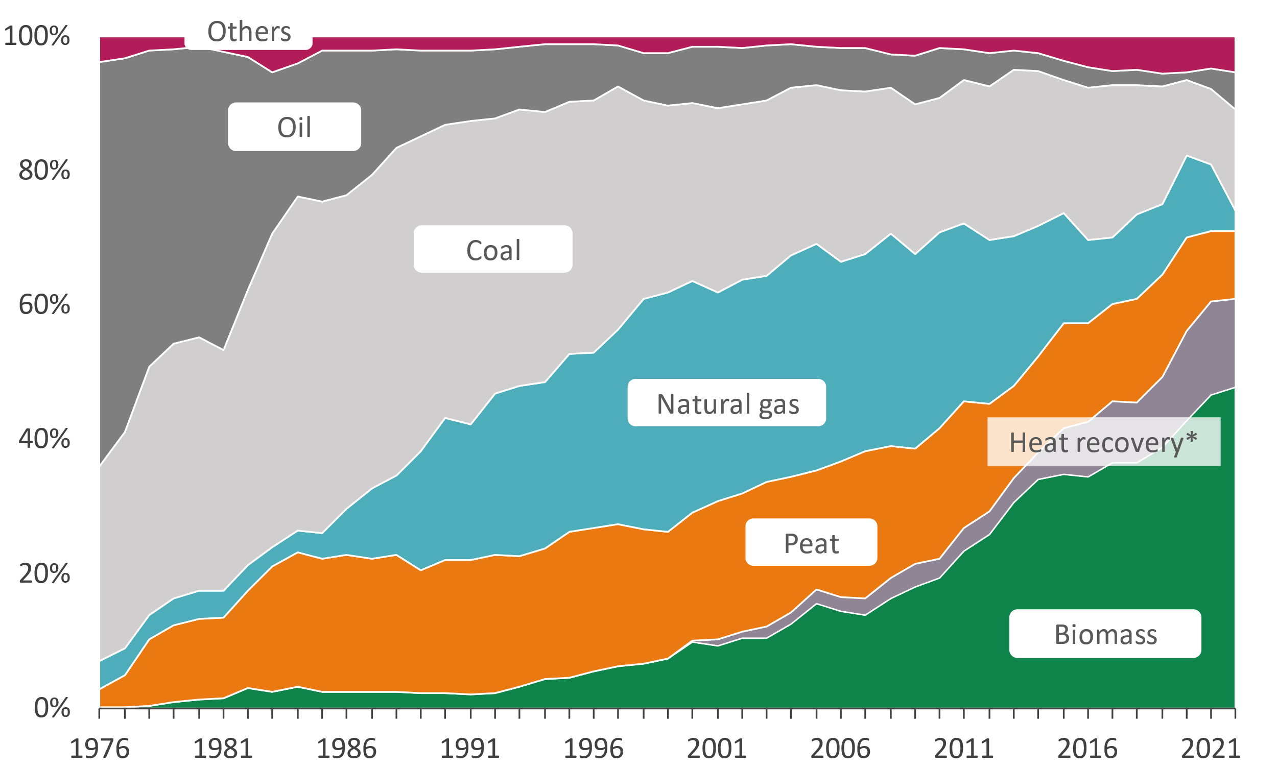
Energy sources for district heat supply
*includes heat pumps and heat recovery

Slide 17
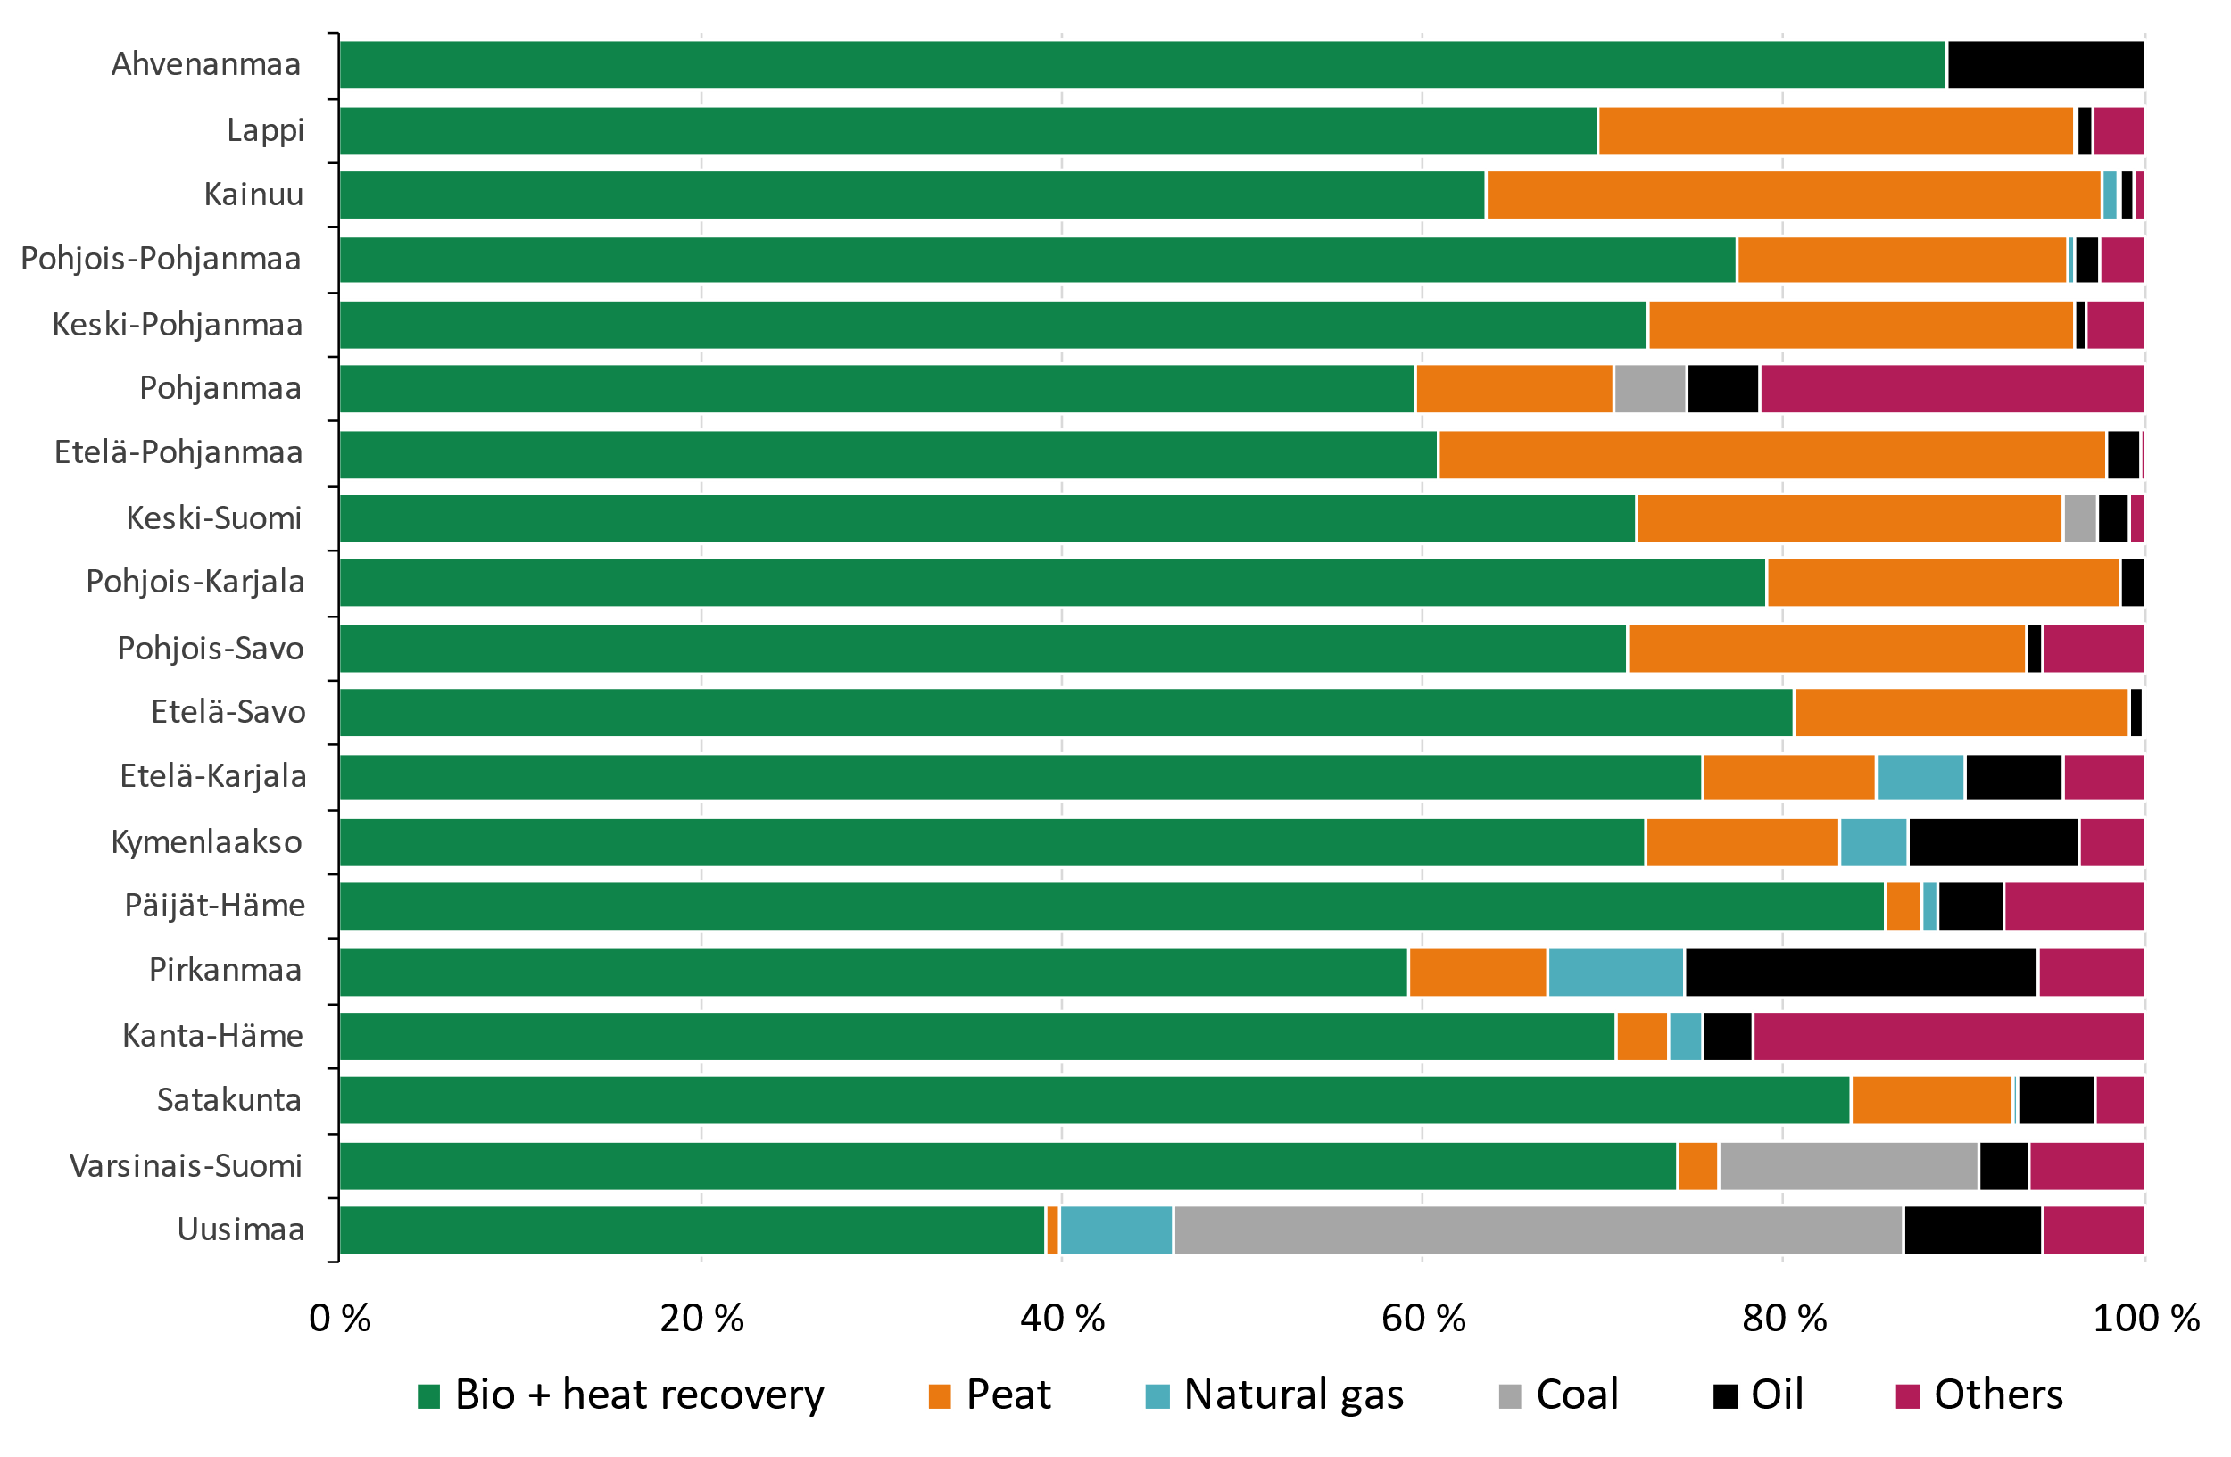
Energy sources for district heat and cogeneration by region in 2022

Slide 18
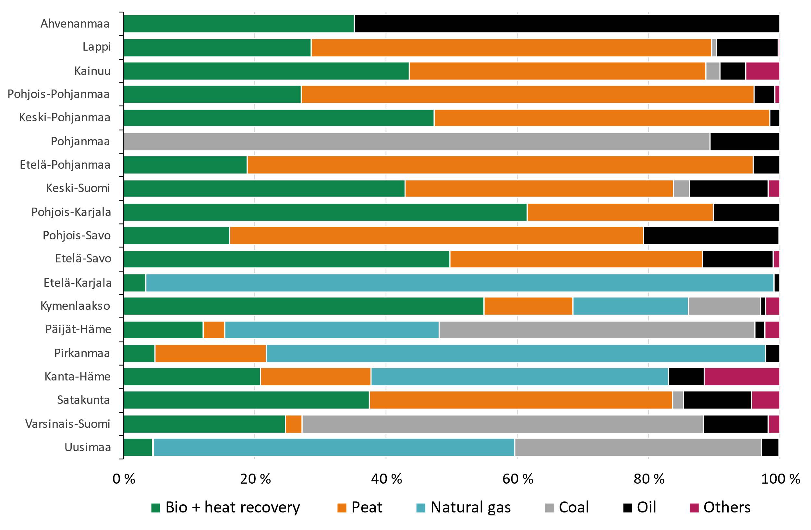
Energy sources for DH and cogeneration by region in 2005 and in 2022
Year 2005
Year 2022

Slide 19
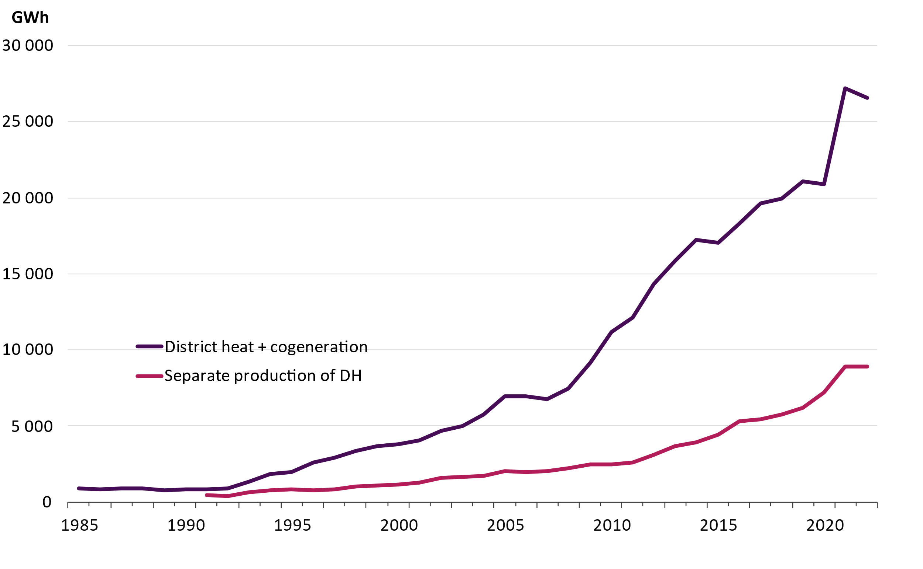
Renewable fuels in the production of district heat and cogeneration

Slide 20
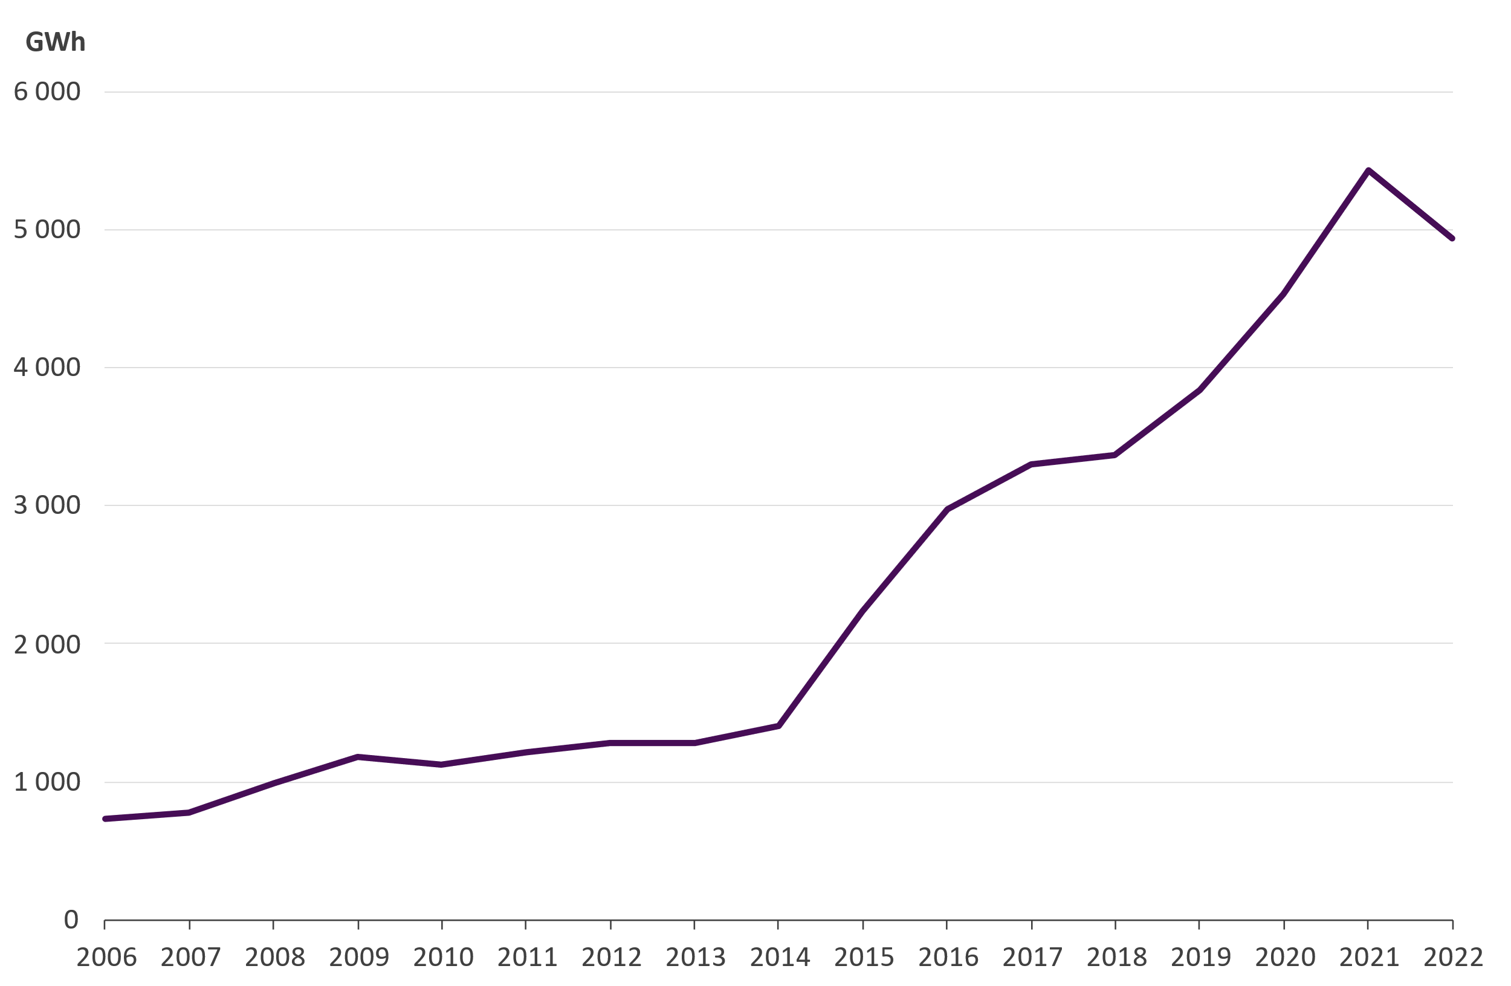
Heat recovery
4 935 GWh of district heat was produced by heat recovery
Heat recovery by heat exchangers 3 485 GWh
The most significant heat sources: flue gases, industrial processes and geothermal energy
Heat produced by the heat pumps 1 440 GWh
The most significant heat sources: sewage, district cooling return water and data centers

Slide 21
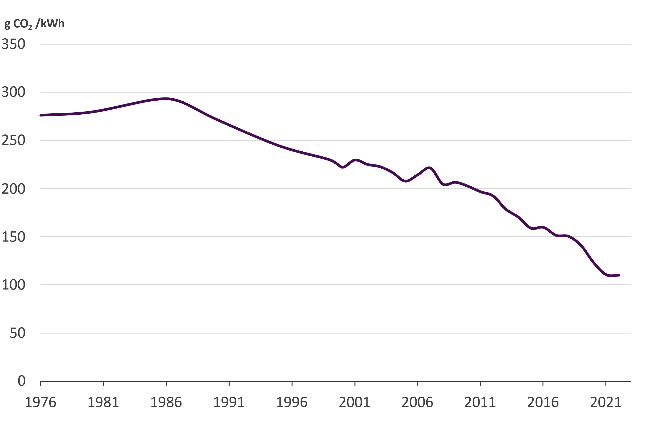
CO₂ -emissions from the district heat supply
Specific emissions from district heat production in 2022 were 109,9 gCO₂/kWh, which
Decreased by 0,4 % from the previous year
Decreased by 43 % since 2010
Fuels used in combined heat and power production were allocated according to the benefit allocation method
Sources:
Statistics Finland (2000…2021)
Finnish Energy (1976…1999, 2022)

Slide 22
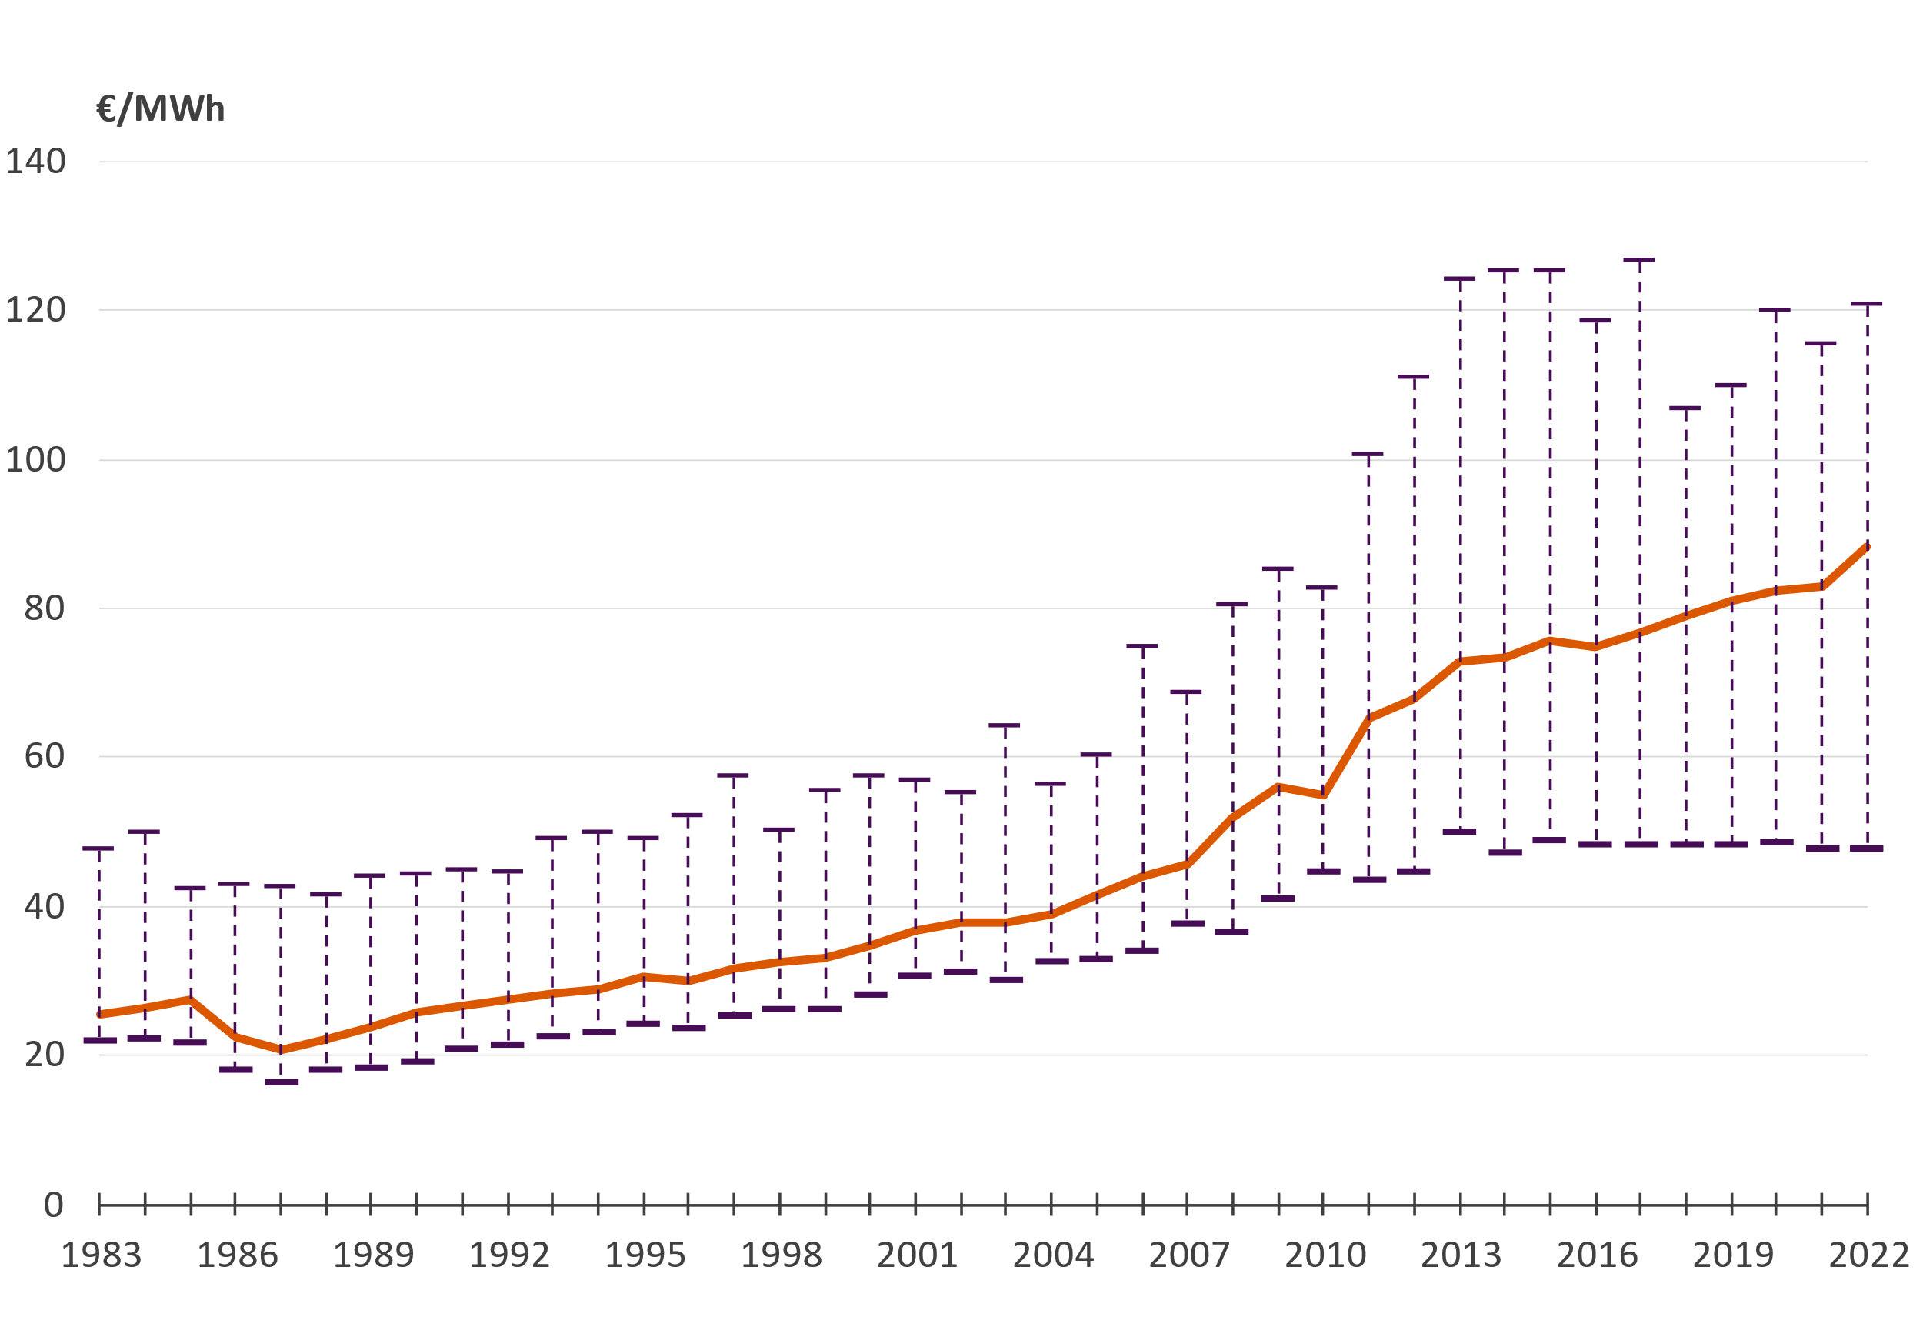
Price of district heat (incl. VAT) Average, minimum and maximum values
The price includes all taxes, demand and energy charges as well as other possible annual charges. Connection fees are excluded.

Slide 23
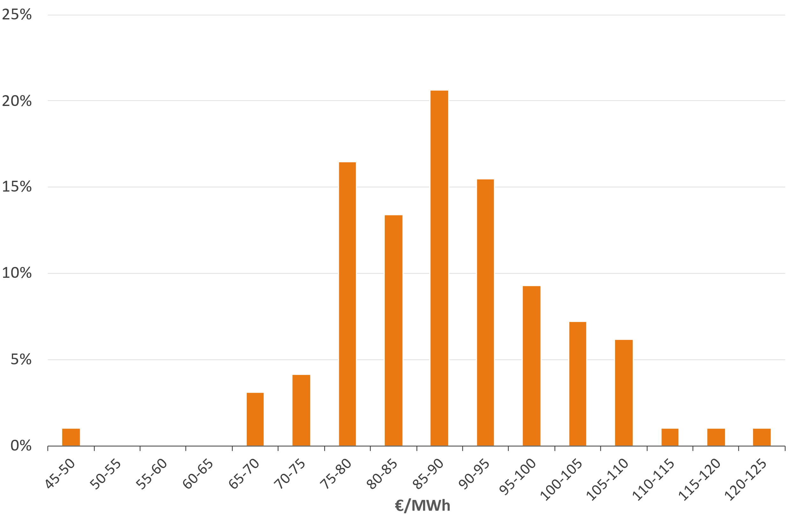
The share of district heating companies according to the average heat sales price in 2022 (incl. VAT)
The price includes all taxes, demand and energy charges as well as other possible annual charges. Connection fees are excluded.
Weighted average price: 91,32 €/MWh
Arithmetical average price: 88,22 €/MWh

Slide 24
Price of district heat in new buildings (€/MWh) Fixed price + energy fee, incl. taxes
The price includes all taxes, demand and energy charges as well as other possible annual charges. Connection fees are excluded.

Slide 25
Real price of district heat Corrected with cost-of-living index
Source: Finnish Energy, District heating prices 07/2022

Slide 26
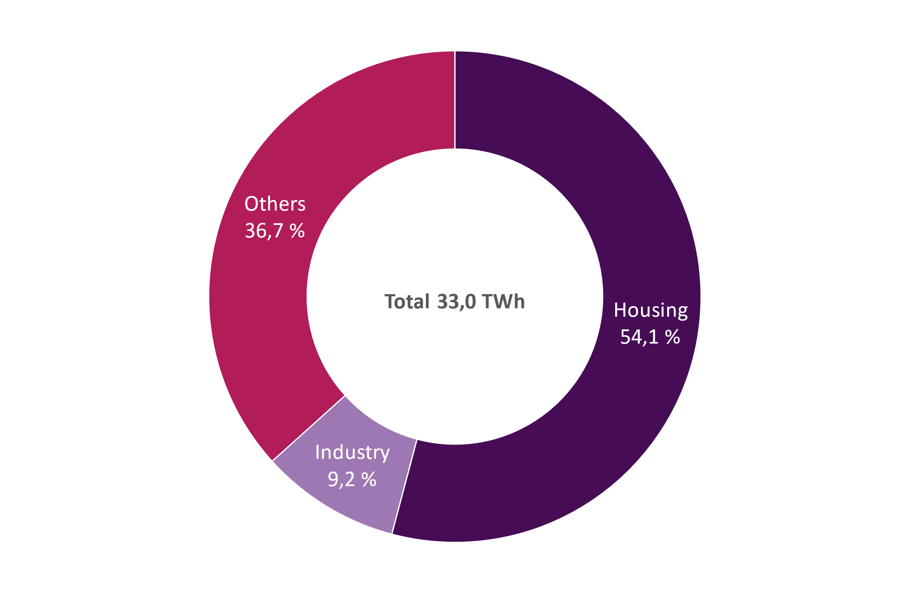
District heat consumption in 2022

Slide 27
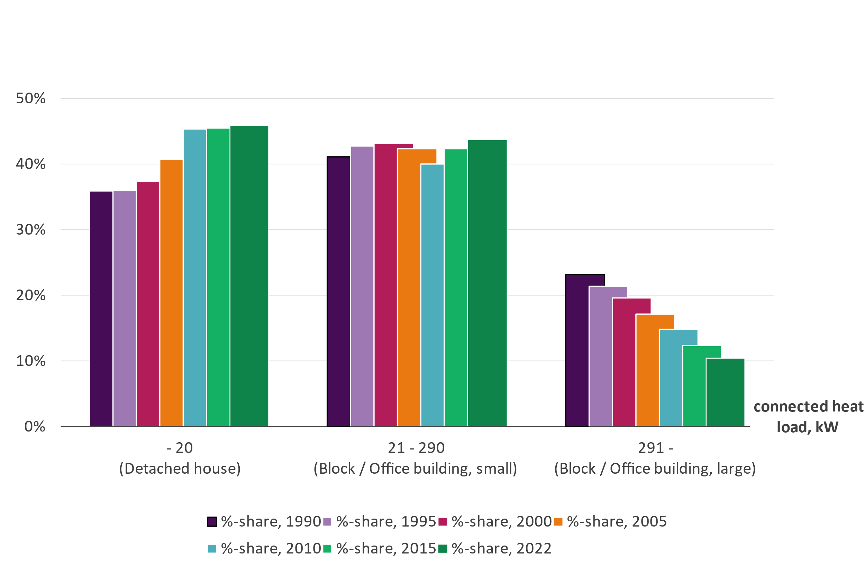
Distribution of customers according to connected heat load
Number of customers: 160 000
120 000 customers in residential buildings
2,9 million inhabitants

Slide 28
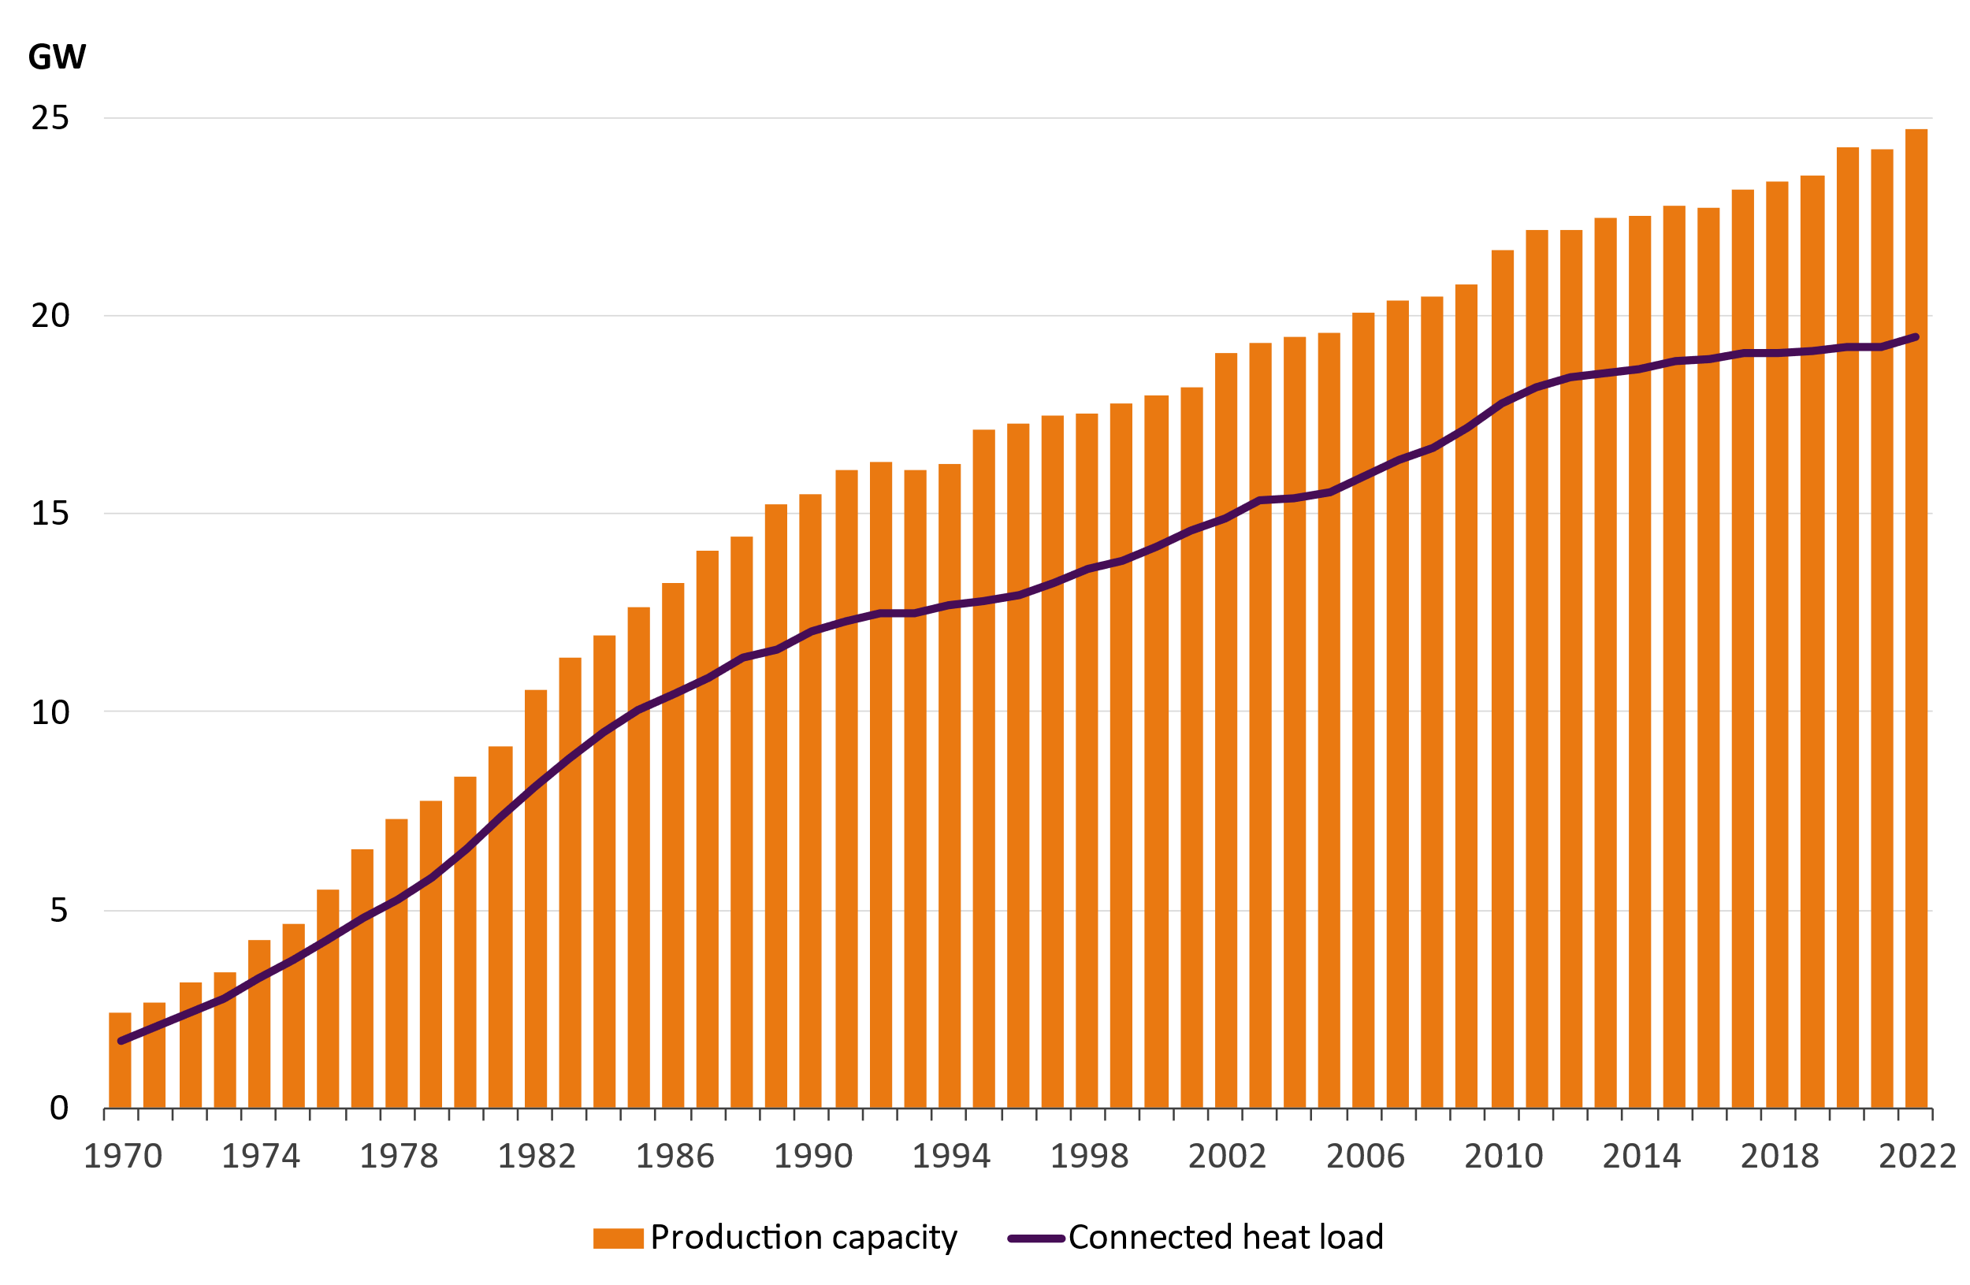
Production capacity and connected heat load of the customers

Slide 29
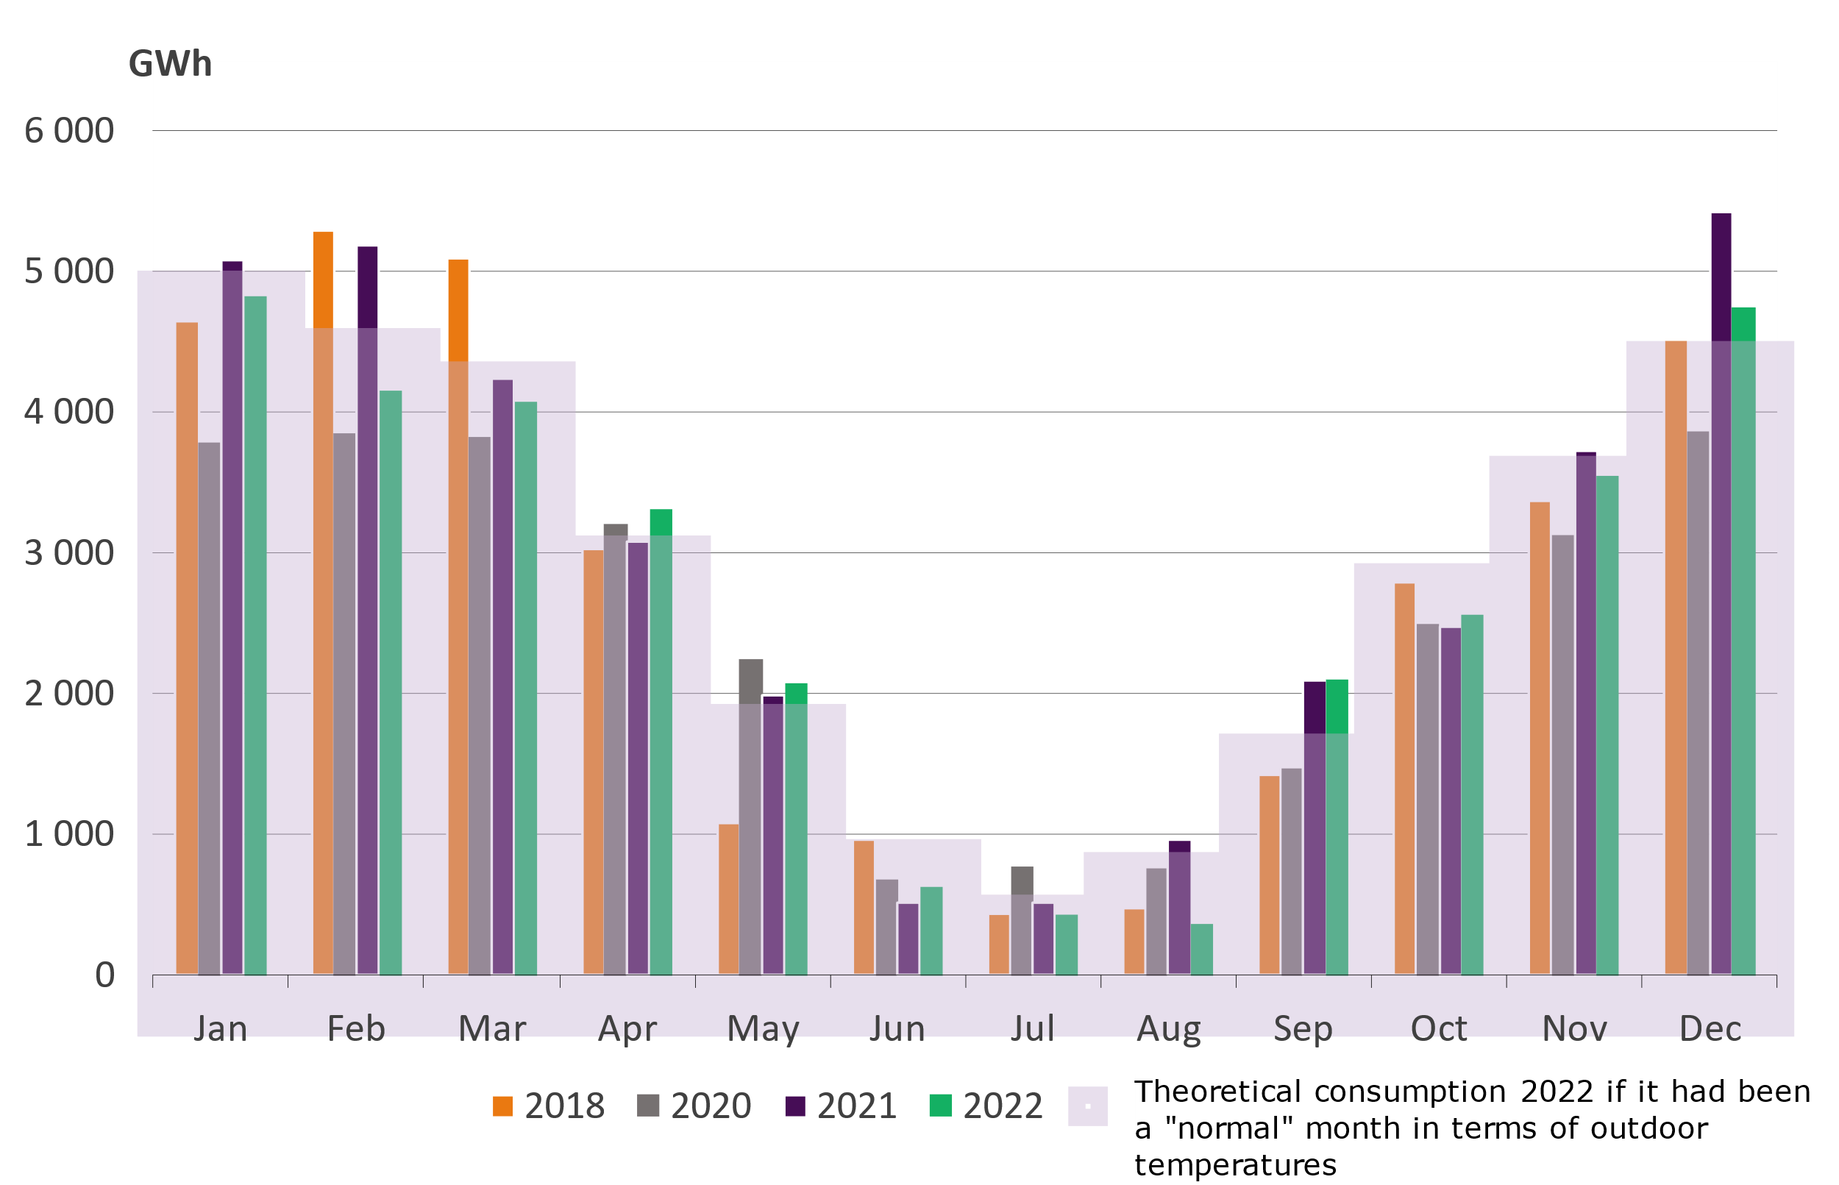
Estimated monthly district heat demand
Year 2022 was 0,4 ºC warmer than the normal period of 1991-2020
Only December was colder than normal months during the heating season.
December was 1,2 ºC colder than normal
The cold winter months exemplify the need for a wide palette of fuels to ensure the security of supply of heating.

