Slide 1


Low-carbon roadmap
for the energy sector

Slide 2

ROADMAP
New energy system
Sector integration of energy
Cooperation with the customer
Enabling energy networks
Developing expertise
TOWARDS CARBON-NEUTRAL ENERGY
Cleaner energy
Emission-free electricity
Integrating district heat
Facilitating circular economy
Domestic bioeconomy
Cleaner gas
Energy as a solution
Electrifying industry
Cleaner traffic
Sustainable heating solutions
Notes:
”Hiilineutraali energia”
Energia ratkaisijaksi
”Visiointia”
Uusi energiajärjestelmä
Energian sektori-integraatio
Energia-asiakas kuskin paikalle
Muutoksen mahdollistavat energiaverkot
Tulevaisuuden energiaosaaminen
”Jalanjälki”
Puhdas tuotanto
Energia biotaloudessa
Energia kiertotaloudessa
Foss. kaasusta uusiutuviin ja synteettisiin
Puhdistuva sähköntuotanto
Polttoon perustumaton kaukolämpö
”Kädenjälki”
Puhtaan energian mahd.
Teollisuuden sähköistyminen
Liikenteen käyttövoimien puhd.
Puhdas lämmitys

Slide 3
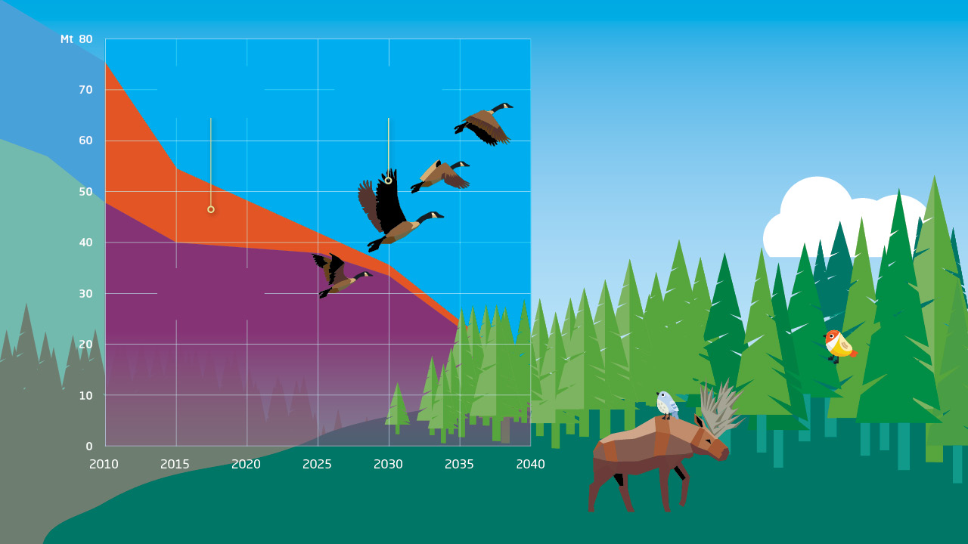
Emissions from electricity and district heat are falling rapidly
District heat and related electricity production
Price of emission allowances
The energy sector supports the government’s target to achieve carbon neutrality already in the 2030s.
In 2019, we committed ourselves to halving the emissions of district heat and the related electricity generation by 2030.
The trajectory indicates that this target will be reached
earlier and emissions will fall more
sharply than predicted..
Emissions from other sectors

Slide 4

Energy as a solution
Zero-emission electricity serves our society either directly, as liquids or as gas.
Ending the use of fossil fuels in transport, services, work machinery, industry, heating, and agriculture.
The developing energy networks safeguard the security of supply and a diverse, emission-free production mix.
LOW-CARBON ROADMAP FOR THE ENERGY SECTOR

Slide 5

Finland’s road to a low-carbon future is based on clean energy, secure networks and a functioning energy market. Electricity, heat and gas networks and a flexible market are the basis for the functioning of a new, clean energy system.
Circular economy is based on cross-sector cooperation, from which all benefit. Sidestreams of agriculture and forestry, as well as waste and excess heat are turned into energy. At the same time, circular economy is enabled by clean energy.
Energy transition is already underway and investments in the field are directed at clean production. The energy sector is implementing the change together with other industries and customers. The actions of energy companies reduce carbon emissions of industry, transport, the heating of buildings, services, and agriculture.
The competitiveness of Finnish production is based on secure and cost-effective energy. Responsibility in the energy sector means that we take care of society’s operational capacity on the way to carbon neutrality.
The energy sector is committed to halving the emissions of energy production by year 2030, with the reference year being 2018.

Slide 6

Cleaner energy
Emissions from energy production are falling year by year
Emissions from electricity and district heat have halved during the past decade and, as a result of the current emissions guidance, the emission levels continue to fall. Fossil fuels and peat will be used as reserve fuels for secure delivery and supply of energy.
The strengths of the diversified energy system in Finland include its variety, which guarantees energy security and the availability of low-cost energy in times of uncertainty.
The costs of clean electricity production have fallen, and electricity is a favourably priced way of reducing emissions in different industries.
District heat production based on the sidestreams of bioeconomy and circular economy is strengthened, and non-combustible technologies will be introduced alongside it.

Slide 7
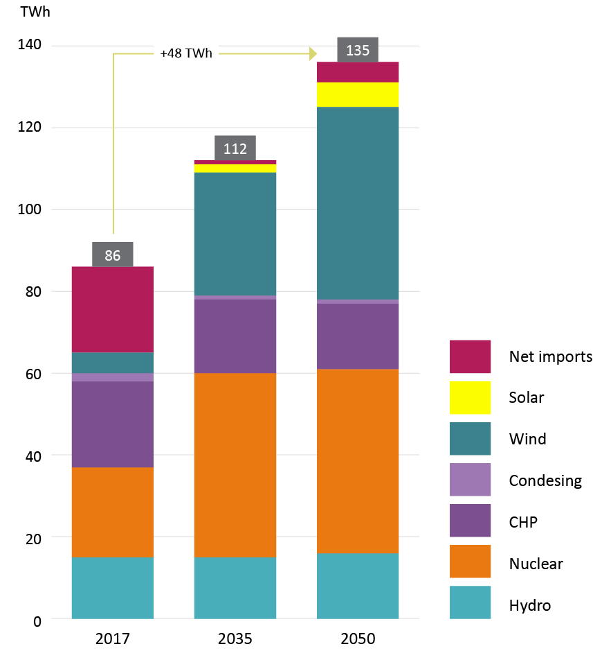
Emission- free electricity
Scenario of strong electrification
The expansion and strengthening of emissions trading is the most important instrument for beyond 2030.
No need for instruments that overlap with emissions trading, for example, those based on national taxation.
Functioning of the electricity market must be promoted with pan-European legislation.
Public funding must be aimed at energy demonstration and pilot projects, energy production does not need funding.
The energy sector is meeting the growing demand for electricity on market terms. Steering of emissions trading safeguards investments in cleaner electricity generation.
Source: AFRY, Finnish Energy Low Carbon Roadmap 2020.

Slide 8

Investment must be speeded up by imposing a fixed period for licensing and by developing an extensive inter-administrative e-business system.
Development of on-shore and off-shore wind power throughout the country must be accelerated by simplifying the planning procedures and resolving the restrictions imposed by the radar system.
Development of licensing and procurement practices in cooperation between businesses and the authorities strengthens the operating environment of nuclear power.
Nuclear power must be included in the EU’s sustainable finance scheme.
Hydropower is a regulator of variable production, and it must be safeguarded. The Water Act must be maintained as an act for the use of waters, and hydropower must be taken into account in the hydropower directive as a key form of use.
Migratory fish projects must be supported also in the future.
Preconditions for using wood fuels based on sidestreams of forestry and industry must be safeguarded in plants producing electricity and heat.

Slide 9
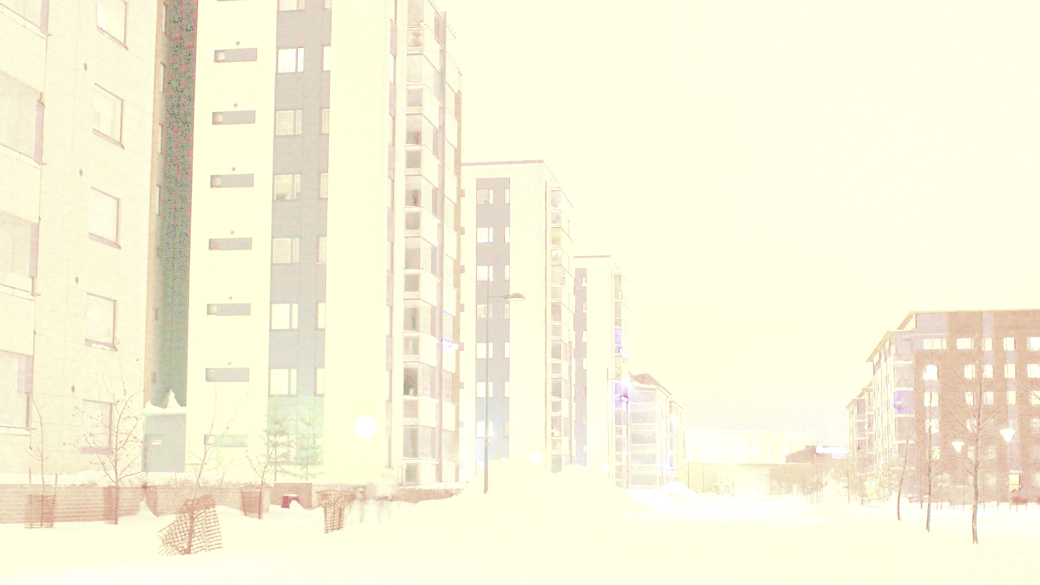
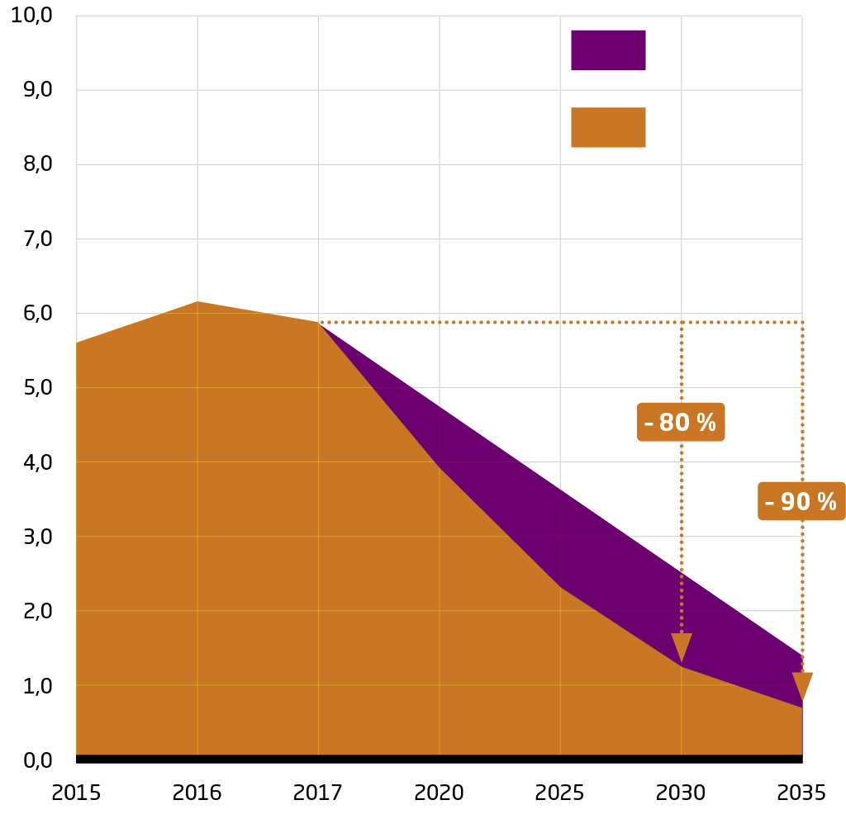
Updated CO₂ emission trajectory of district heat
District heat emissions are decreasing significantly faster than predicted
Roadmap 2020
Revised estimate 2021
District heat emissions have halved in ten years, and they are continuing to fall to a third of the current levels over the next 10 years.
Companies in the industry have a strong shared vision of the necessity of zero emissions, and in many places district heat is already emission-free.
Energy companies strongly believe that the district heating system offers the most efficient and flexible way of meeting society’s many expectations.

Slide 10
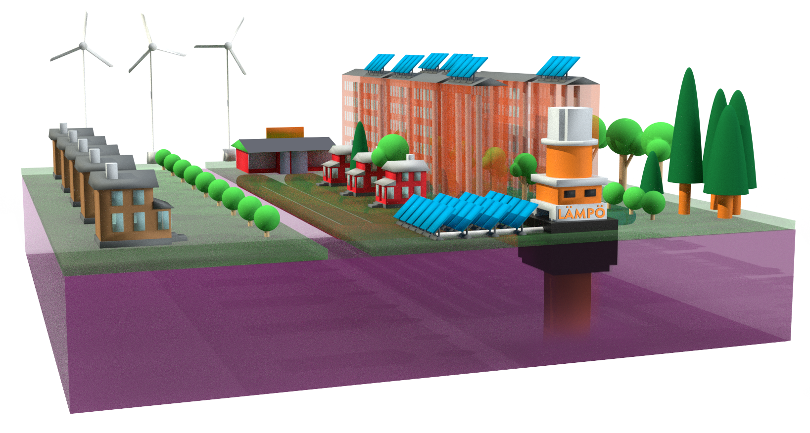
In recent years, district heat companies have upgraded their production and distribution systems to be more efficient with lower emissions. This change continues, and fuels with higher emissions are being replaced with renewable and other than combustion-based production while ensuring energy security.
Piloting of new technologies is carried out throughout the district heating system from production, distribution and storage all the way to customer solutions.
District heating networks are developed towards lower temperatures, which promotes the introduction of new, clean technologies and seasonal storage of heat.
An abundance of heat is produced as a by-product of hydrogen production, and it can be utilised in a productive way. District heat can provide a significant national competitive edge for the hydrogen economy.
Companies are investigating the possibilities of the district heating system to act as a platform economy for new services.
The sector is investigating the possibilities of using carbon capture and offsets in order to reduce remaining emissions.
Cleaner district heat

Slide 11

Climate and energy policies must safeguard the operating preconditions of a district heating system that has a capacity for rapid change by revising ARA subsidies to not discriminate against district heat.
The policy must promote a diverse production structure in order to safeguard energy security: In order to promote alternative solutions to combustion, electricity tax related to industrial heat production and distribution must be reduced to a minimum level while offering a view to a development of energy taxation until 2035.
The preconditions for using sustainable wood fuels based on the by-products of agriculture and industry must be safeguarded. Rapid withdrawal from peat poses a challenge to the security of heat supply, the safeguarding of which requires activation of forestry and the possibility of using imported wood.
The use of gases linked to the hydrogen economy in energy production must be improved.
Commercialisation of new technologies and storage must be supported and similar projects must be coordinated on a national basis. Nordic cooperation must be developed in the EU’s RDI projects.
Licensing of small modular reactors must be accelerated and streamlined in connection with the update of the Nuclear Energy Act, and international cooperation must be stepped up to enable serial production of plants.

Slide 12

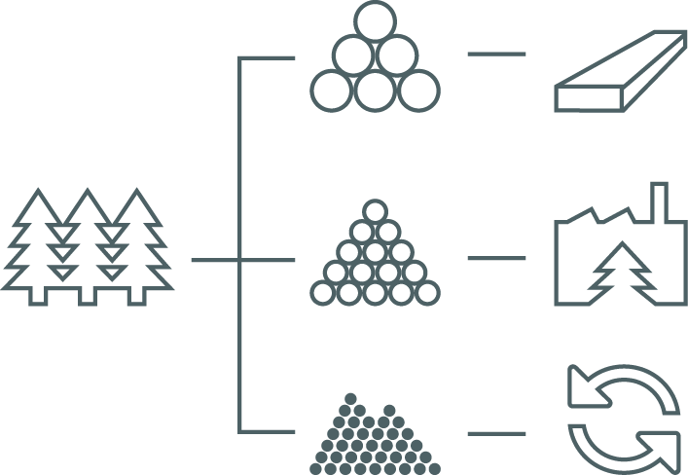
Domestic bioeconomy
Energy peat will be phased out in the 2030s as a result of emissions trading. During the transition period, peat will be needed to safeguard the security of heat supply and to curb the pressure on the demand for wood fuels.
The growing pressure on the demand for wood fuels must be relieved by promoting the development of district heat production methods as an alternative to combustion.
Recommendations for action in forestry must be developed in order to take account of biodiversity even better than at present. The energy sector will boost the implementation of the recommendations for action by updating its procurement recommendation.
Availability of small-dimensioned wood needed in energy production is ensured with good forest practices.
Companies develop the stocking capabilities and the security of supply of wood fuels while dispensing with peat and fossil fuels.
Resources for the management of young forests must be increased in order to encourage trees to become sturdier and the forests to grow, as well as to promote the availability of wood fuel.
Continuity of the energy use of wood fuels based on the sidestreams of forestry and industry must be safeguarded.

Slide 13
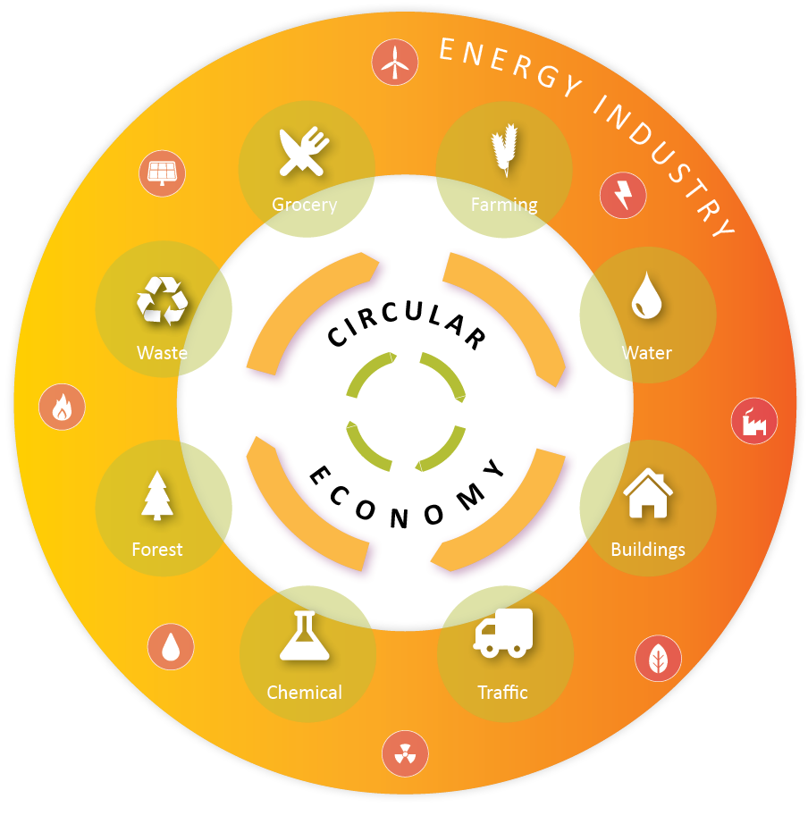
Circular economy will become a reality with the aid of clean energy
Circular economy is broad in scope, and it requires expertise that crosses conventional sector lines. The management of large entities requires cooperation, availability of information, and functioning networks.
Incentives for circular economy must be allocated to cross-sector innovations and to the utilisation of excess heat by providing development aid and by reducing the electricity tax on recycling plants.
The social vision of circular economy, the role of the energy sector and regulation must be clarified.
The efficiency of source separation and recycling of waste must be improved in order to reduce emissions.
Better use must be made of recycled materials.
Carbon capture and utilisation must be developed.
A Green Deal on waste incineraton must be drawn up to build joint projects of a waste management chain to improve the efficiency of recycling, e.g. in small and medium-sized companies.
Municipal-level emissions calculation must be developed so that emissions from waste processing are included in the climate calculation for the source of waste. This will encourage recycling of waste and utilising it for energy in the form of electricity, heat and biogas.
The energy sector plays a key role in the building of society with circular economy.

Slide 14
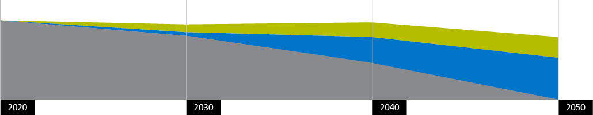
Cleaner gas
Development, production and introduction of clean gas must be ensured by strengthening emissions trading.
Promotion of biogas requires a national biogas programme.
Non-taxation of biogas must be maintained and notified in the EU.
Taxation of gas must be kept at a competitive level in order to maintain a functioning and extensive gas network which is important to a clean energy system.
To promote clean gases, such as synthetic gases and hydrogen, we need a national strategy that develops Finland’s technological competitiveness and supports the development of the new energy system.
Hydrogen solutions must be promoted by reducing electricity tax in industry and by creating an outlook of long-term energy taxation.
The cleaning of gas will be advancing strongly in Europe in the 2030s. Gas networks are developed with gradual introduction of biogas and hydrogen in them. Gas plays a significant role in enabling an entire low-carbon energy system as part of the sector integration.
Biogas
Hydrogen
Natural gas
Source: Guidehouse, Gas Decarbonisation Pathways 2020.

Slide 15

Energy as a solution
A carbon-neutral society is based on practical solutions implemented by energy companies

Slide 16
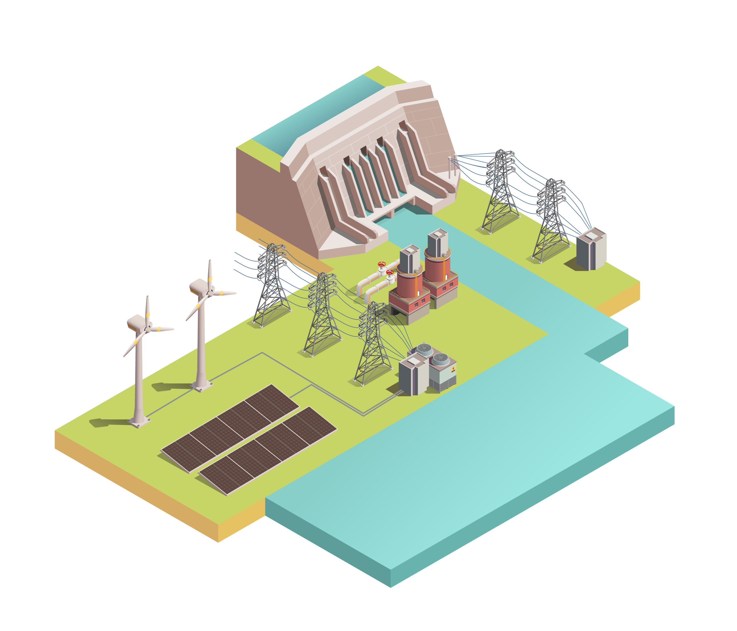
Climate needs effective measures
To be carbon-free, you need especially electricity, as well as heat, gases and liquids produced with electricity.
According to estimates, the electrification of industry and the rest of society requires an up to 50% increase in electricity consumption.
The building of a carbon-neutral society needs market-based electricity generation, energy efficiency, regulating power, strengthening of transmission links, and new technology.
District heat and cooling production is moving from fuels with emissions to those without emissions while utilising waste heat produced by industry and by commercial and service buildings.
Energy transition requires sizeable investments. Society must accelerate the change by removing barriers to the deployment of electrification and other clean energy technology and by supporting research and development of new energy technologies.

Slide 17
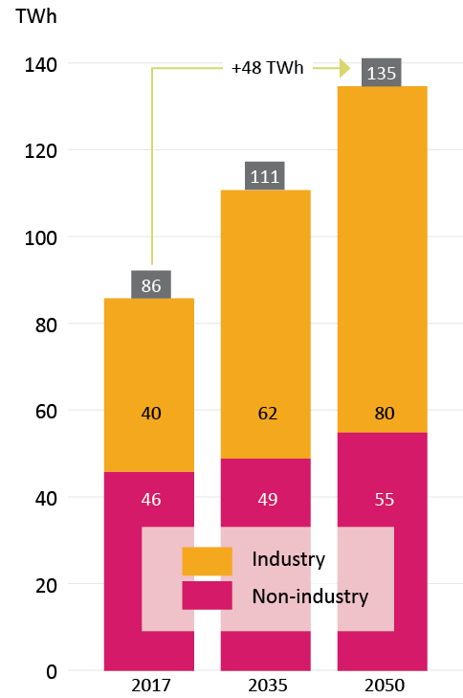
Electrifying industry
Scenario of strong electrification
The electrification of industry must be promoted:
  The outlook of climate policy must be strengthened for the time beyond 2030.
  Development work on new technologies needs support.
  Electrification must be made commercially viable.
  Nordic cooperation strengthens the electricity market:
  Intensifying the electricity transmission networks and Nordic cooperation will safeguard sufficient capacity and enable efficient functioning of the market.
  A low-carbon industry will trigger a signal for the demand for electricity, which will create a basis for new investment in electricity generation.
Source: AFRY Finnish Energy Low Carbon Roadmap, 2020.

Slide 18
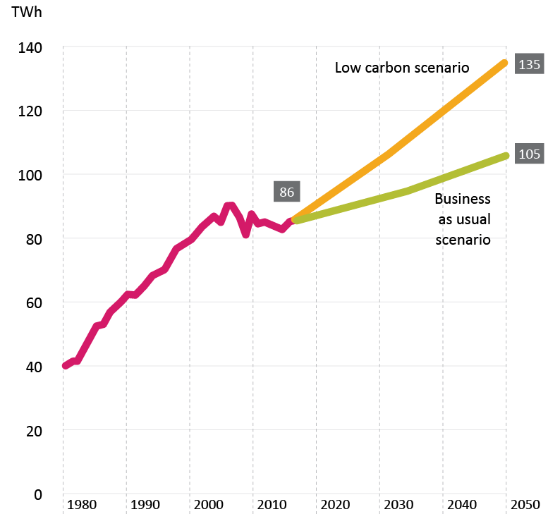

Electrification of industry will be implemented in phases in the next decades. With the current industrial production structure, the change may mean an up to 50 per cent increase in the need for electric energy.
Industrial emissions will be reduced, e.g. by replacing fossil fuels with clean energy sources in the industry’s own electricity and heat production and through electrification of processes.
Industrial investments must be accelerated by clarifying licensing processes and by developing an extensive inter-administrative e-business system.
A national strategy for clean gases must be created. Flexibility required by the electricity and heat system must be ensured with the integration of energy systems.
Source: AFRY Finnish Energy Low Carbon Roadmap, 2020.

Slide 19
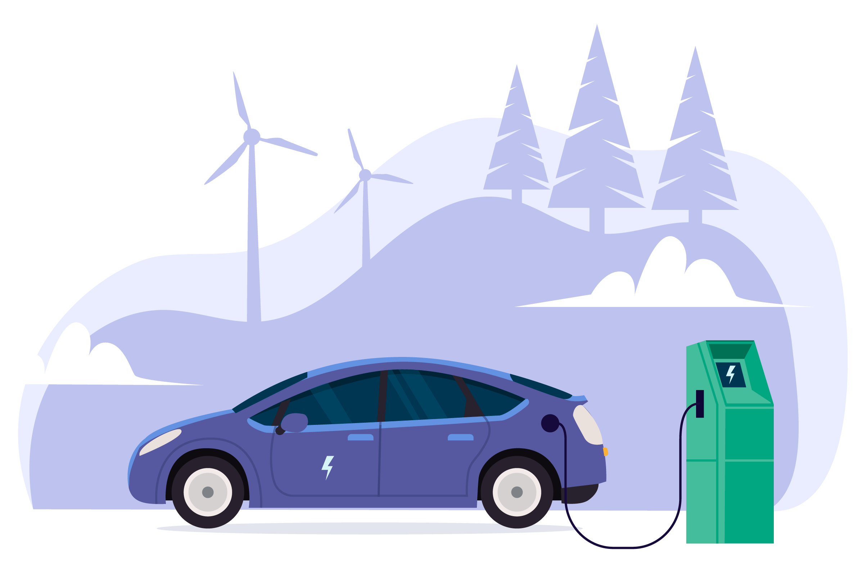
Cleaner traffic
Changing the taxable value of a company cars to be based on emissions will accelerate the cleaning of emissions from road traffic.
Extensive use of biogas from the field to the tank calls for a domestic biogas programme.
Vehicle and car tax for low-emission vehicles must be reduced by steepening the emission factor.
Roadmap work on energy taxation must include investigation of moving charging electricity to a lower tax class.
The national implementation of the EU directive on the energy performance of buildings must ensure that housing companies provide a charging service.
The current non-taxation of biogas must be maintained and notified in the EU.
The charging and gas filling network must be expanded to the entire country.
Promotion of new, low-emission technologies is essential in heavy transport, at sea and in the air.
Road traffic accounts for about 90% of transport-related emissions in Finland, and their reduction requires increased utilisation of all clean alternatives.

Slide 20

Sustainable heating solutions
District heating networks enable a diverse range of emission-free heat.
RDI funding must be increased for the development of services related to housing, buildings and towns.
The criteria for ARA energy grants must be amended immediately to support the development of a low-carbon society.
New obligations must enable improvement of energy efficiency in building renovations in a cost-effective way. Heating forms must be treated equally.
The needs for and the cost-effective alternatives concerning adapting buildings to low-temperature systems must be investigated.
The targets and guidelines for energy efficiency agreements must be harmonised so that they direct to a reduction in emissions.
A national strategy is needed for promoting clean gases.
Freedom of choice in the heating market must be maintained in the reform of the Land Use and Building Act.
Utilisation of excess heat must be improved in the reform of the Land Use and Building Act by means of zoning. Reduction of electricity tax accelerates industrial-scale deployment of all production technologies that provide an alternative to combustion.
Climate steering that overlaps with emissions trading in the regulation of building must be dismantled.
Origin regulation must be developed in a neutral way concerning the heating method.

Slide 21

New energy system

Slide 22
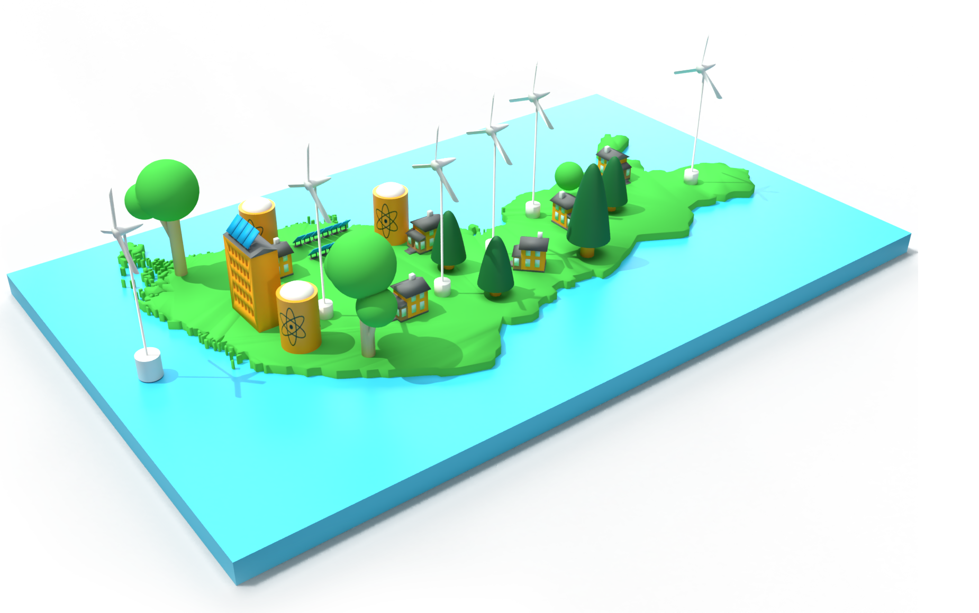
A vision of the energy sector
New energy system in customer-focused circular economy

Slide 23

New energy system
An emission-free, cost-effective and secure energy system is based on smart integration of different sectors and on innovative solutions.
Sector integration means the interconnection of industry, transport and heating via electricity, district heat and gas networks. At the same time, the customer’s role will change from a consumer of energy to a storer and possibly also a producer of energy.
Energy transition is under way, and it requires continuous investment. The challenge is to realise the transition in a profitable way. Society can accelerate the transition by investing in the necessary technology for research, development and piloting.
Cooperation with customers creates opportunities to develop new heating solutions and enrich the energy system to be inclusive and interactive.
Building of the new energy system requires diverse experts and new know-how in all parts of Finland.

Slide 24

Energy sector integration
SMART
A smart energy policy that builds the future creates preconditions for a system-level change. In terms of this change, the key factors are:
One solution is not suitable for all. Local conditions must be taken into account in decision-making.
Building of a smart energy system requires dismantling of administrative barriers. Taxation still does not recognise variations in energy sources.
Differences in the electricity, heat and gas markets must be identified.
Energy networks enable the transition to a smart energy system.
Our energy system becomes clean through existing steering methods. Energy companies are committed to meeting society’s need to move to carbon-neutrality.
Energy sector integration will resolve:
The energy and mobility needs of citizens and businesses in a cost-effective and clean way.
Efficient use, distribution and versatility of different energy forms. Electricity is an essential, but not the only, energy form in an energy system of the future.
Efficient development of energy networks.
PRICE
EFFICIENT
FLEXIBLE
CLEAN

Slide 25

Energy networks that make the change possible
The strong electrification of society and especially industry requires strengthening of the entire electricity system. Network companies contribute to enabling electricity-intensive investments.
The energy sector increases electricity production and network investments according to demand. Investments require a demand signal from industry as well as an open debate at a sufficiently early stage.
The transition of district heating networks to low-temperature ones must be studied in stakeholder cooperation by identifying the barriers to and benefits of the change in a separate programme and by providing finance to modelling studies and pilot projects.
A national strategy to promote clean gases must be drawn up in order to strengthen gas networks as part of the future energy market and the integration of different sectors.
Administrative costs and especially bureaucracy slow down the development of functioning energy networks.
Availability of electricity with secure supply must be safeguarded through the electricity market act and regulation.
Increased electricity consumption requires investment in maintaining the balance of the electricity system. This means the development of flexibility and storage.

Slide 26

Cooperation with customers becomes stronger and more diversified
Markets make the best options available to customers.
The long-term perspective of regulation must be ensured to safeguard cost-effectiveness when companies invest in the development of products and services.
Society’s investment must be directed to product development and piloting and to advising customers on new opportunities.
E-business must be promoted through deregulation of the energy sector where regulation is more restrictive than in other industries.
Smart energy networks provide a platform for new services and solutions.
The development work on a smart energy system is already in full swing. The great reform in the energy sector is guided by customers’ wishes, needs and safety. The energy services make it possible for customers to make value judgements and to choose their preferred ways of participation and means of having an impact on their expenses. Through their own energy use, storage and production, customers can take part in the balancing of the the entire system and earn by providing these services – usually in a fully automated way.

Slide 27

Energy expertise of the future
All the best contributors in the sector are needed at the centre of the energy transition and in the mitigation of climate change. Addressing the climate challenge provides new opportunities in the labour market. The energy sector needs both experienced and new contributors to develop and create new solutions.
Achieving the energy transition and decarbonisation also means financial investment in excellence. In this, the role of natural and mathematical sciences is key: we must start already in the primary school in order to create a basis for future excellence, which will be indispensable to Finnish companies.
The sector offers meaninful jobs for mechanics, customer service advisors, product developers, experts in digitalisation, and nuclear physicists. The need for an interdisciplinary approach and diverse knowhow is growing.
New expertise that is needed in the energy transition:
commercial and technical understanding
digitalisation
data analytics
ability to learn and interaction skills
customer focus
project management

Slide 28

Carbon-neutral society is created in cooperation with the energy sector and the decision-makers.
A proactive energy and climate policy enables transition to a carbon-neutral society. Markets direct the companies towards clean solutions and give the power of decision to the customers.
The actions of energy companies help industry, transport, services and heating to reduce emissions.
The development of energy networks is the basis for the energy transition.
Extensive energy expertise guarantees Finland’s status as a frontrunner.
EU must set clear emissions reduction targets for 2040 and 2050.
Development and expansion of emissions trading is the most important climate policy instrument.
A roadmap for energy taxation shall be drawn up to remove energy taxes and tax structures that impede the reduction of emissions.
Society’s contributions must be focused on research and product development.

